Slide 1
Role
play

Slide 3
salesperson

Slide 4
Salesperson
Bad vs Good

Slide 5
Salesperson
A bad salesperson wants to sell you something.

Slide 6
Salesperson
A good salesperson wants to solve a problem.

Slide 7
customer

Slide 8
Customer
A customer has a problem they want to fix.

Slide 9
Customer
What do customers (you) care about?

Slide 10
Customer
Different types of customers

Slide 11
Customer
A penny pincher
doesn’t want to spend money.

Slide 12
Customer
A bargain hunter always wants a discount.

Slide 13
Customer
An impulse buyer will buy something unplanned.

Slide 14
Customer
Going with your gut means with your feeling.

Slide 15
Customer
A loyal customer will continue to buy from one vender.

Slide 16
Customer
A need-based customer gets what they need and leaves.

Slide 17
Customer
A wandering customer doesn’t know what they want.

Slide 18
penny pincher
bargain hunter
impulse buyer
going with your gut
loyal customer
need-based customer
wandering customer

Slide 19
Salesmanship

Slide 20
Salesmanship
Identify the deeper problem.

Slide 21
Salesmanship
Offer a solution.

Slide 22
Salesmanship
Demonstrate your value.

Slide 23
Salesmanship
Negotiate price.

Slide 24
Salesmanship
Relationship > Price

Slide 25
activity

Slide 26
Activity
A customer has errands they need help with.
Errand
Clean my car.
How long will it take?
Cost:
Receipt

Slide 27
Activity
Write down how long it will take.
Errand
Clean my car.
How long will it take?
2 hours
Cost:
Receipt

Slide 28
Activity
Negotiate price.
Errand
Clean my car.
How long will it take?
2 hours
Cost:
100,000 won
Receipt
100,000 won

Slide 29
Activity
RULE: no tit for tat

Slide 30
Activity
Keep track of income and expenses.

Slide 31
REVIEW

Slide 32
Review
total profit

Slide 33
Review
net profit

Slide 34
Review
hourly wage

Slide 35
Role
play

Slide 36
Game of Possibilities
Find as many ways to use the item as possible.

Slide 37
Grab Bag Skits
Create a play based on random items.

Slide 38
IRL
Restaurant
Hospital
Pharmacy
Hotel
Post Office
Bank

Slide 39
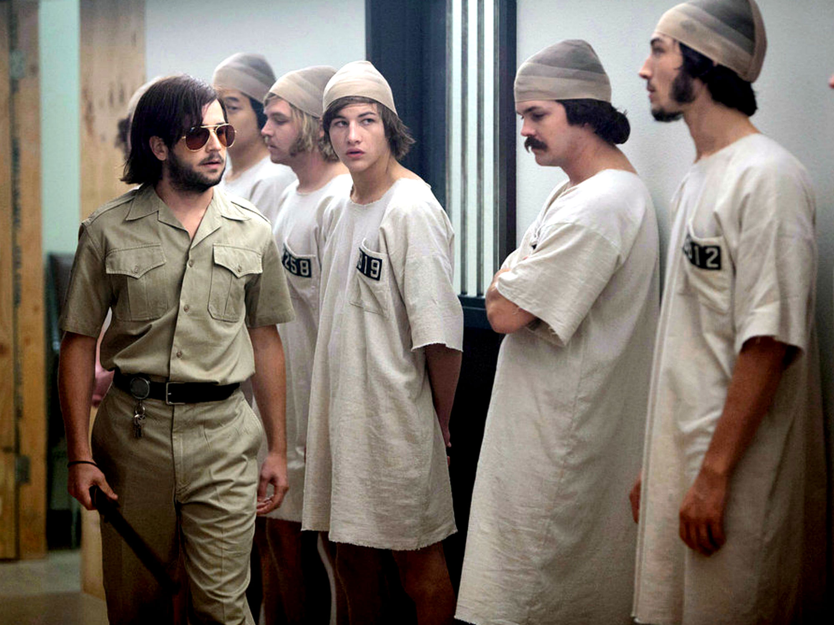
Stanford Prison Experiments
Abuse of Power
Controversial

Slide 40
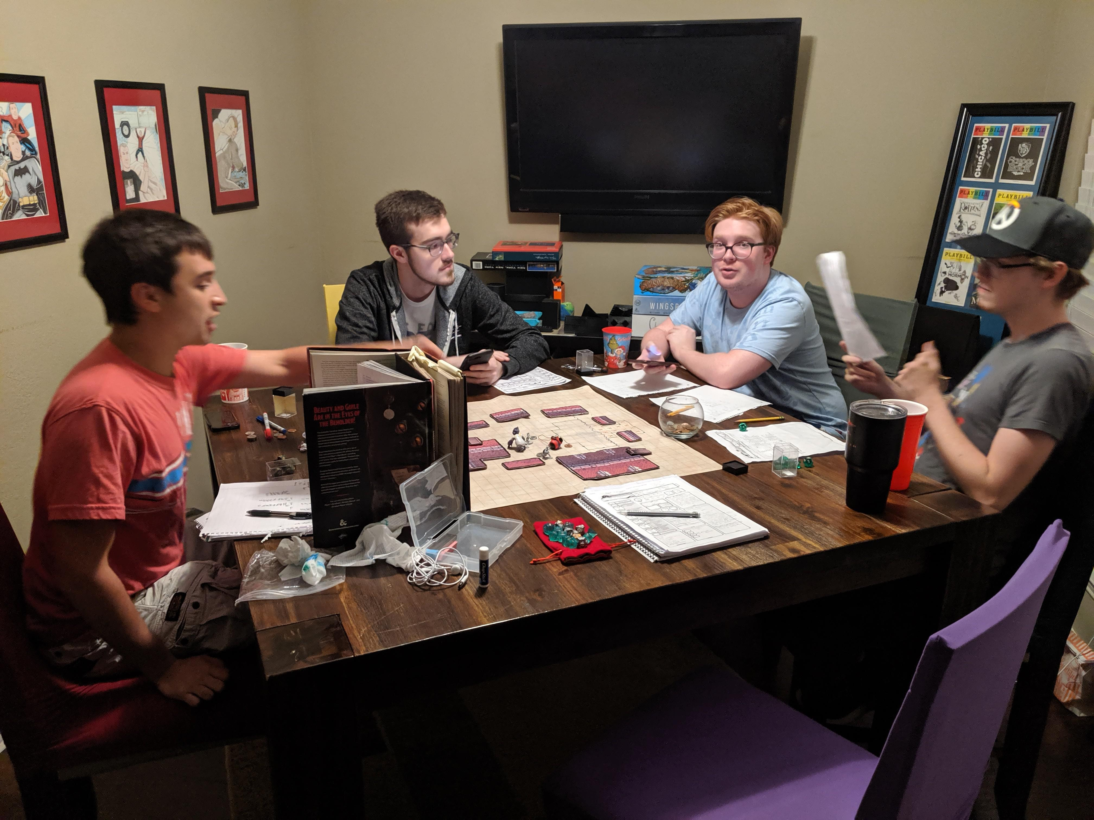
DnD
Tabletop RPG

Slide 41
Dread
DnD with Jenga

Slide 42
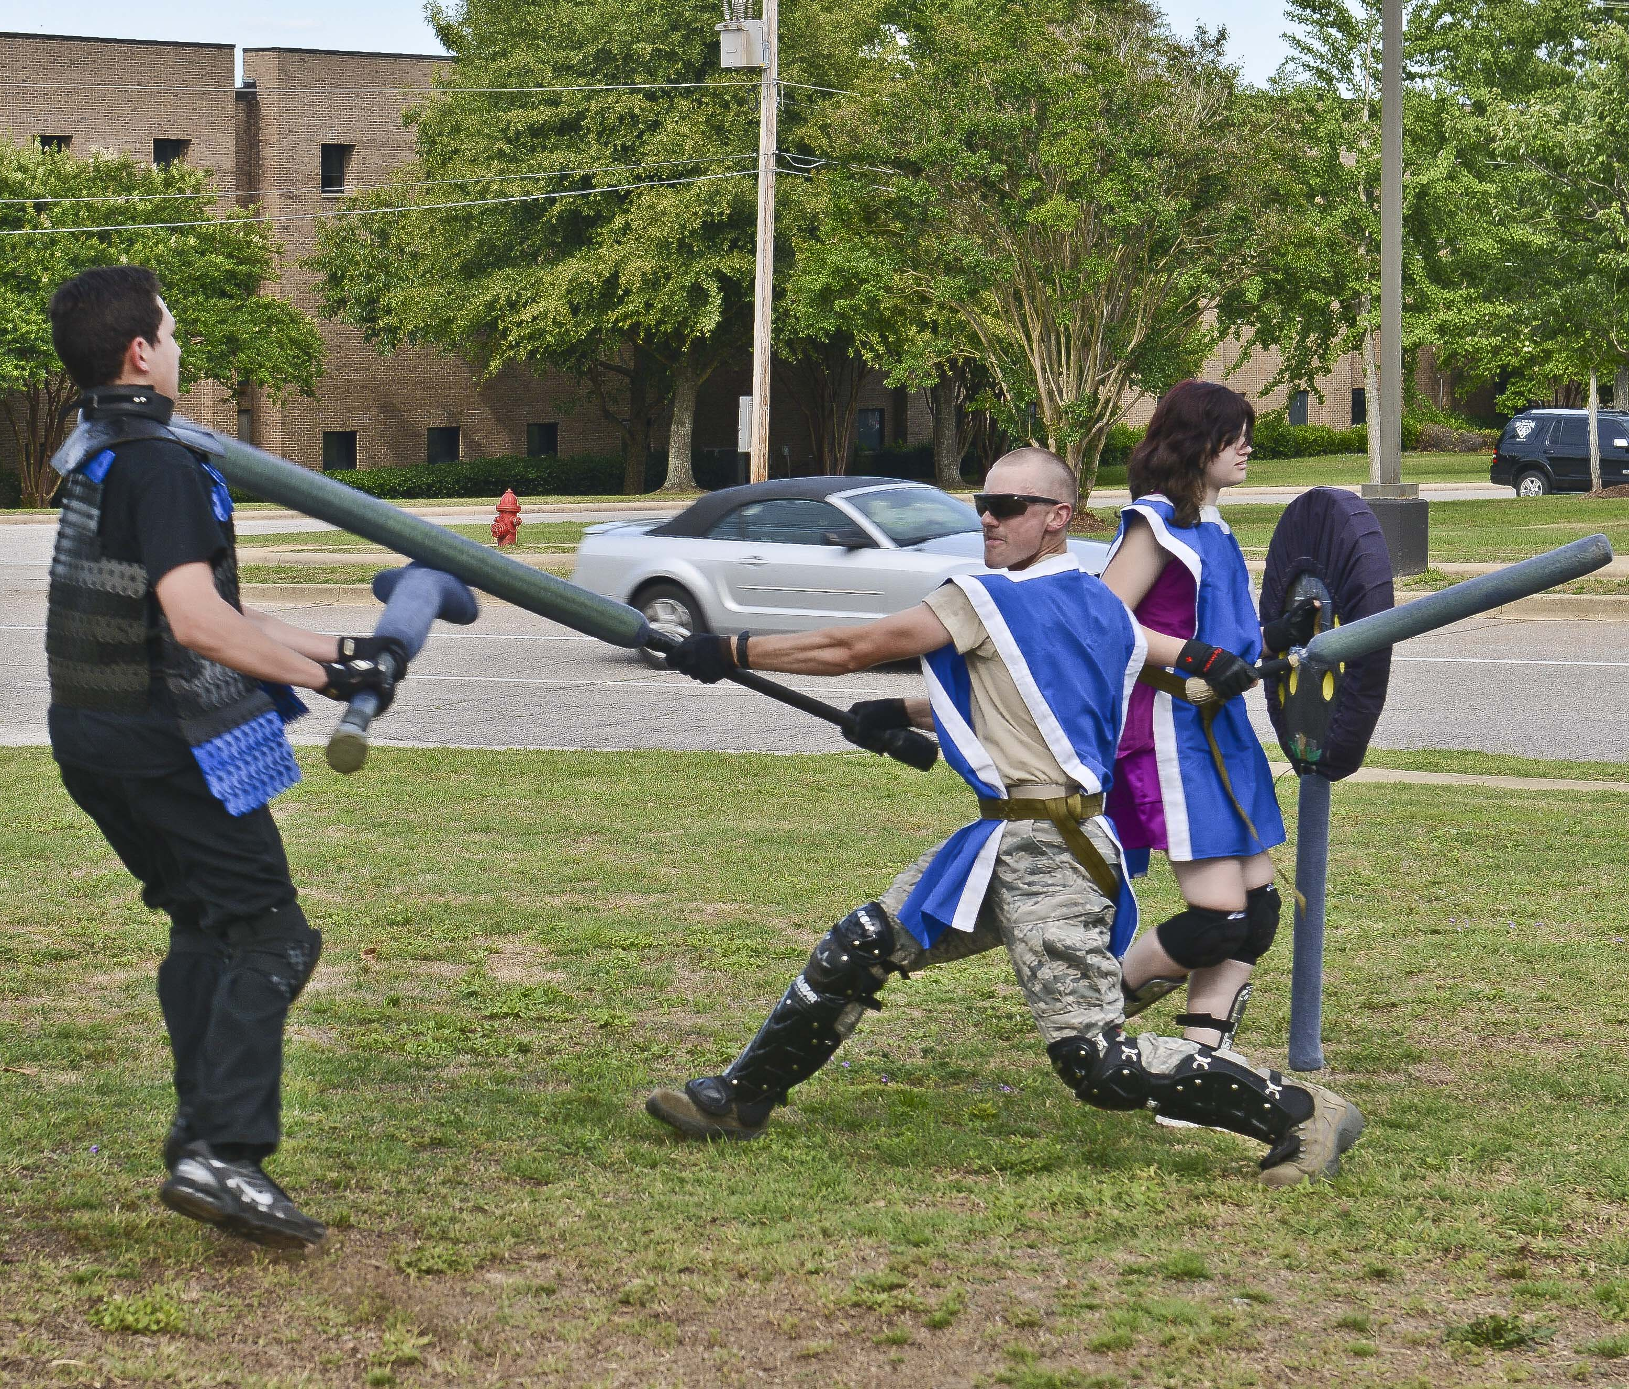
LARP
Live Action Role Play
Mad About a Boy
http://mad-about-the-boy-larp.blogspot.com/p/the-larp.html
Autonomy (LARP)
https://payhip.com/b/KvbG
Panoticorp
https://www.youtube.com/watch?v=mifzvxepjOA

Slide 43
EDULarp
LARP for class
Denmark
Learning disabilities

Slide 44
Mini un
Each student represents a country
Work together to solve global issues

Slide 45
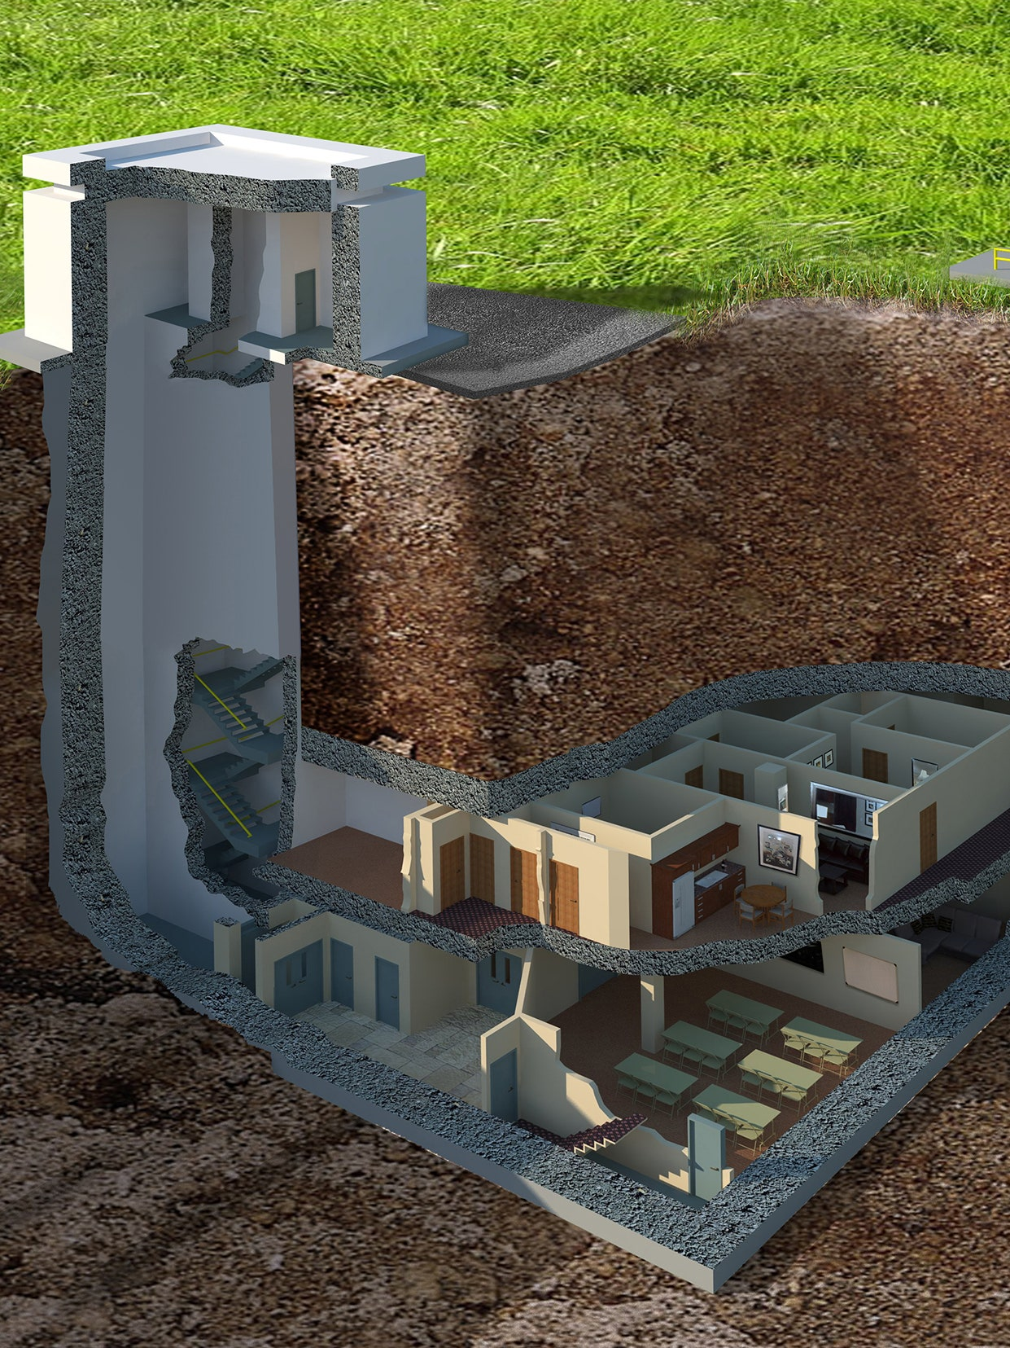
Bunker interviews
Apocalypse
Interview to get in a bunker

Slide 46
Fiasco
Role play board game

Slide 47
microscope
Create an alternate universe

Slide 48
Murder Mystery
Club Activity

Slide 49
ESL toybox
www.esltoybox.com

Slide 50
Gamification in the Classroom:
Rewards students with xp
Punishes students with hp
Real life consequences / power ups
Arranged into teams
Classcraft
https://www.classcraft.com/
https://www.youtube.com/watch?v=30oNjYEO4wk

Slide 51
Gamification in the Classroom:
Public schools
Uses game systems
Game designers / Teachers
Problem-Based Learning
Need to know
21st Century skills
Quest to Learn
https://www.q2l.org/
https://www.youtube.com/watch?v=kHtj6PCpyLQ

Slide 52
No Thank You, EVIL!
For elementary role plays kids

Slide 53
Types of Customers
https://corporatefinanceinstitute.com/resources/knowledge/other/types-of-customers/
Role –Playing Games Used as Educational and Therapeutic Tools for Youth and Adults
https://www.researchgate.net/publication/237074784_Role-playing_Games_Used_as_Educational_and_Therapeutic_Tools_for_Youth_and_Adults
Role –Playing Games for Common Well-Being in High School – Notes from a Study Developed in Southern Brazil
https://www.researchgate.net/publication/333755286_Role-Playing_Games_for_Common_Well-Being_in_High_School_-_Notes_from_a_Study_Developed_in_Southern_Brazil
EDULarp
https://goodjobstudios.com/animation-edu-larp/

Slide 54
Autonomy (LARP)
https://payhip.com/b/KvbG
Panoticorp
https://www.youtube.com/watch?v=mifzvxepjOA
Mad About a Boy
http://mad-about-the-boy-larp.blogspot.com/p/the-larp.html
https://www.theverge.com/2012/11/27/3609806/my-so-called-larp-living-world-without-men
More @ the Larp Library
https://library.interactiveliterature.org/

Slide 55
More @ the Drive Thru RPG
https://www.drivethrurpg.com/
FUTUR (Role Play)
https://www.youtube.com/channel/UC-b3c7kxa5vU-bnmaROgvog

