Slide 1
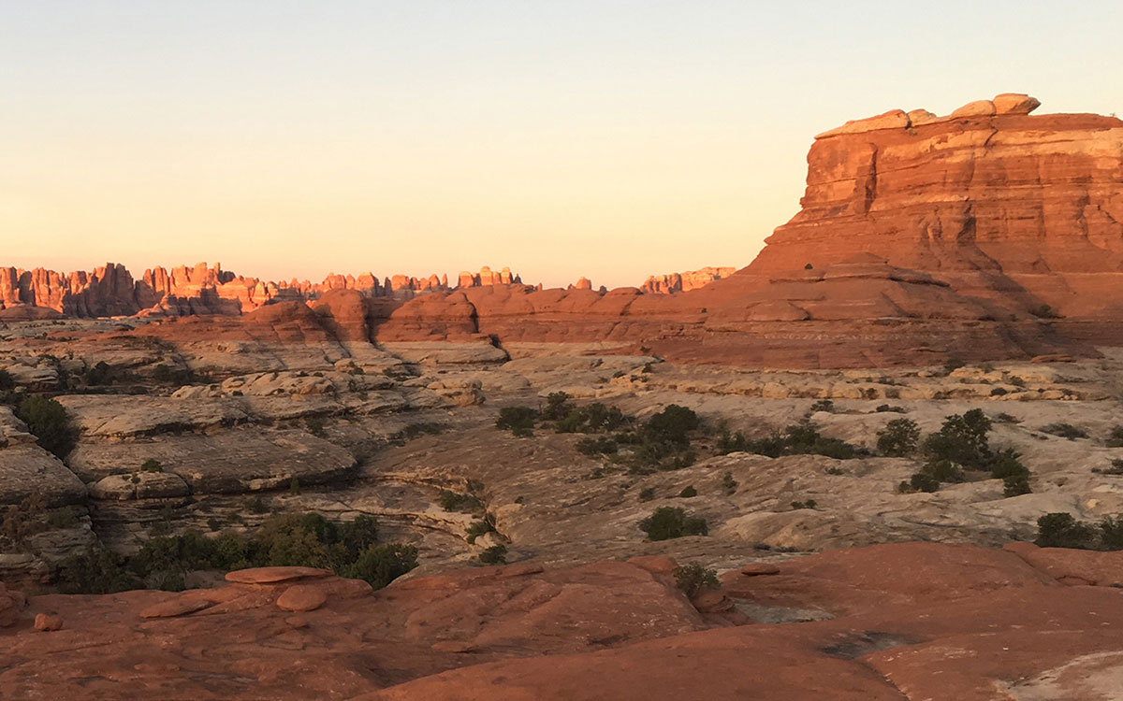
Desert
Survival

Slide 2
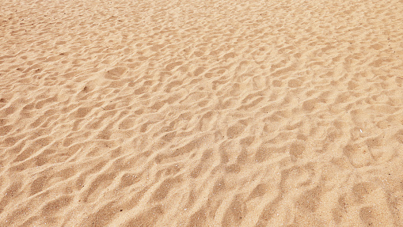
Scenario

Slide 3
It is approximately 10:00 a.m. in mid July, and you have just crash landed in the Sonora Desert in the southwestern United States. The light twin engine plane, containing the bodies of the pilot and the co-pilot, has completely burned. Only the air frame remains. None of the rest of you have been injured.

Slide 4
The pilot was unable to notify anyone of your position before the crash. However, ground sightings, taken before you crashed, indicate that you are 100 km off the course that was filed in your VFR Flight Plan. The pilot has indicated before you crashed that you were approximately 110 km south-southwest from a mining camp which is the nearest known habitation.

Slide 5
The immediate area is quite flat and except for occasional barrel and saguaros cacti appears to be rather barren. The last weather report indicated that temperatures would reach 43° C which means that the temperature within a foot of the surface will hit 54° C.

Slide 6
You are dressed in light-weight clothing—short sleeved shirts, pants, socks, and street shoes. Everyone has a handkerchief. Collectively, your pockets contain $2.83 in change, $85.00 in bills, and a ballpoint pen. Before the plane caught fire, your group was able to salvage 14 items.

Slide 7
Task

Slide 8
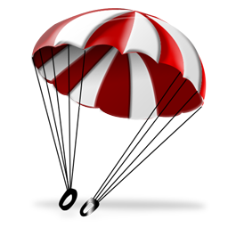
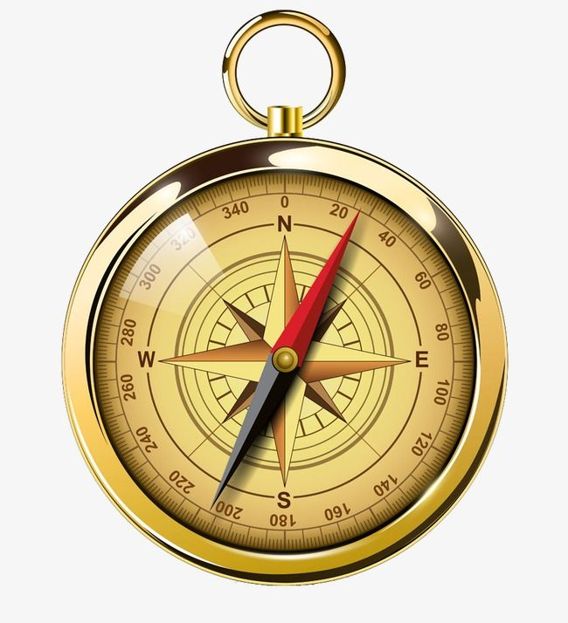
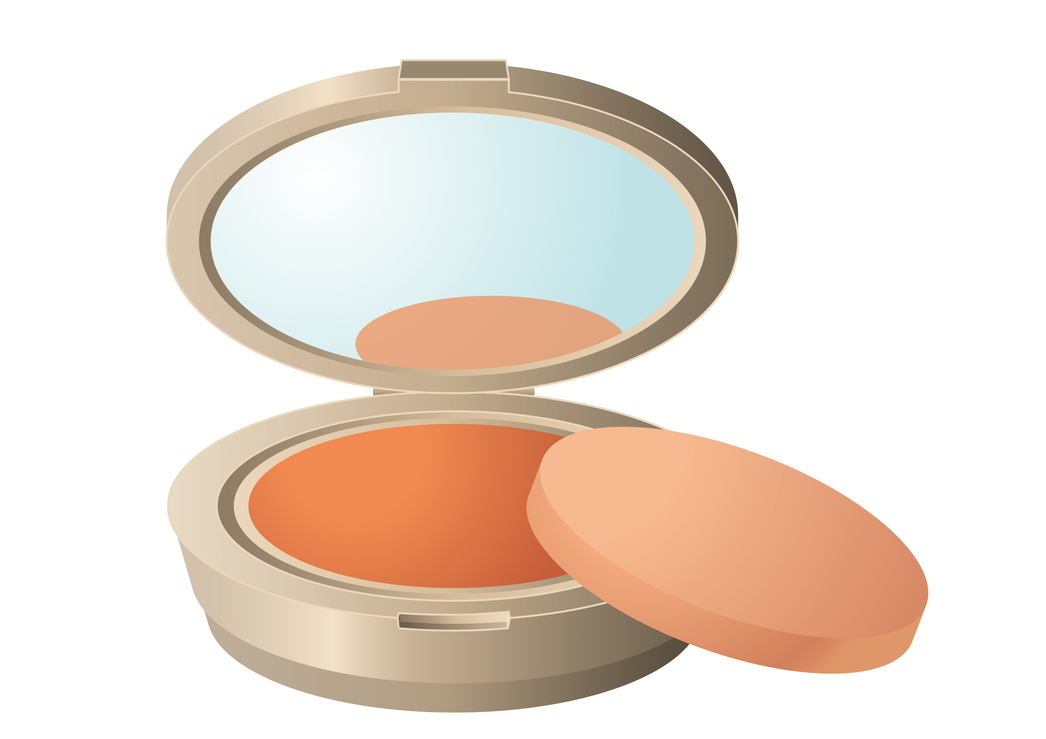
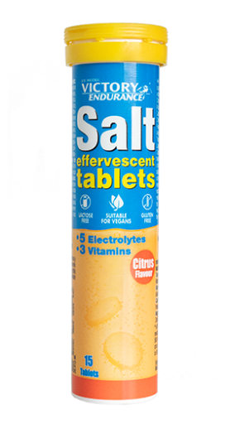
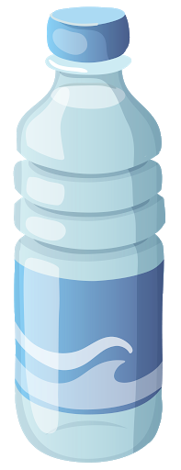
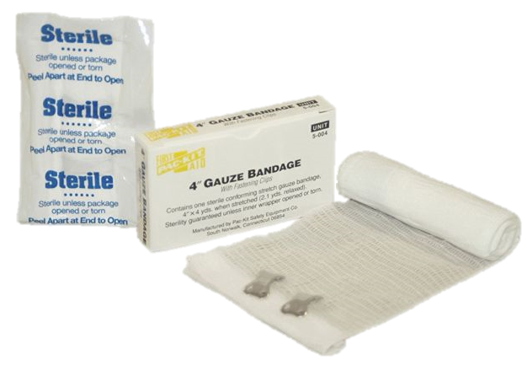
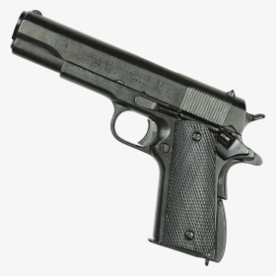
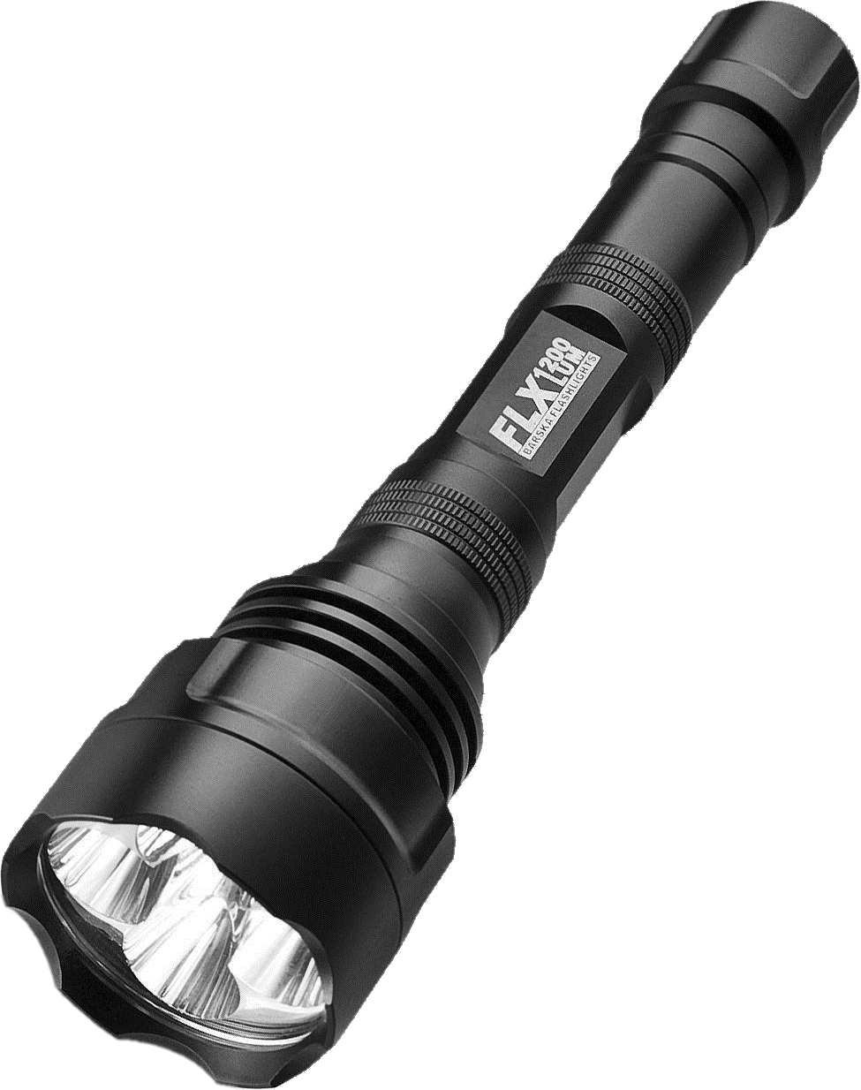
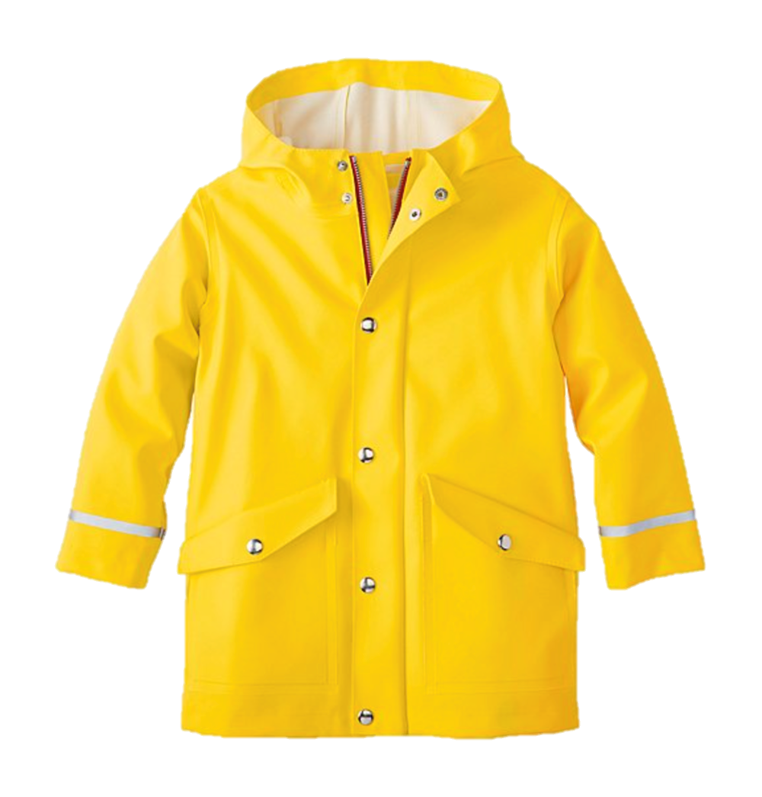
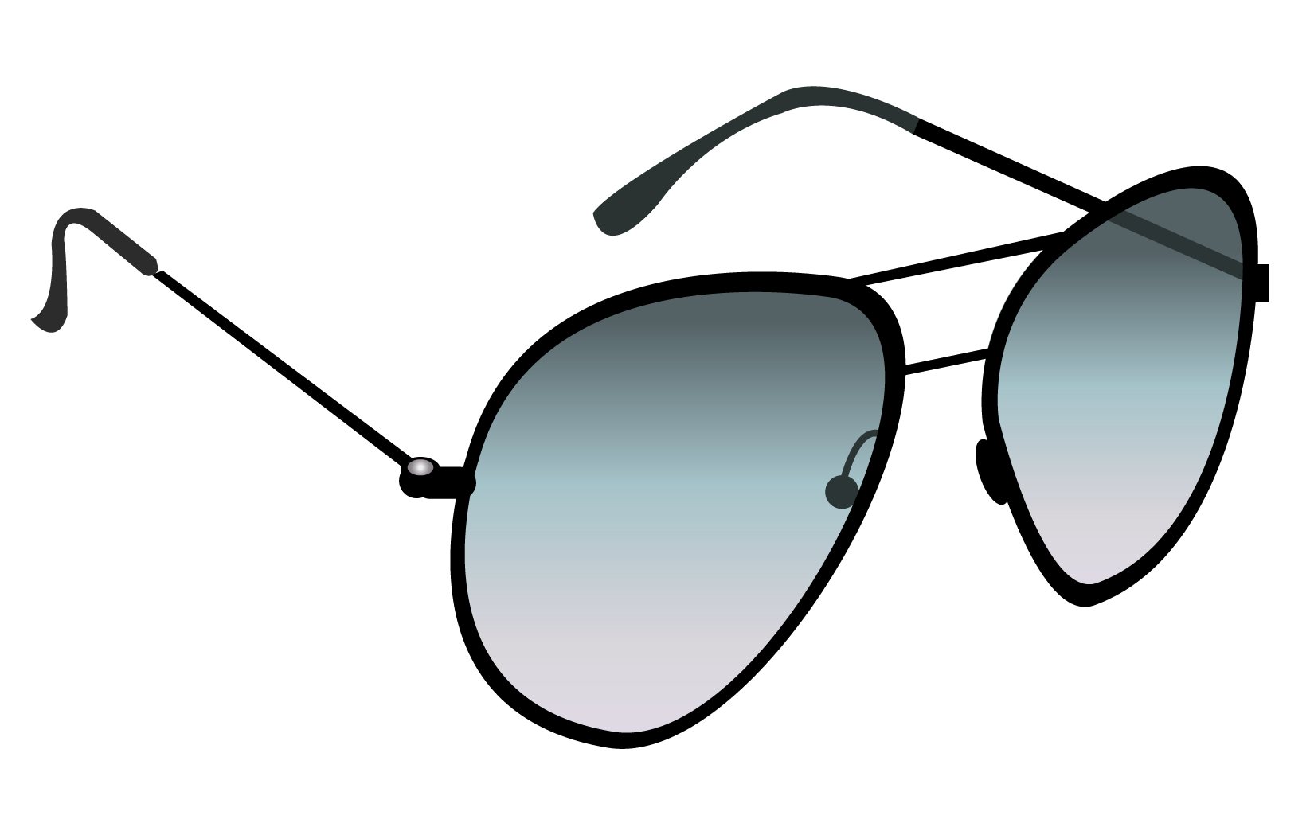
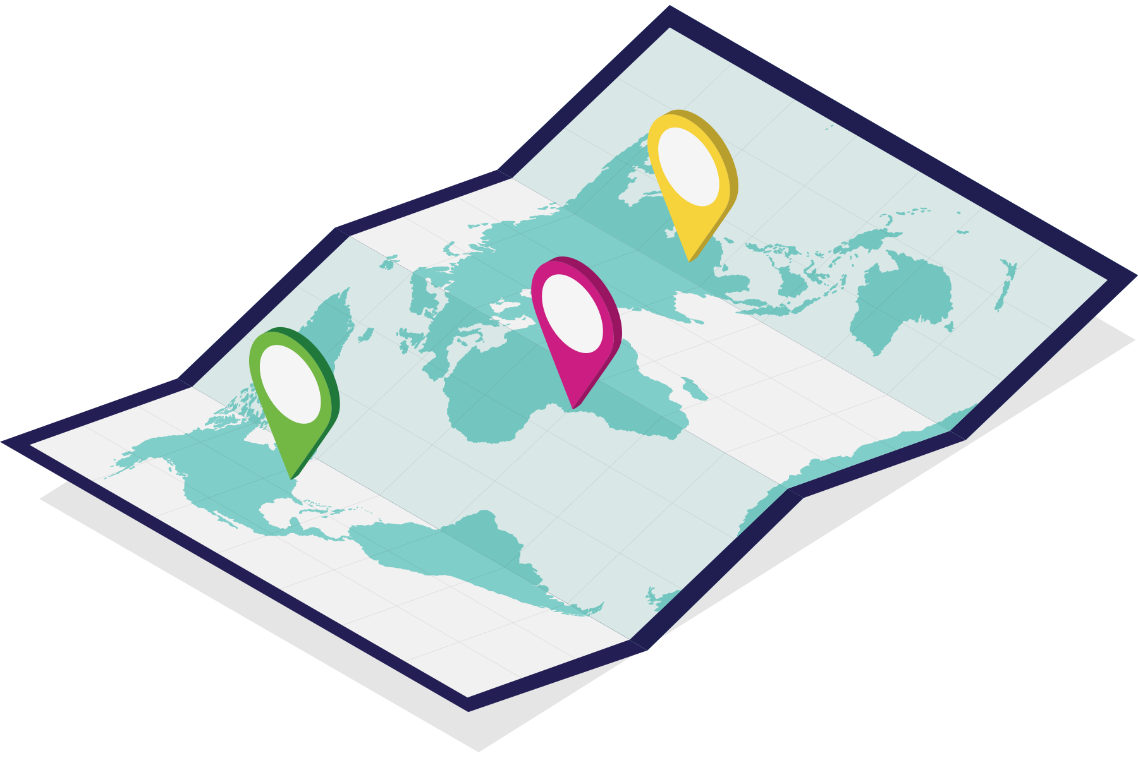
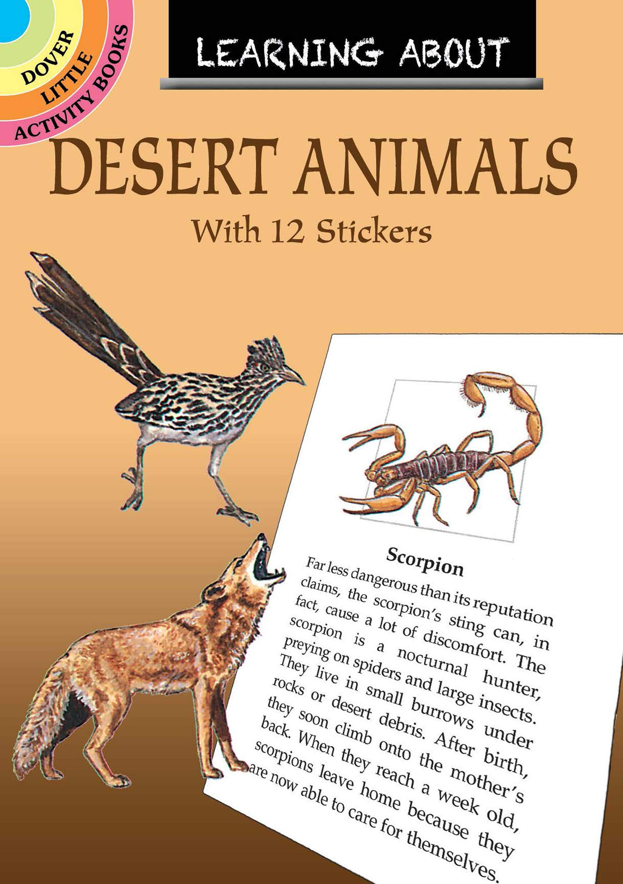
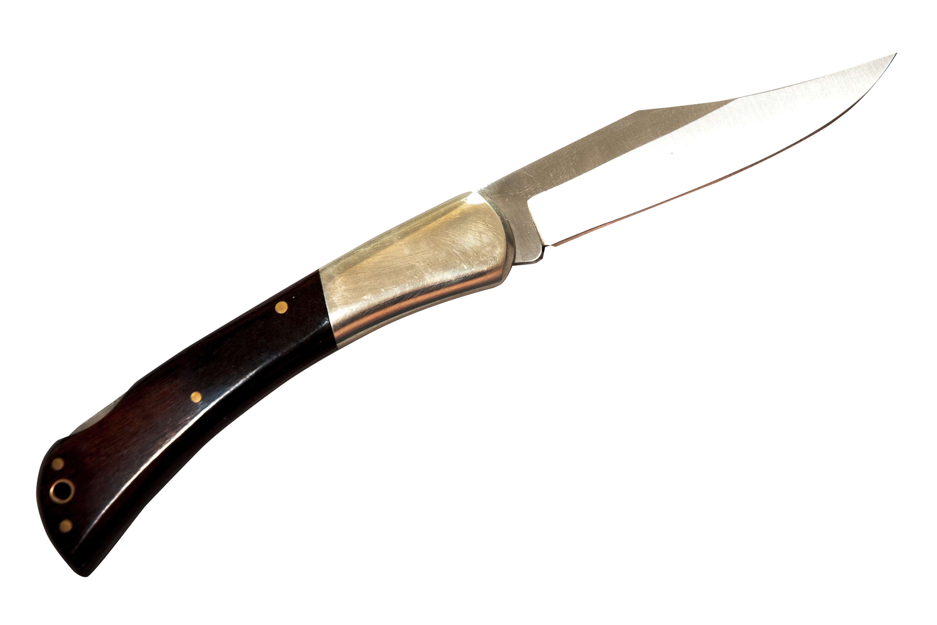
1 Plastic Raincoat
Cosmetic Mirror
Red + White
Parachute
Map of the Area
100 Salt Tablets
1L of Water (per person)
Flashlight
(Large, 4 D batteries)
.45 Caliber Gun
(loaded)
Sunglasses
(1 pair)
Compress Kit
(with gauze)
Rubbing Alcohol
(1 Liter)
Book
(Edible Animals of the Desert)
Pocket Knife
Compass

Slide 9
Rank the following items in order of importance:
Item | Individual | (difference) | Team | (difference) | Expert
.45 caliber gun (loaded)
1L of water (per person)
compass
pocket knife
100 salt tablets
cosmetic mirror
flashlight
compress kit (with gauze)
book (Edible Animals In The Desert)
1 plastic raincoat
rubbing alcohol (1L)
map of the area
sunglasses (1 pair)
red and white parachute

Slide 10
Ranking

Slide 11
1
Cosmetic Mirror
Of all the items, the mirror is absolutely critical. It is the most powerful tool you have for communicating your presence. In sunlight, a simple mirror can generate 5 to 7 million candle power of light. The reflected sunbeam can even be seen beyond the horizon. If you had no other item, you would still have better than an 80% chance of being spotted and picked up within the first 24 hours.

Slide 12
2
1 Plastic Raincoat
By digging a hole and placing a raincoat over it, the temperature differential will extract some moisture from urine soaked sand or cut up cactus/plants under it. By placing a small stone in the center of the plastic it creates an inverted cone causing moisture to drip into the flashlight container below it. Up to a liter of water per day can be obtained this way. It’s important, however, to not expend too much energy digging or preparing during the hottest part of the day, as this would require more water to do this than it’s worth. Prepare this, if possible, at night.

Slide 13
3
1L of Water (per person)
You can probably survive the first three days with just the first two items. Although the liter of water would not significantly extend the survival time, it would help to hold off the effects of dehydration. It’s best to drink the water as you become thirsty so that you can remain as clear headed as possible during the first day when important decisions have to be made and shelter created. Once dehydration begins, it’s impossible to reverse it with the amount of water available with this situation. Therefore, rationing it would not be a good idea.

Slide 14
4
Flashlight
(Large, 4 D batteries)
The only quick, reliable night signaling device is the flashlight. With it and the mirror you have 24 hour signaling capability. It also is a multi-use item during the day. The reflector and lens could be used as an auxiliary signaling device or as a fire starter. The battery container can be used for digging and used also as a water container in the distillation process.

Slide 15
5
Pocket Knife
The pocket knife can be used for rigging a shelter, and cutting up cactus or vegetation. Is enumerable other uses gives it a high ranking.

Slide 16
6
Red + White
Parachute
The parachute can serve as both shelter and signaling device. Create a shade cover using trees or cactus as poles and parachute lines to tie the shelter down. By doubling or tripling the fabric over itself it can reduce the temperature as much as 30%.

Slide 17
7
.45 Caliber Gun
(loaded)
By the end of the second day, speech would be seriously impaired an you may not be able to walk (6-10% dehydration). The pistol can be used as a signaling device (only 3-5 km) and the bullets can be used as a fire starter. (the international distress signal is three shots fired in rapid succession). The butt of the pistol may also be used as a hammer. The pistol’s advantages are counterbalanced by its very dangerous disadvantages. Impatience, irritability, and irrationality would all occur as dehydration sets in. Under the circumstances, the availability of such a lethal tool constitutes a real danger. It could be used for hunting, but would be a complete waste of time. Eating protein increases dehydration enormously as the body requires water to process food.

Slide 18
8
Sunglasses
(1 pair)
In the intense sunlight of the desert, photothalmia and solar retinitis, (both similar to snow blindness) could be serious problems by the second day. However, the dark shade of the parachute shelter will reduce the problem, as would darkening the area around the eyes using Sole property of PUHSD. Not to be used or reproduced without expressed permission of PUHSD/CTE. 8/12 soot from the wreckage. Use strips of cloth fashioned around the head with slits for in the front for your eyes to help eliminate this problem. One pair of sunglasses is nice, but it will only help one person.

Slide 19
9
Compress Kit
(with gauze)
Because of the low humidity of the desert, it’s considered one of the least infectious places in the world. And because the blood thickens with dehydration, there is little danger from bleeding unless a vein is severed. In one well documented case, a man, lost without water, who had torn off all of his clothes and had fallen on sharp cactus until his body was covered with cuts, did not bleed until he was rescued and given water. The kit material might be used as rope, or used to wrap the legs, face , and head for protection from the sun.

Slide 20
10
Compass
Aside from the possibility of using the reflective surfaces of the compass as a signaling device, the compass is of little use. It would be dangerous to have it around as the effects of dehydration set in. It might tempt a person into trying to walk out.

Slide 21
11
Map of the Area
The map might be useful to start a fire with, or for toilet paper. You could also use it as a shade for your head. It is essentially useless because it might encourage members to try and walk out, and that is the deadliest of all options.

Slide 22
12
Book
(Edible Animals of the Desert)
The problem confronting the group is dehydration, not starvation. Desert animals are rarely seen and may take too much energy to kill, for the proposed gain. Again, the intake of protein increases dehydration because much of it is needed in the digestion process. The rule of thumb is, if you have lots of water, eat, otherwise don’t consume anything but water.

Slide 23
13
100 Salt Tablets
With dehydration, blood salinity increases. If salt tablets are ingested, blood salinity continues to rise to dangerous levels and may become deadly. It has the same effect as drinking ocean water, which is not a good idea.

Slide 24
14
Rubbing Alcohol
(1 Liter)
Rubbing alcohol is deadly if ingested, and it looks similar to water. It can be dangerous as dehydration sets in and causes irrationality. Rubbing alcohol is flammable and may be used to start a fire, but the flame is dangerously invisible.

Slide 25
Score

Slide 27
Cooperative Learning (1994) by Dr. Spencer Kagan.Publisher: Resources for Teachers, Inc.
https://teacher.desmos.com/activitybuilder/teacherguide/5e1dbb0b74b9b0546a5b2998

Slide 28
ESL toybox
www.esltoybox.com

