Slide 1
What is the capital city?
https://youtu.be/9egn2LWJ3p4

Slide 2
https://create.kahoot.it/details/bd7219a5-81e2-4679-8d3d-7c3d213d7a84

Slide 3
Caput Mundi
Historical Capitals

Slide 4
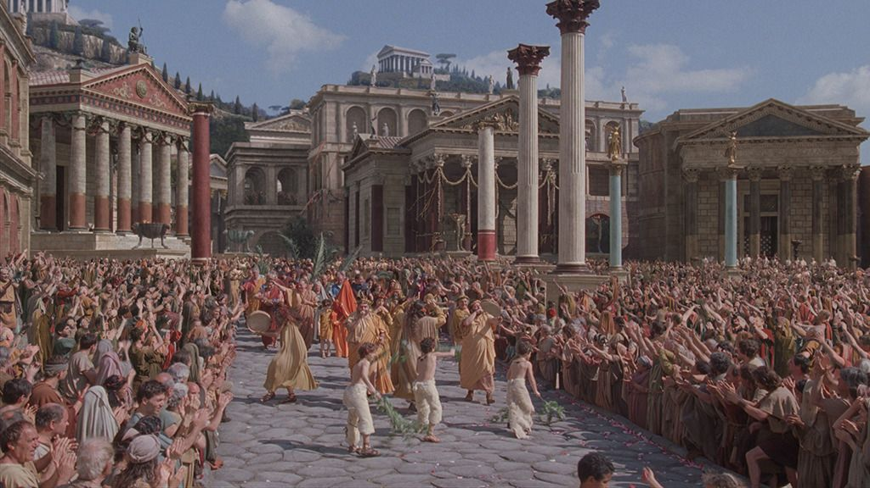
Rome

Slide 5
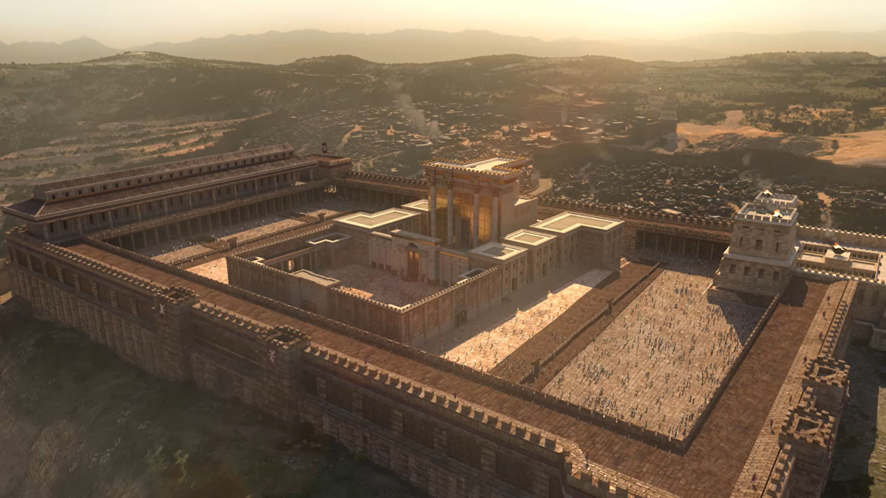
Jerusalem

Slide 6
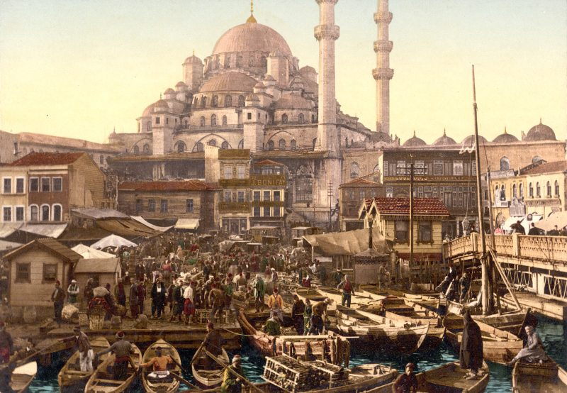
Constantinople

Slide 7
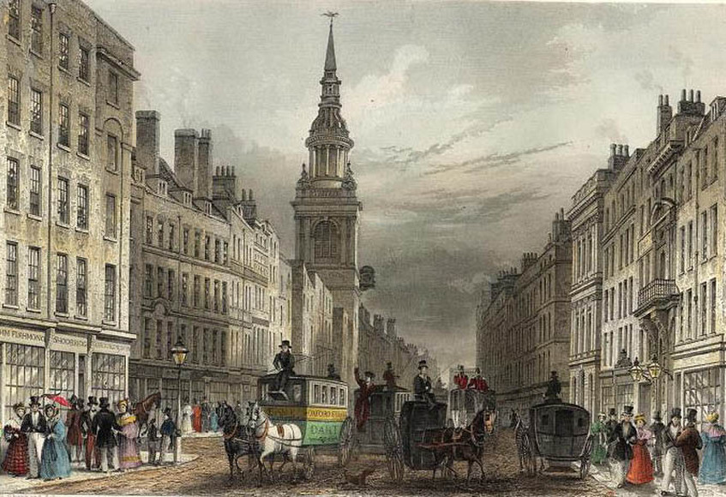
London

Slide 8
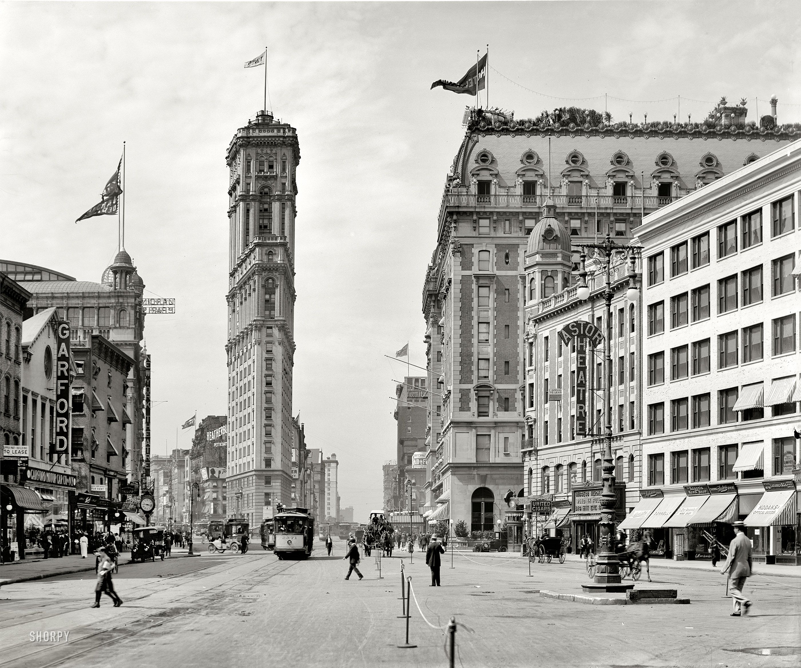
New York

Slide 9
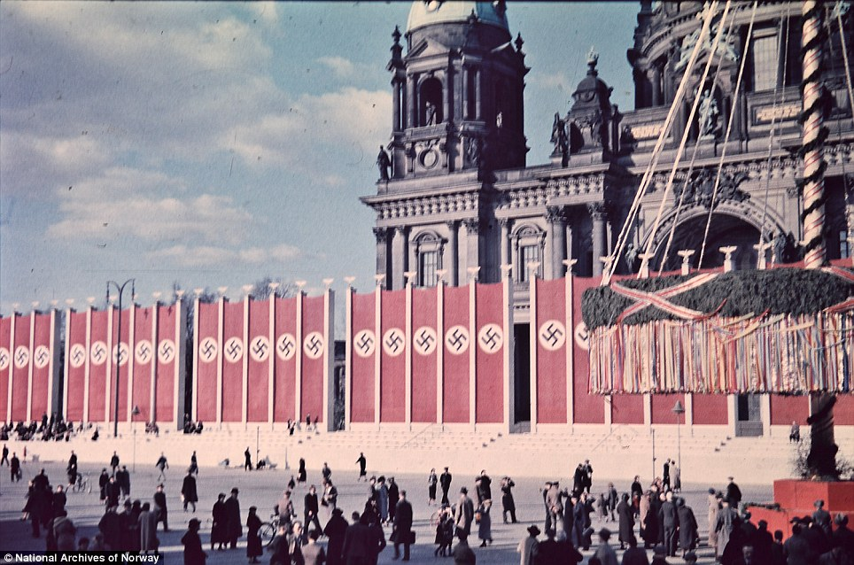
Berlin

Slide 10
Today’s World Capital
Discuss with your group

Slide 11
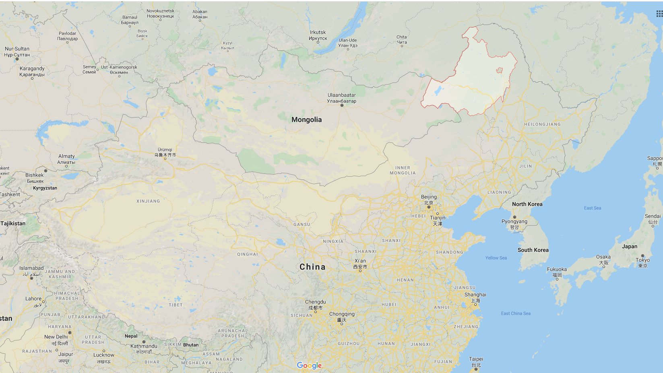
Hulunbuir
Largest Area

Slide 12
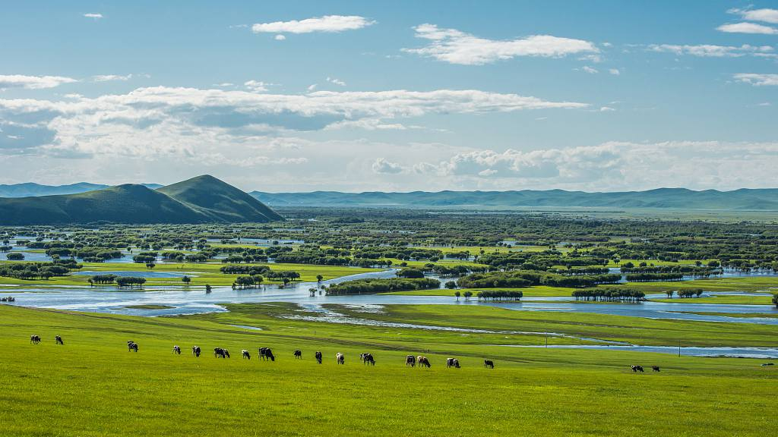
263,953 km²
2.6 x South Korea

Slide 13
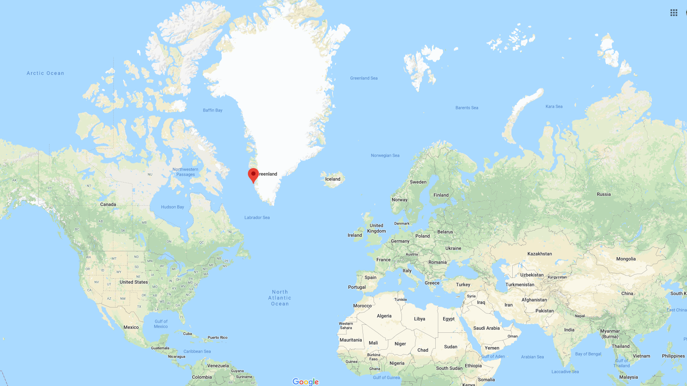
Nuuk
Smallest Capital

Slide 14
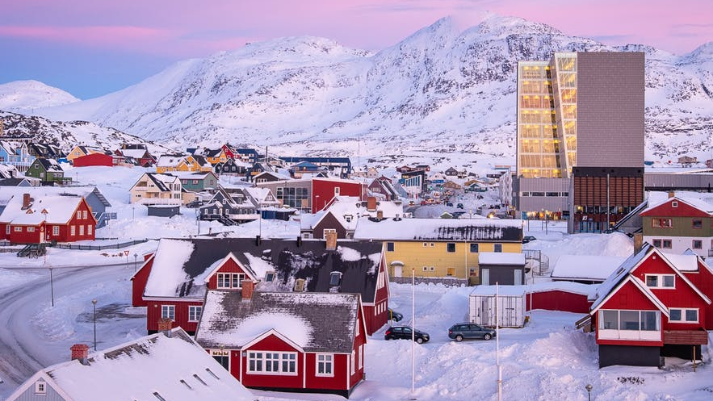
Pop. 18,800

Slide 15
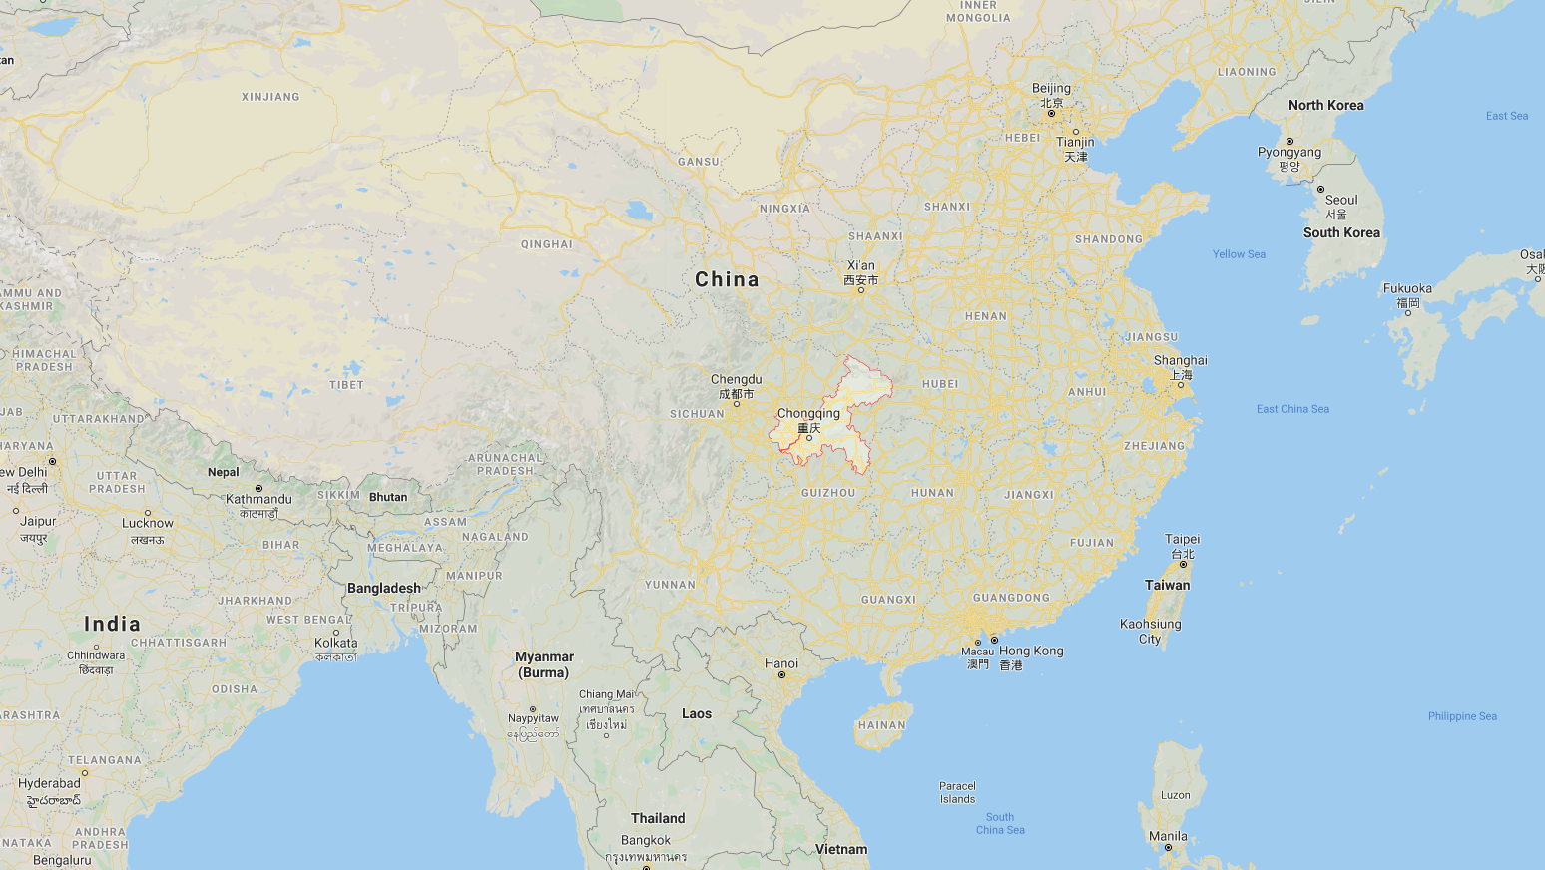
Chongqing
City Proper

Slide 16
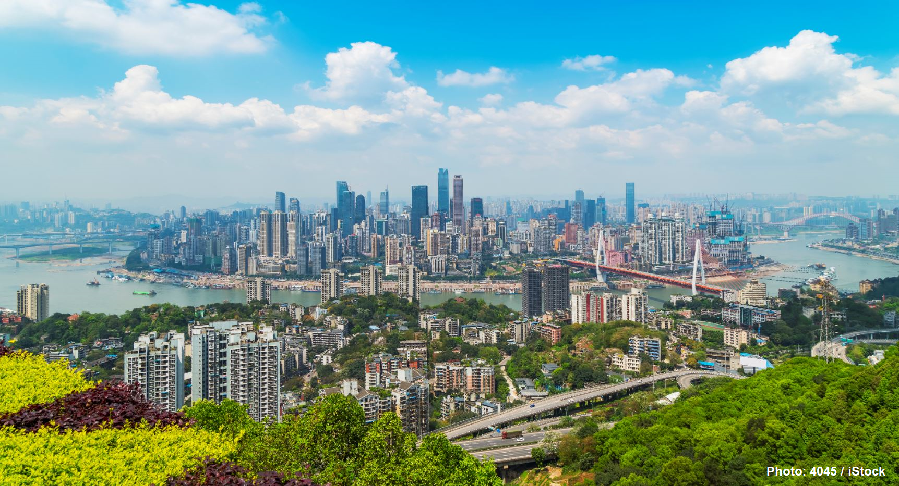
Pop. 32,054,159

Slide 17
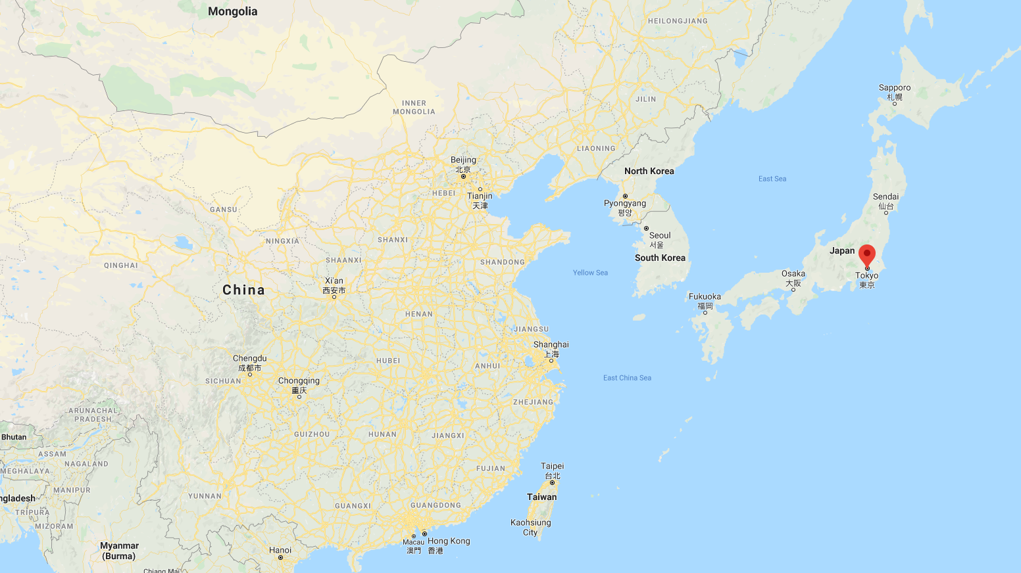
Tokyo
Metropolitan

Slide 18
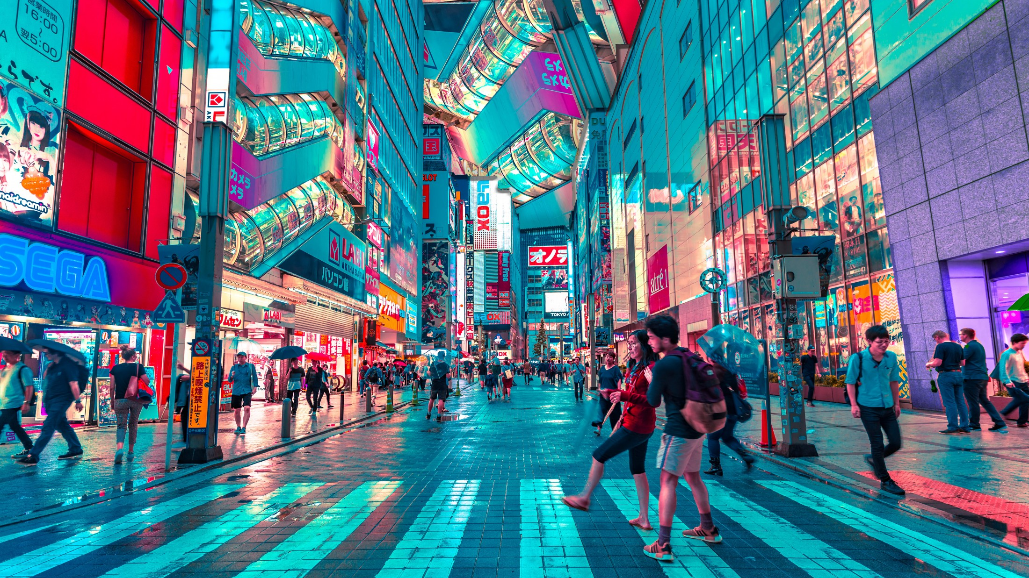
Pop. 37,274,000

Slide 19
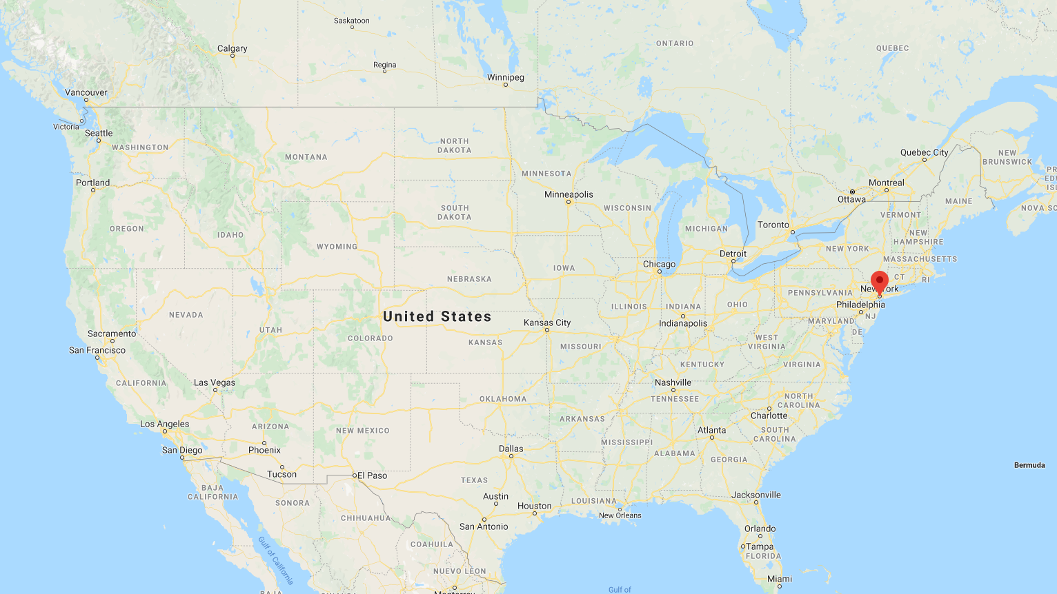
New York
Financial Center

Slide 20
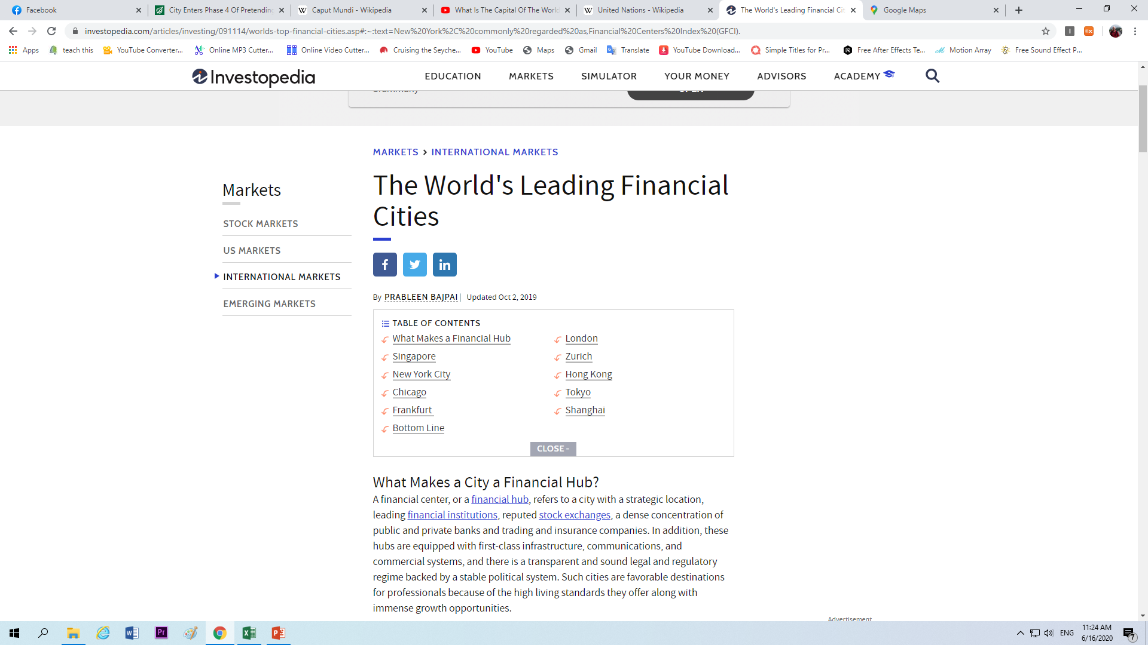

Slide 21
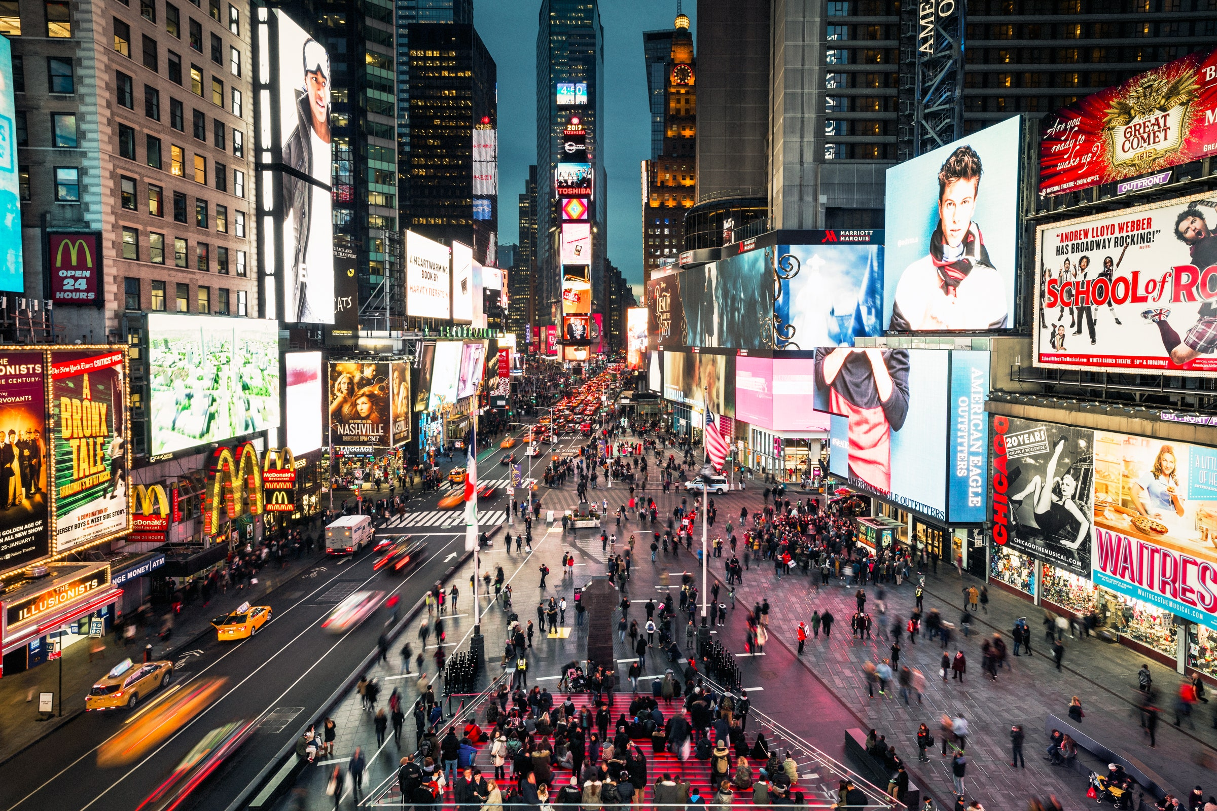

Slide 22
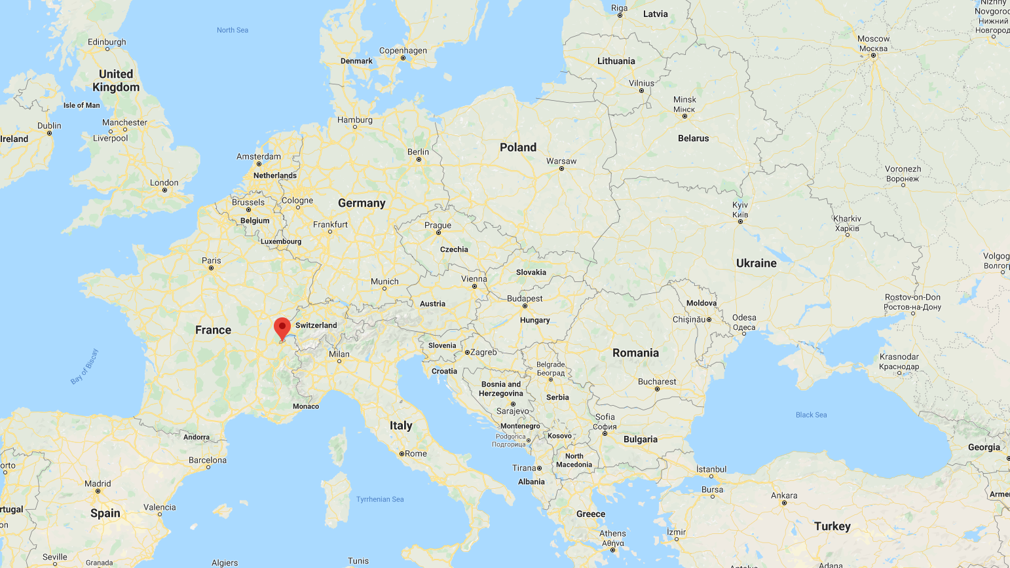
Geneva
Most UN Committees
(New York = headquarters)

Slide 23
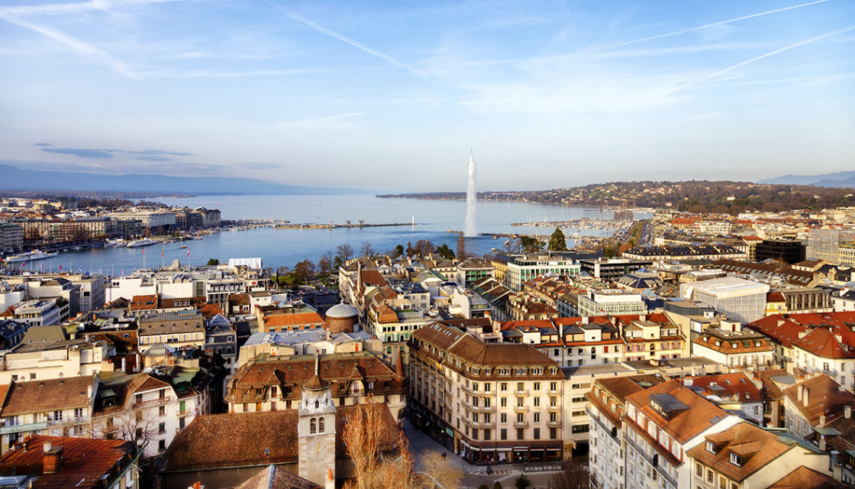

Slide 24
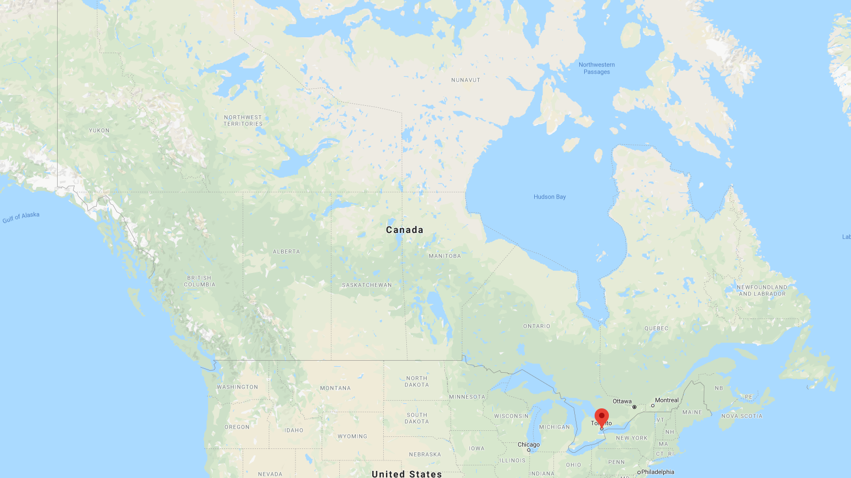
Toronto
Cultural Capital

Slide 25
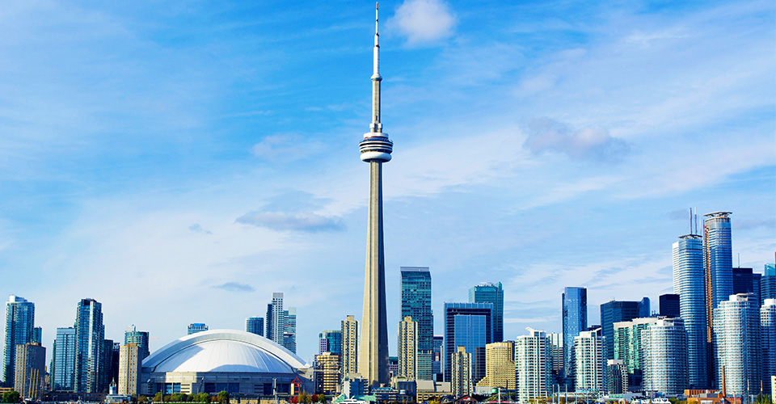

Slide 26
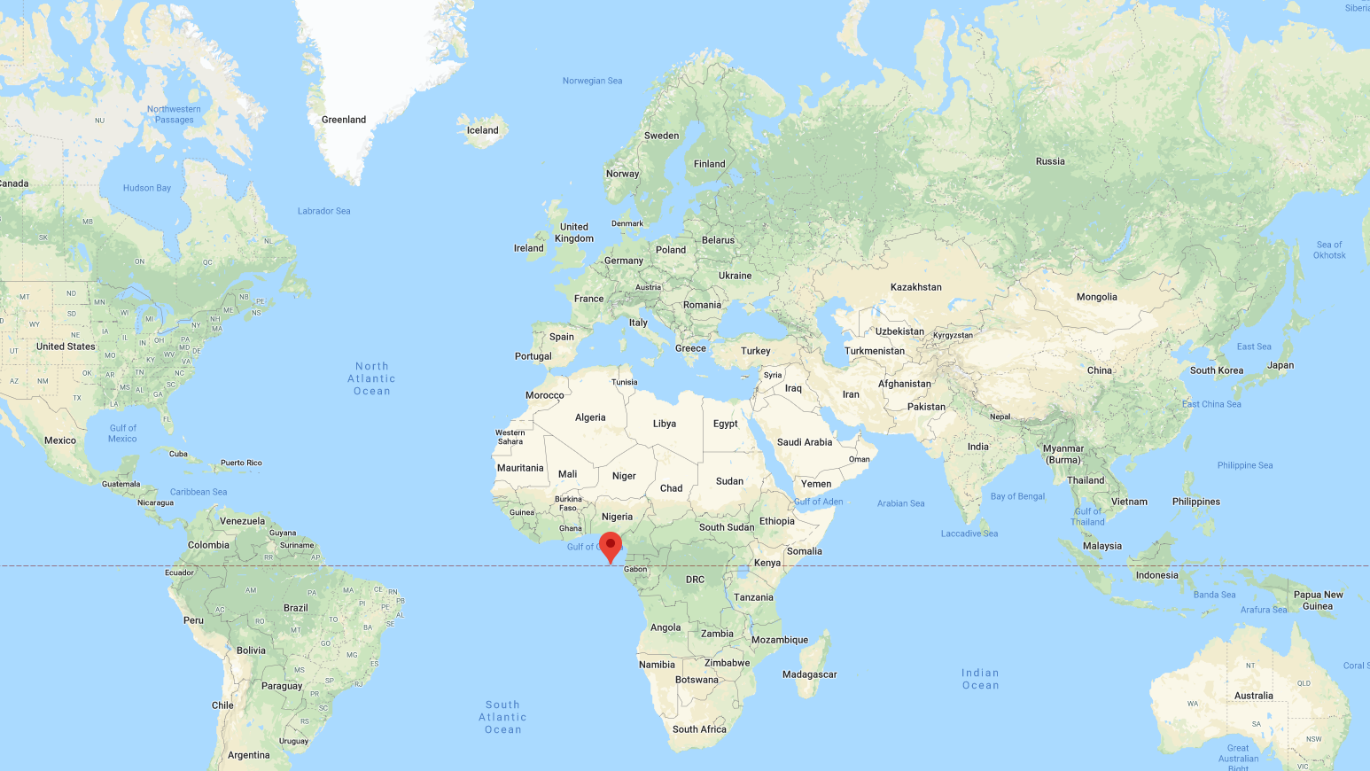
São Tomé and Príncipe
Horizontal and Vertical Center

Slide 27
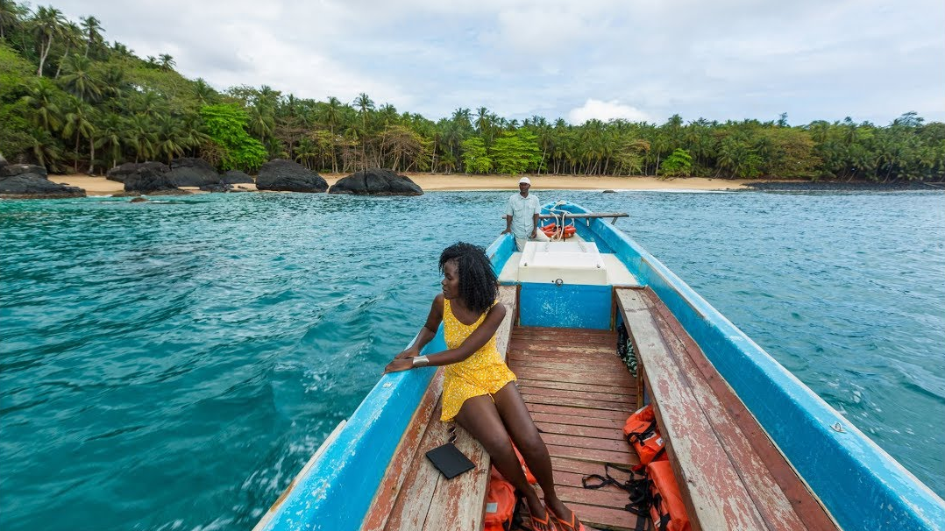

Slide 28
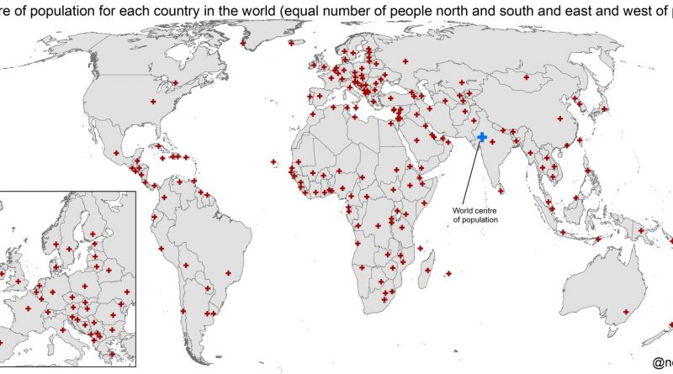
Near New Delhi
Population Center of the world

Slide 29
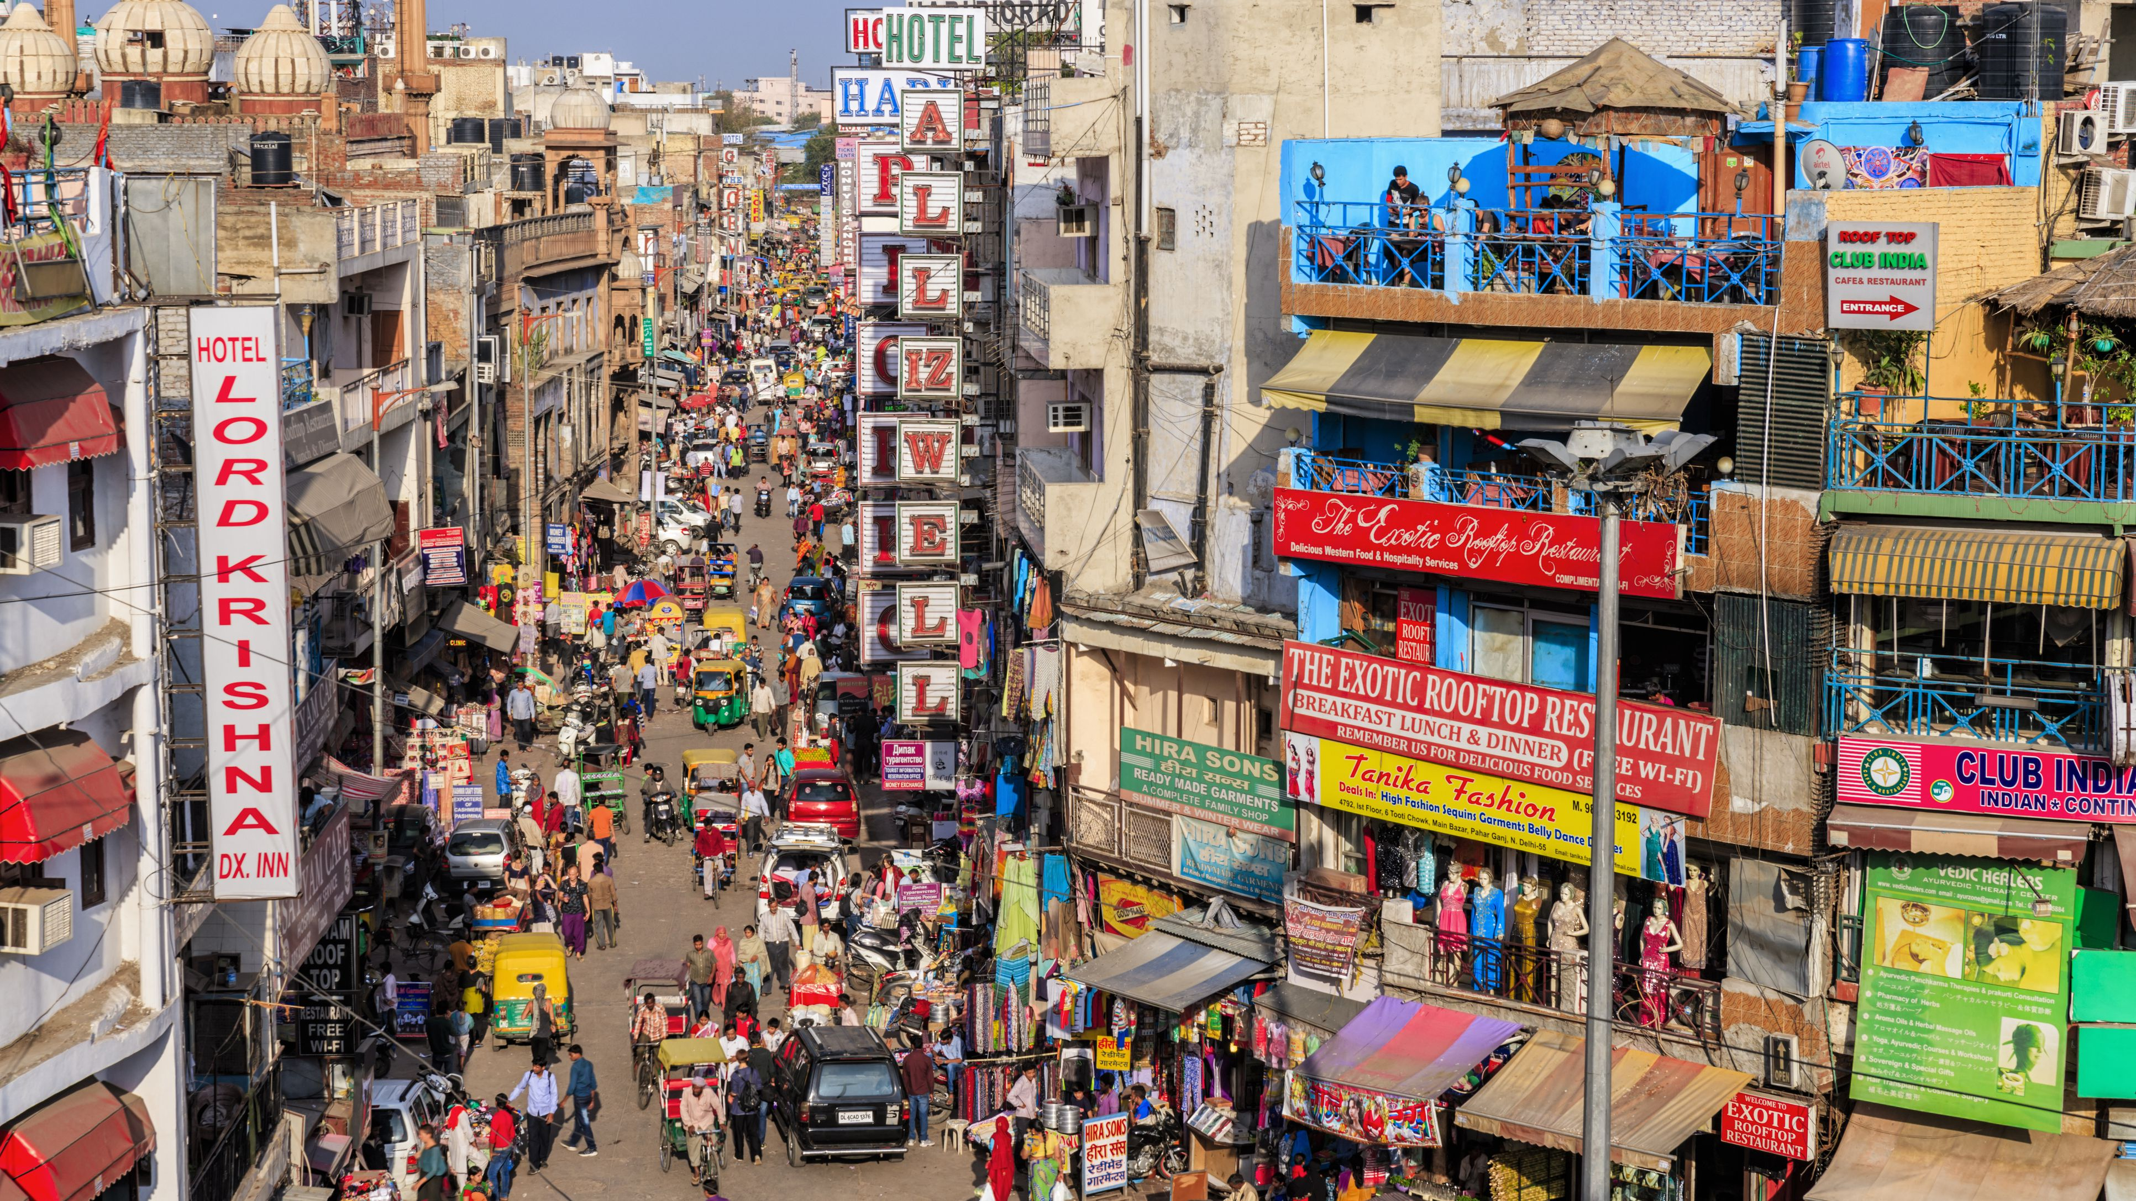

Slide 30
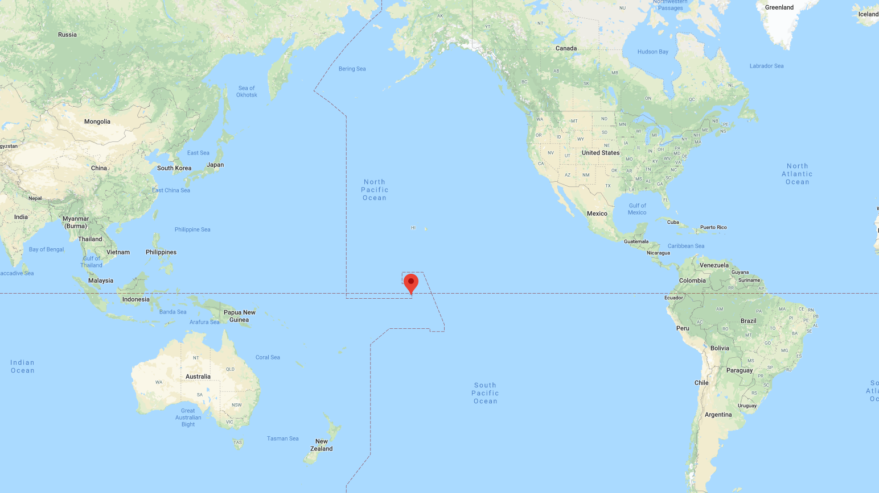
Jarvis Island
Four Hemisphere

Slide 31
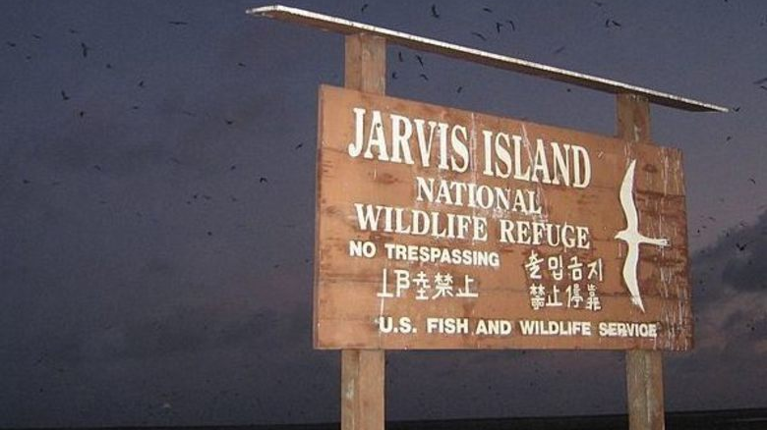

Slide 32
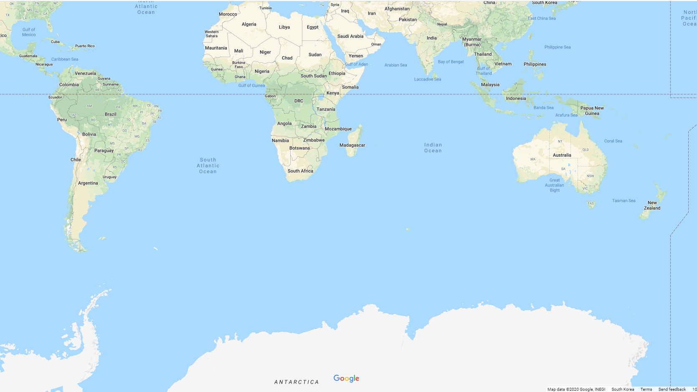
Antarctica
Neutral Zone

Slide 33
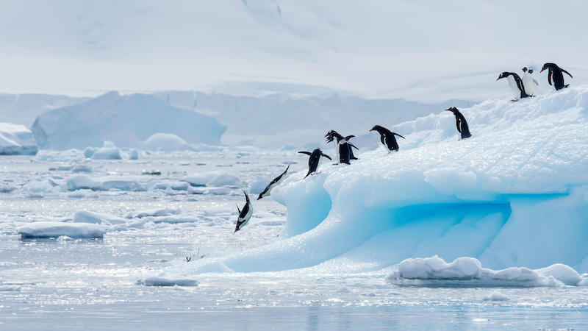

Slide 34
Tokyo
Safest City

Slide 36
My Opinion

Slide 37
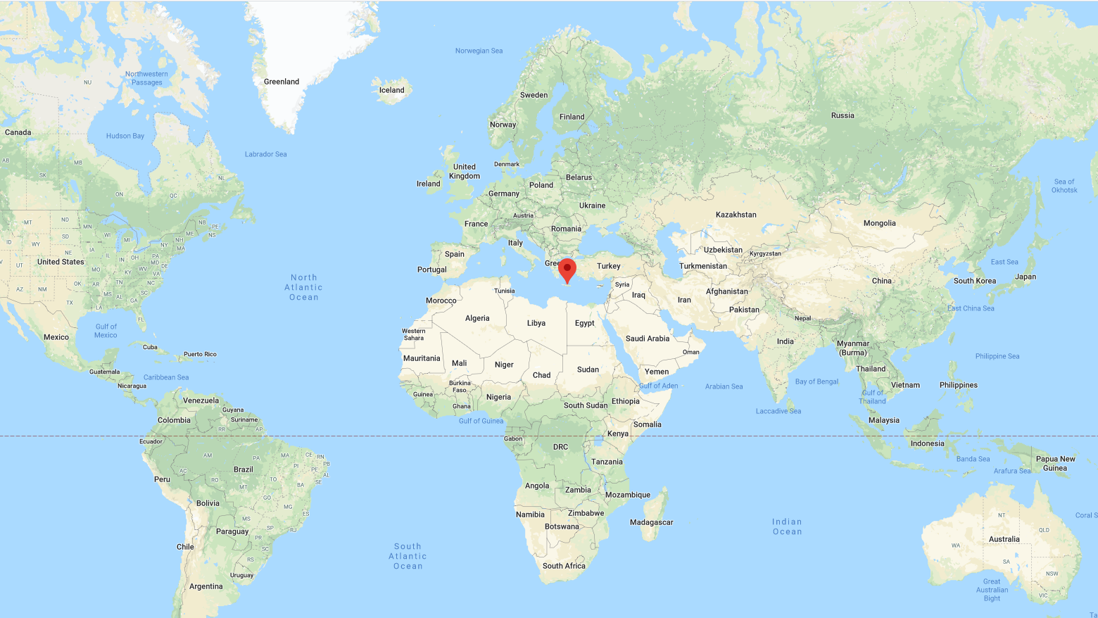
Heraklion

Slide 38
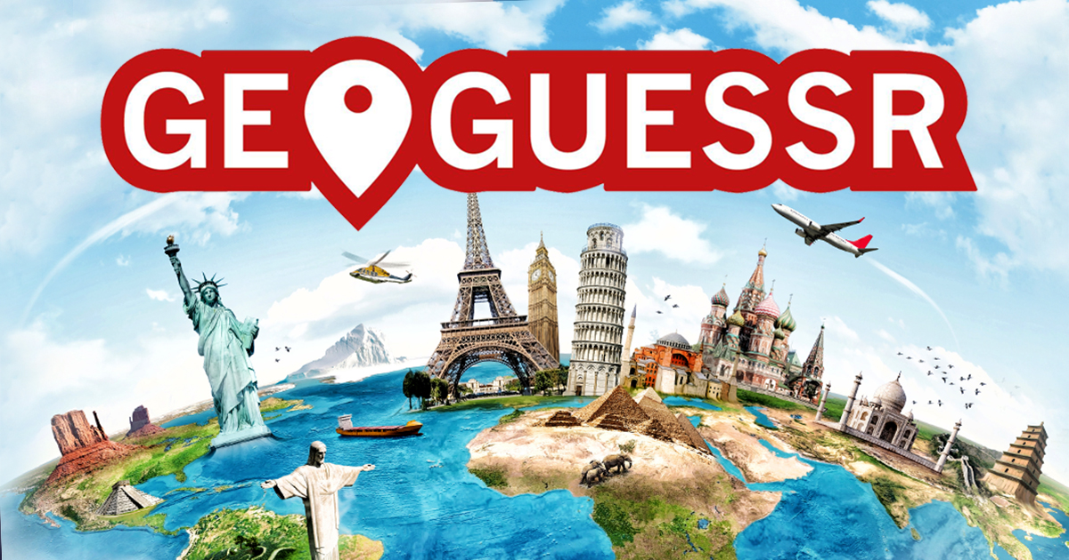
https://www.geoguessr.com/maps/5aec9bb130e010ac3087c237

Slide 39
ESL toybox
www.esltoybox.com

