Slide 1
Murder in
MANHATTAN

Slide 2
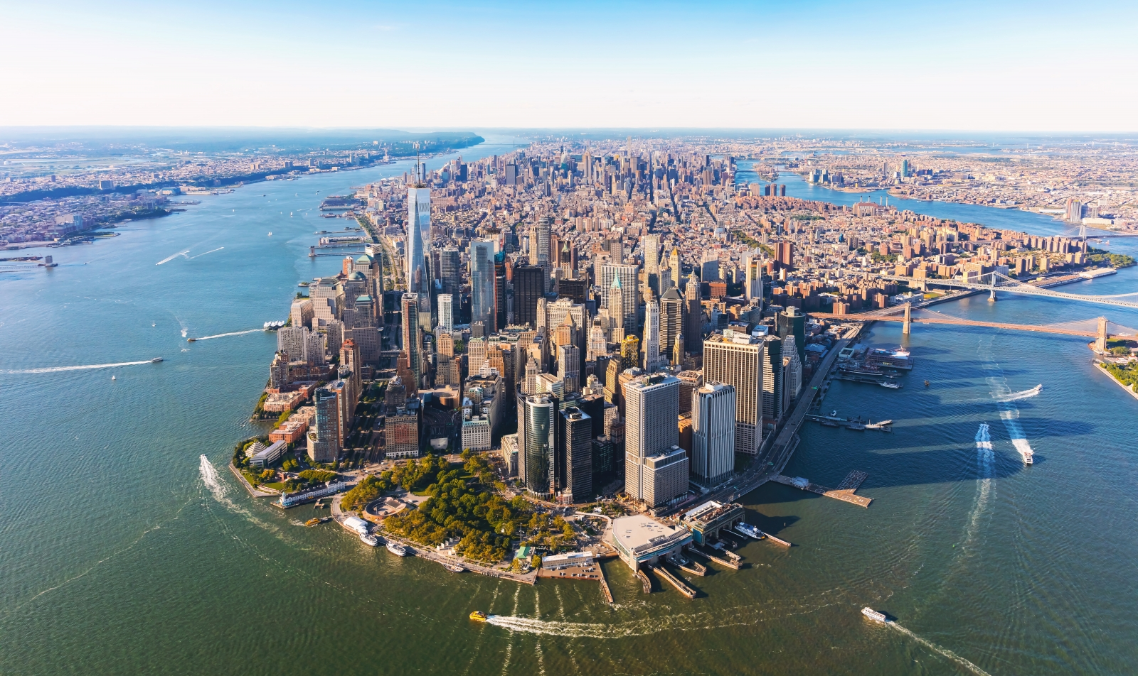

Slide 3
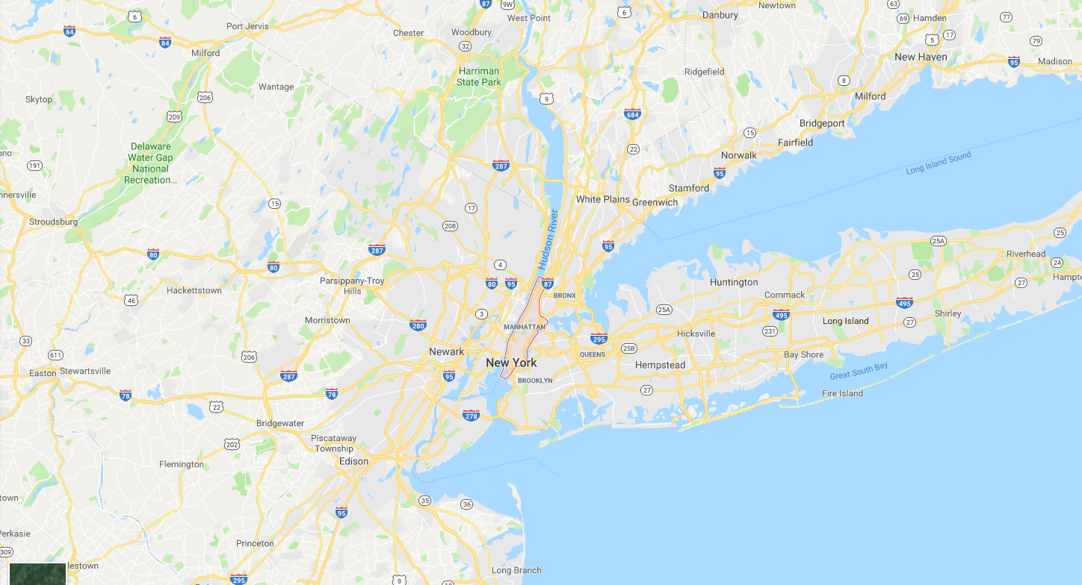

Slide 4
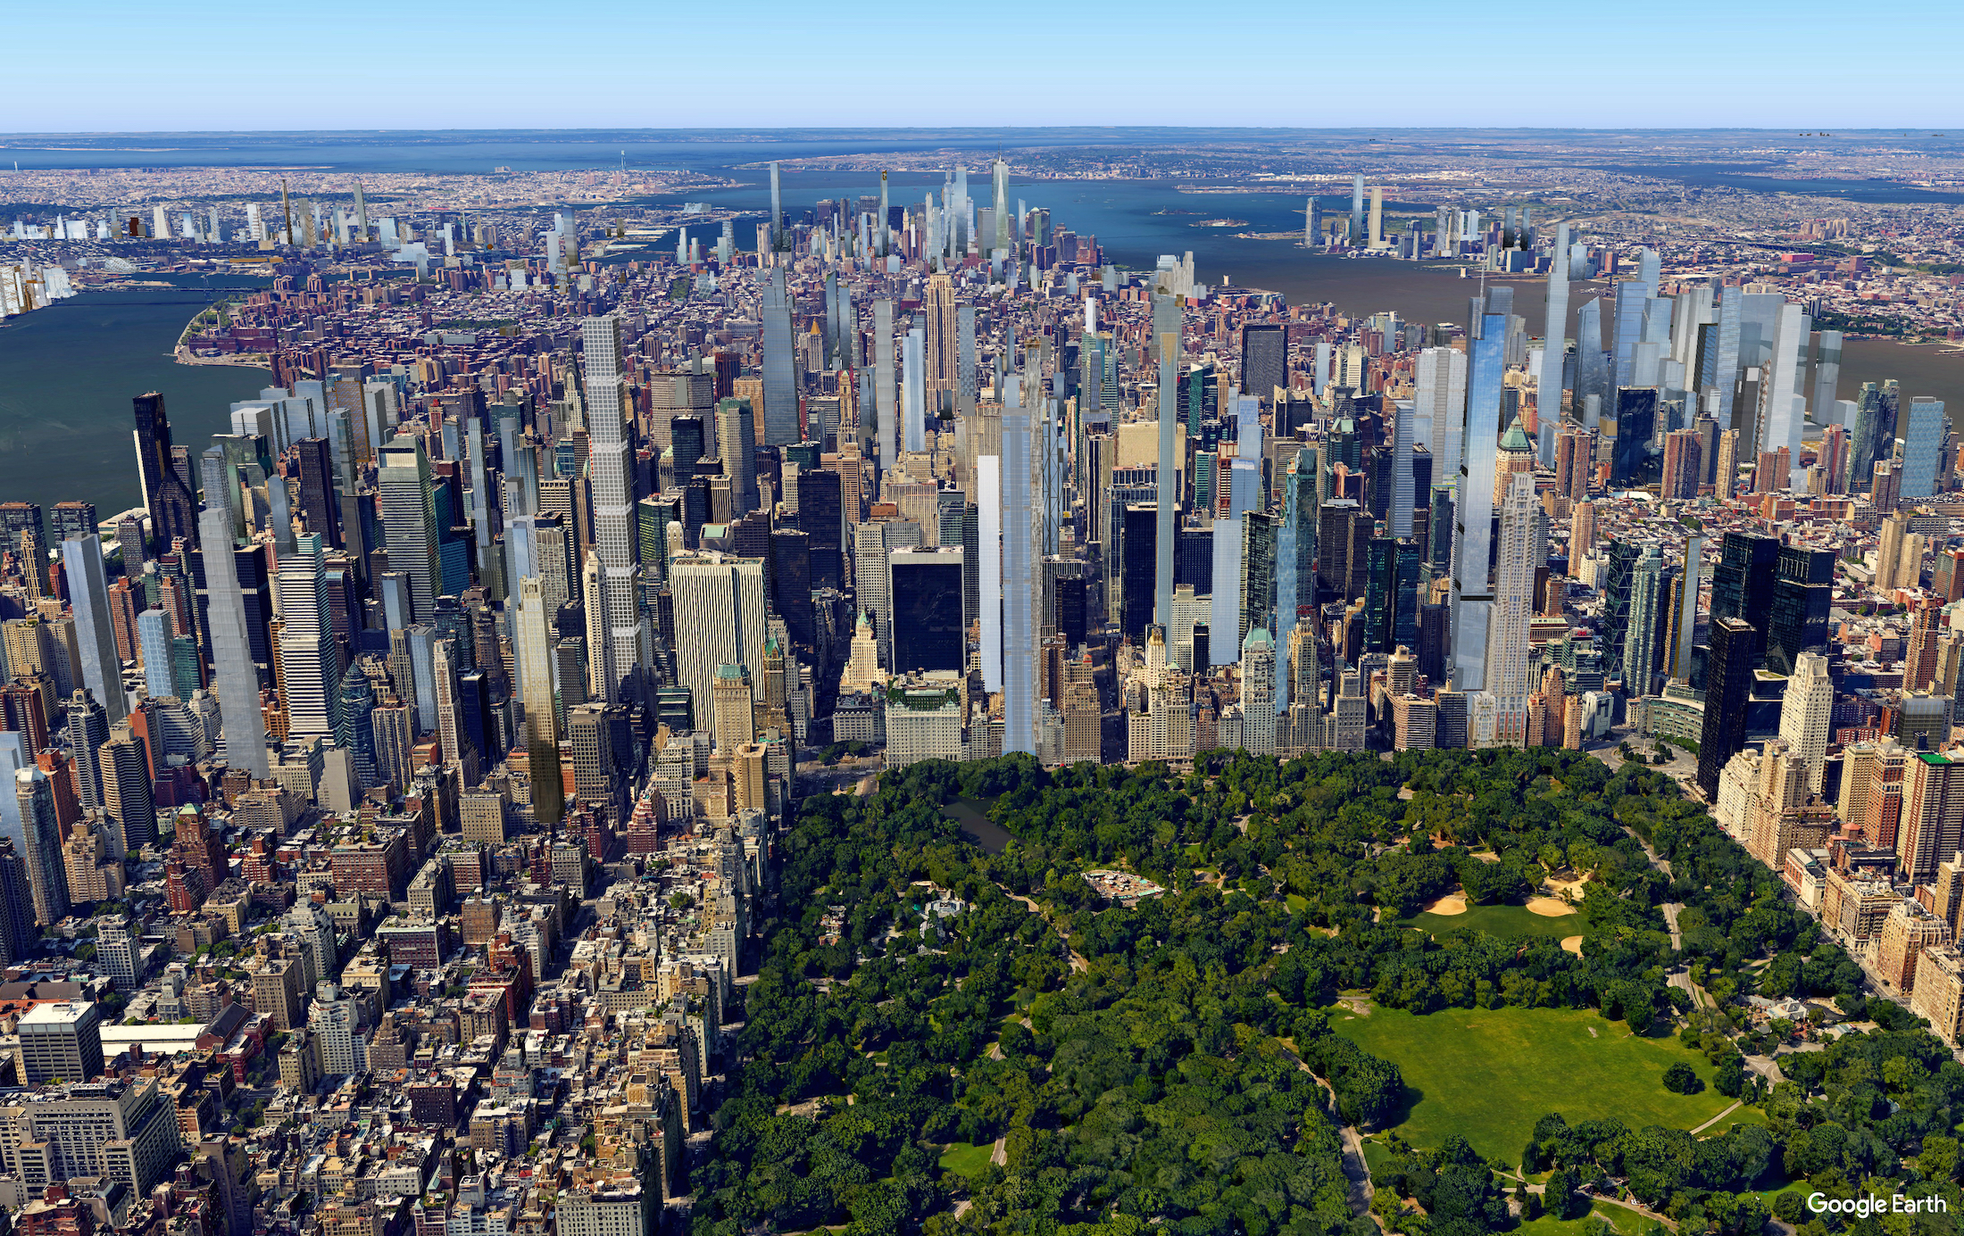
There are many popular destinations in Manhattan.

Slide 5
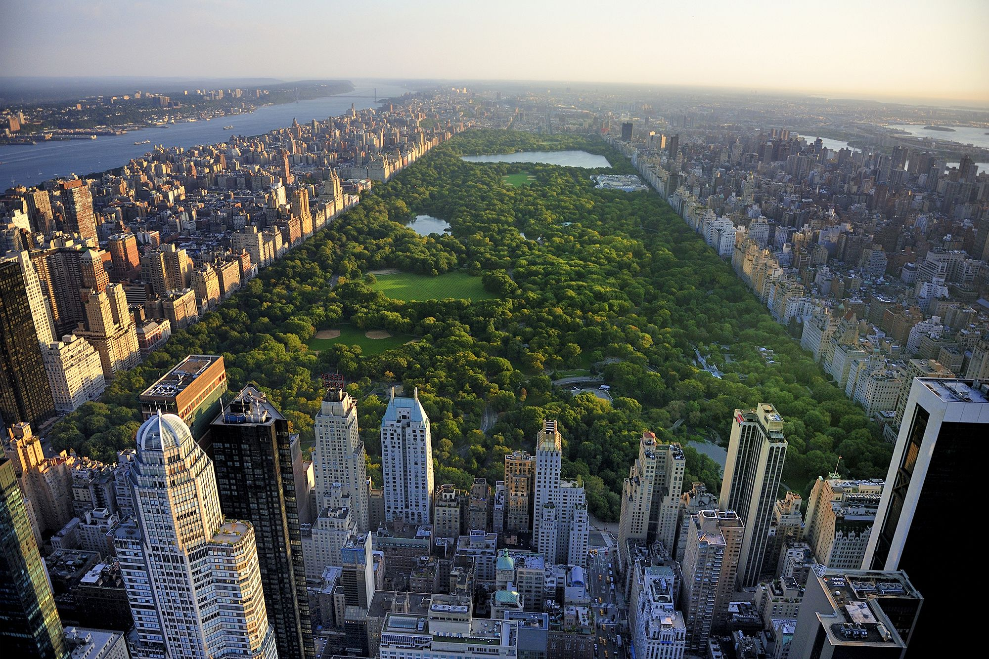

Slide 6
Central Park

Slide 7
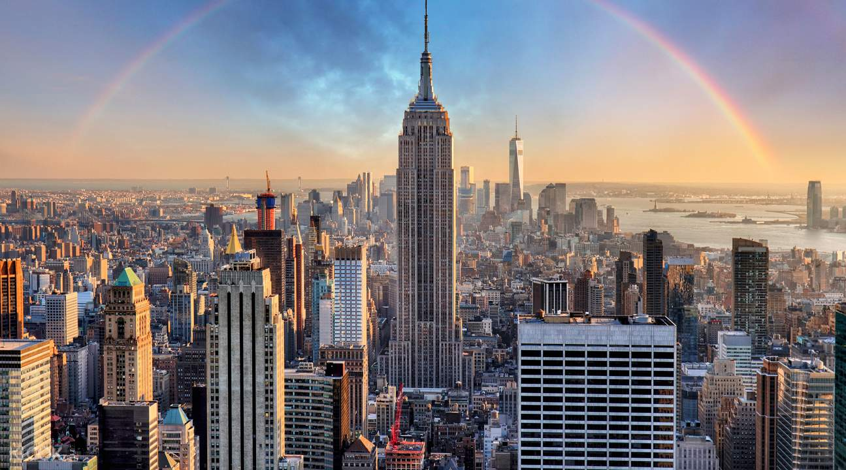

Slide 8
Empire State Building

Slide 9
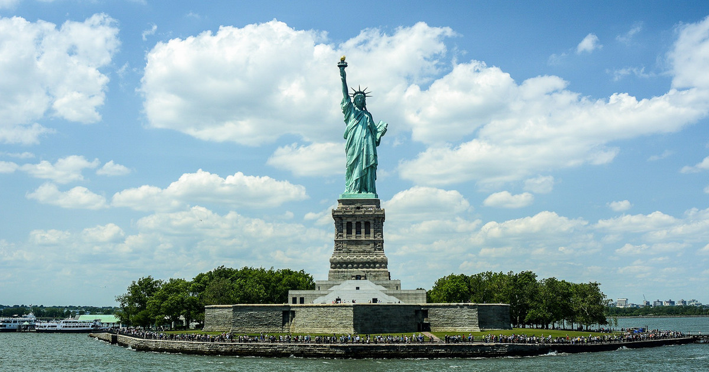

Slide 10
Statue of Liberty

Slide 11
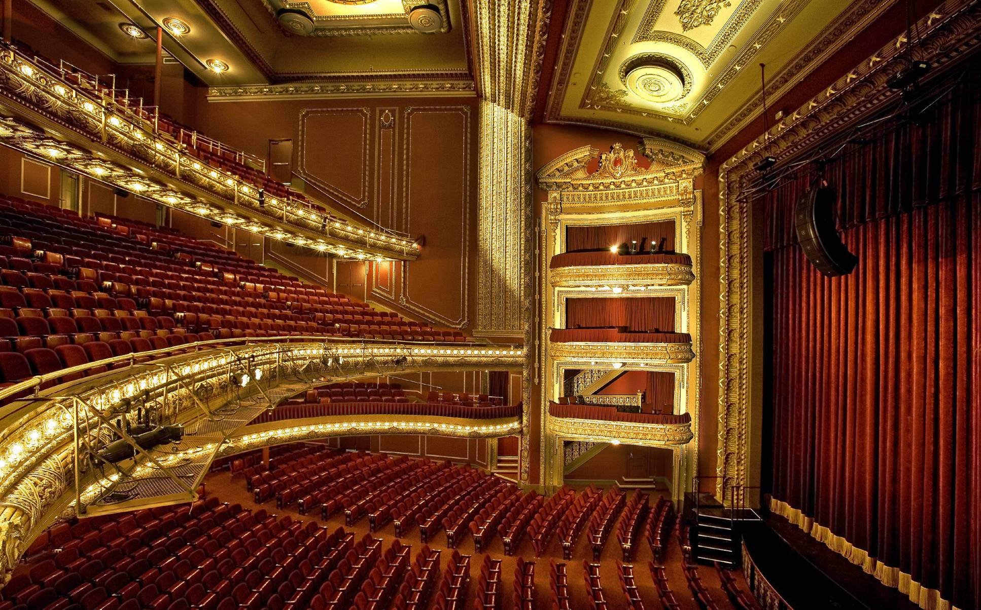

Slide 12
Broadway

Slide 13
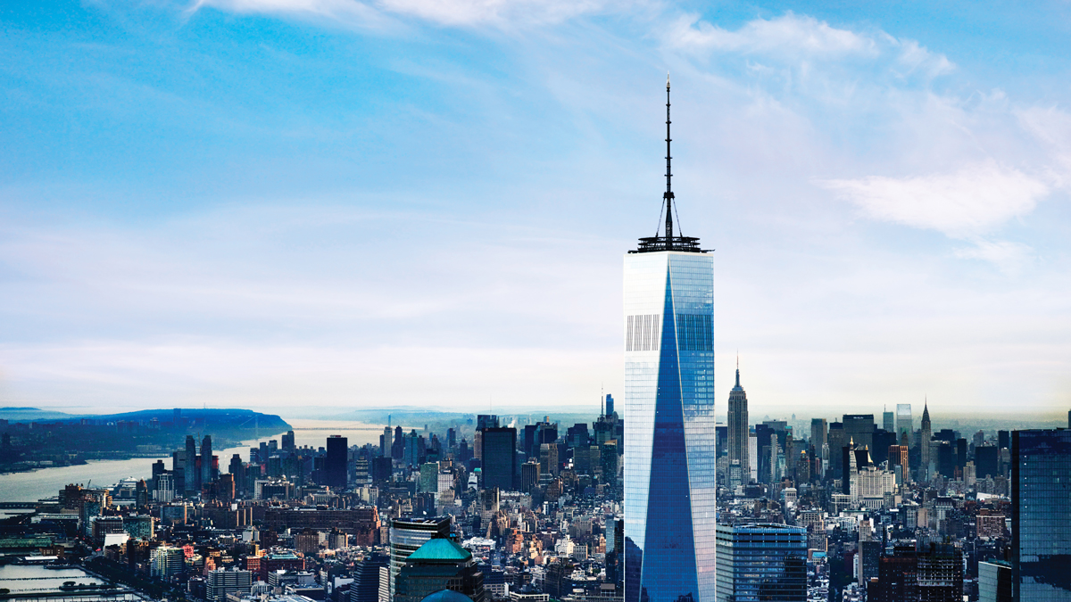

Slide 14
One Trade Center

Slide 15
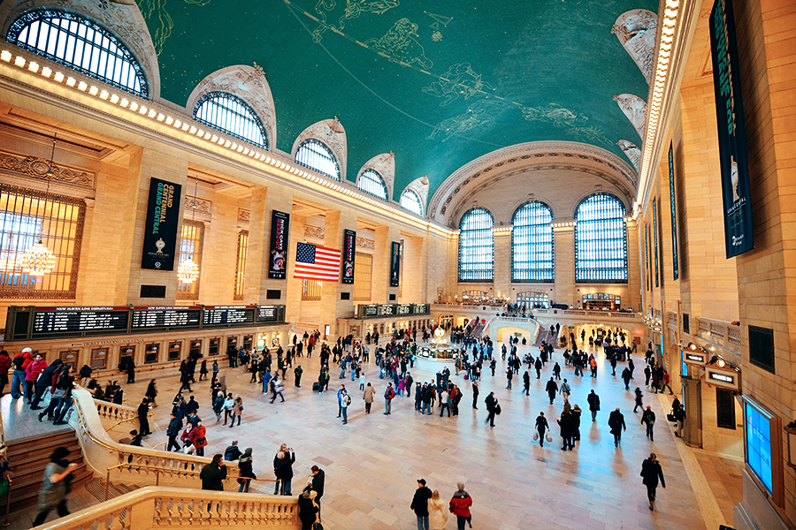

Slide 16
Grand Central Station

Slide 17
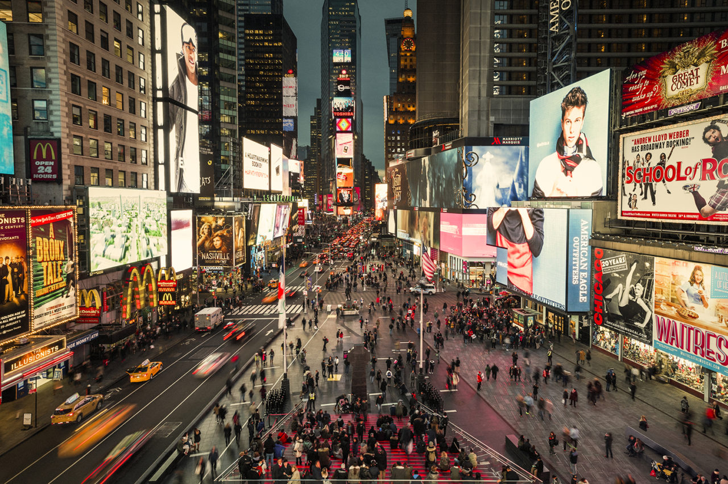

Slide 18
Times Square

Slide 19
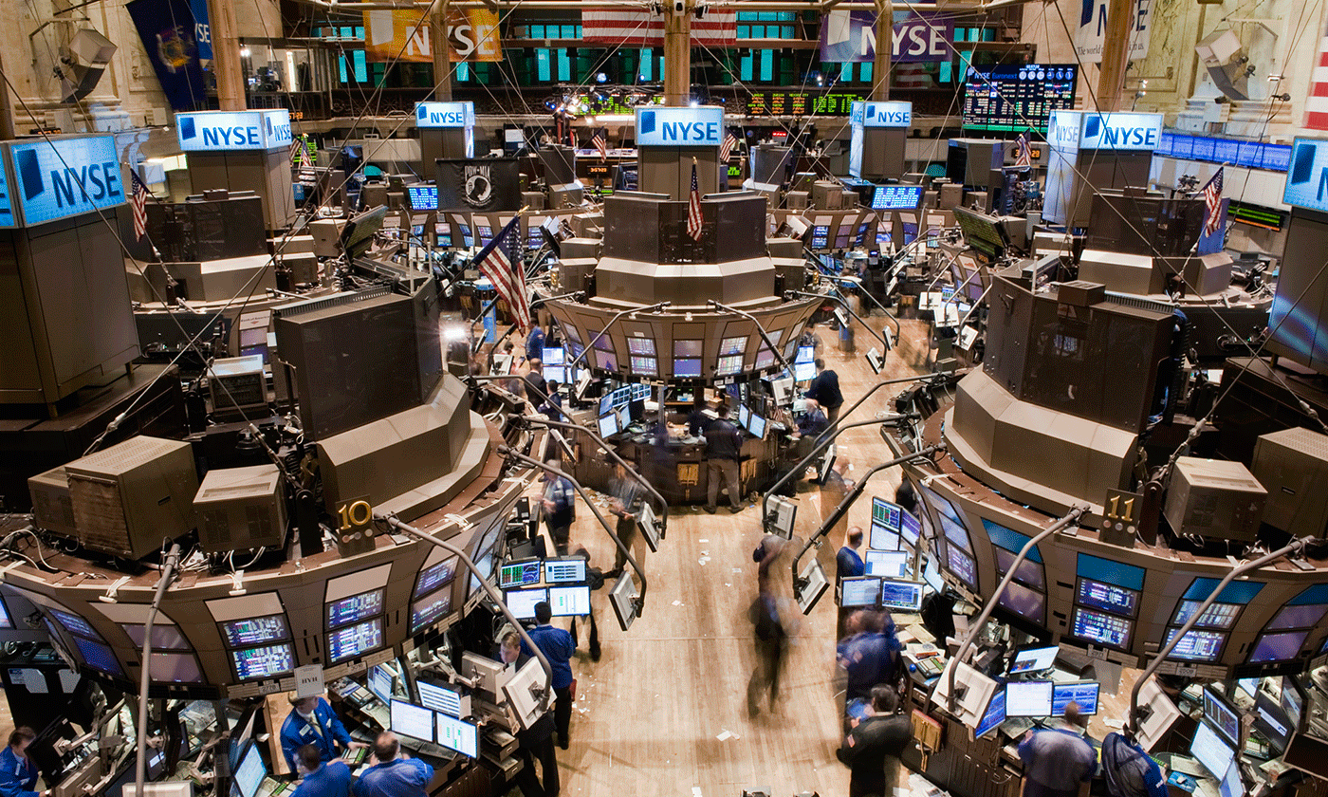

Slide 20
Wall Street (NYSE)

Slide 21
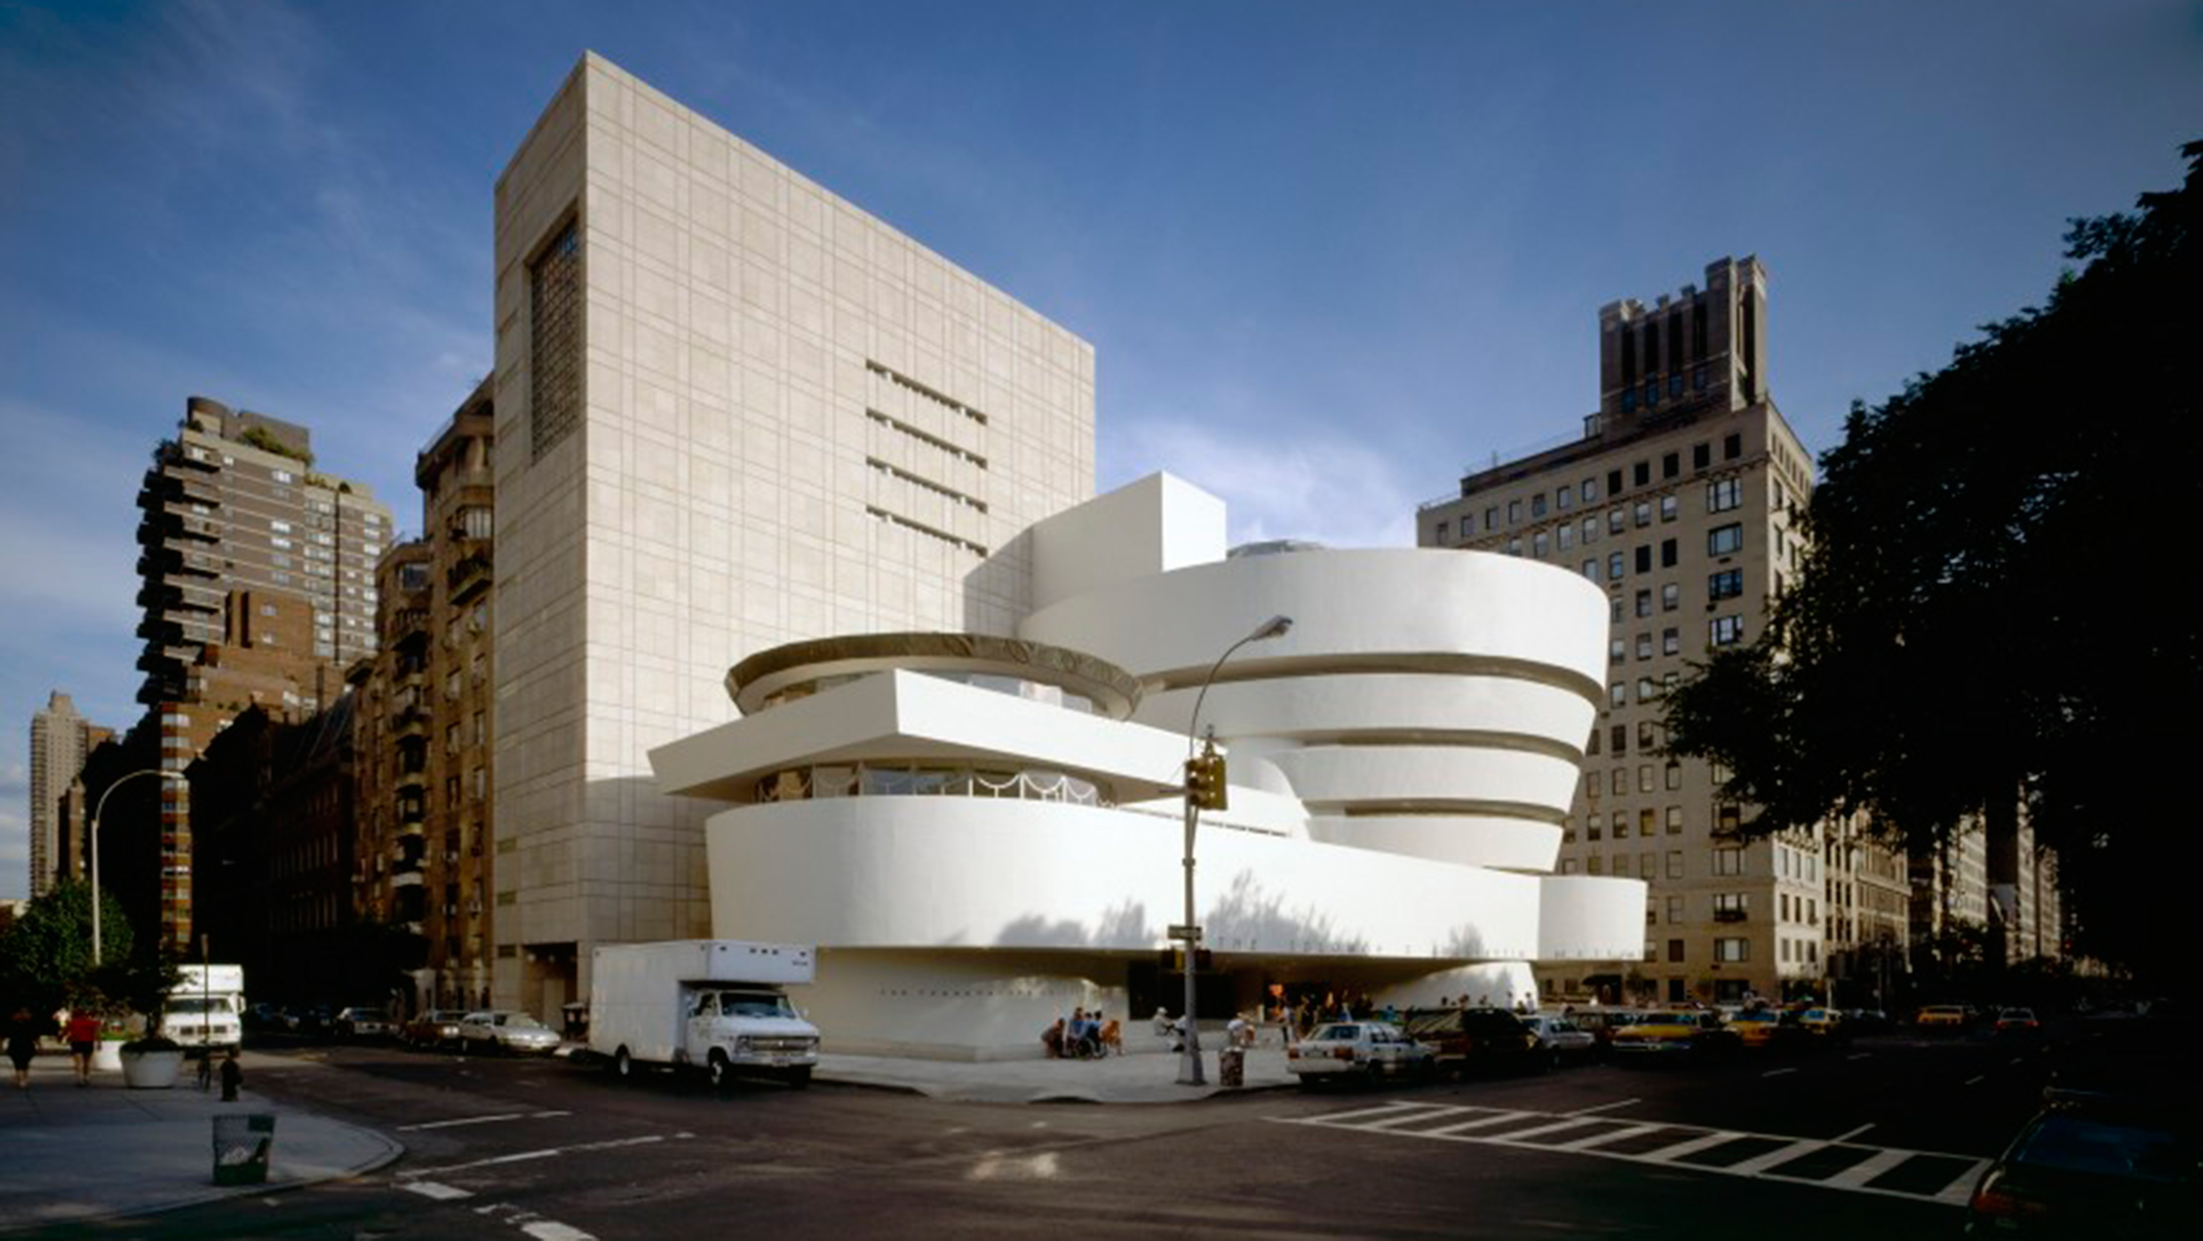

Slide 22
Guggenheim Museum

Slide 23
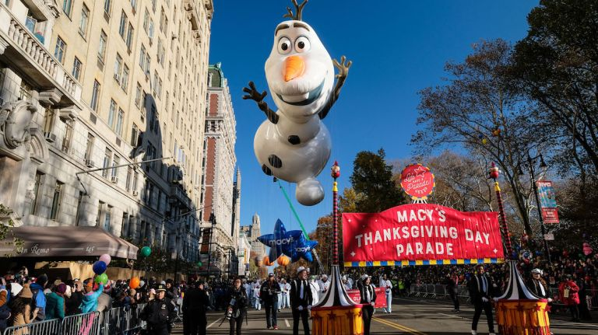
Manhattan is often described as the cultural, financial, media, and entertainment capital of the world.

Slide 24
Vocabulary

Slide 25
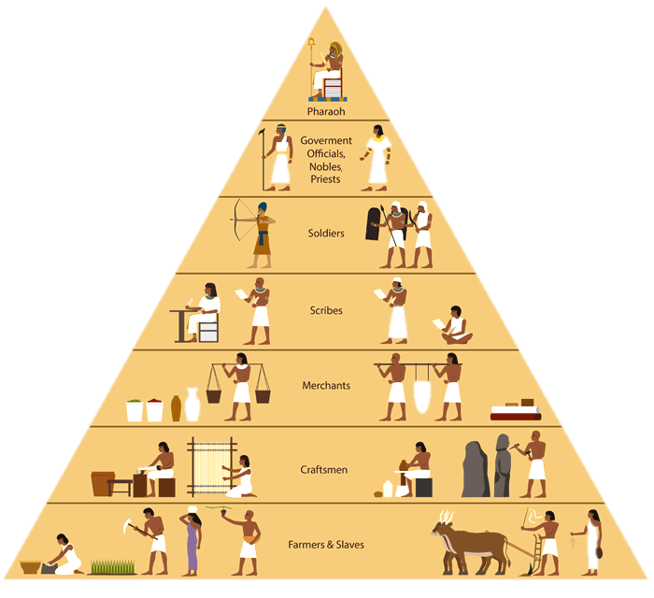
Social Status

Slide 26
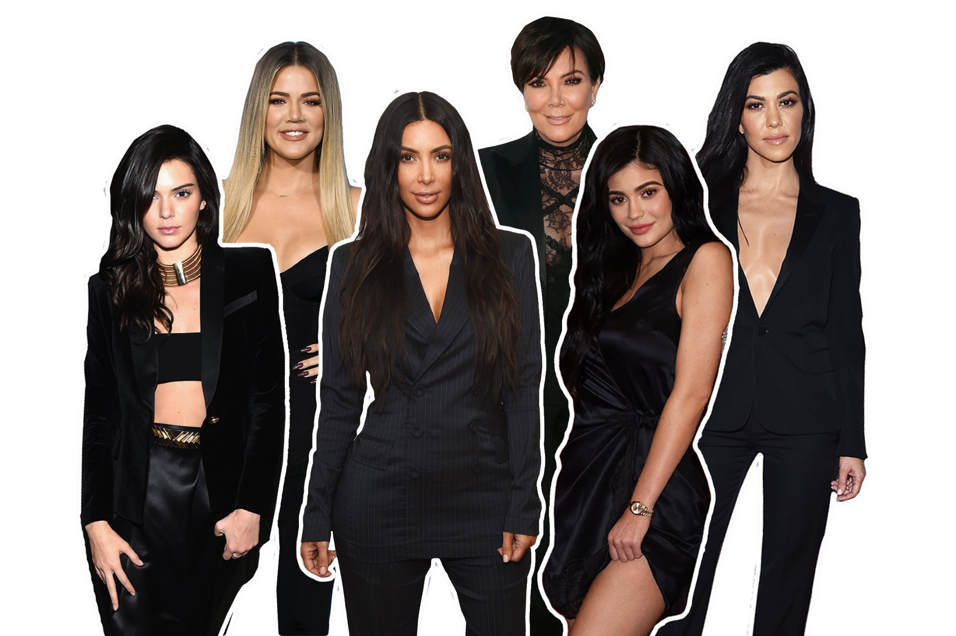
Socialites

Slide 27
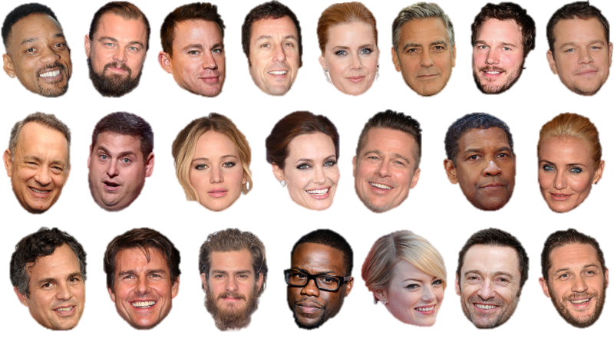
A-List Celebrity

Slide 28
Mingling

Slide 29
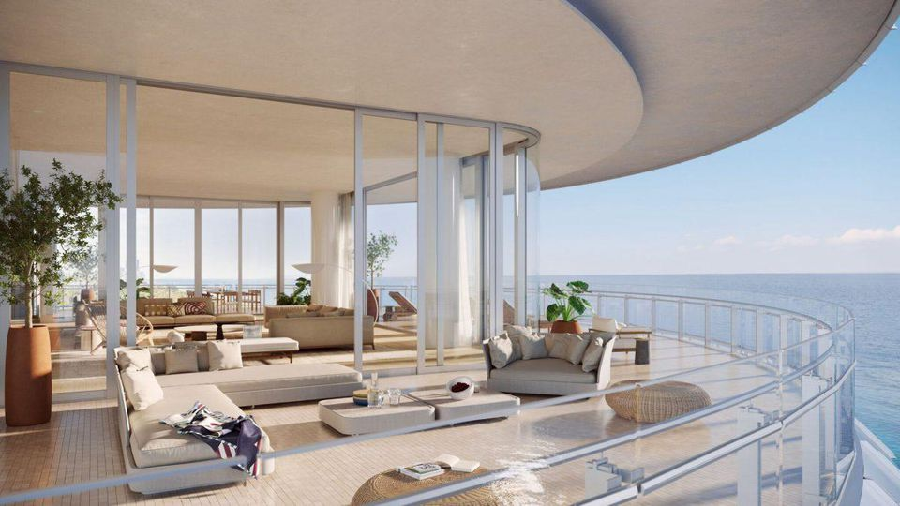
Penthouse

Slide 30
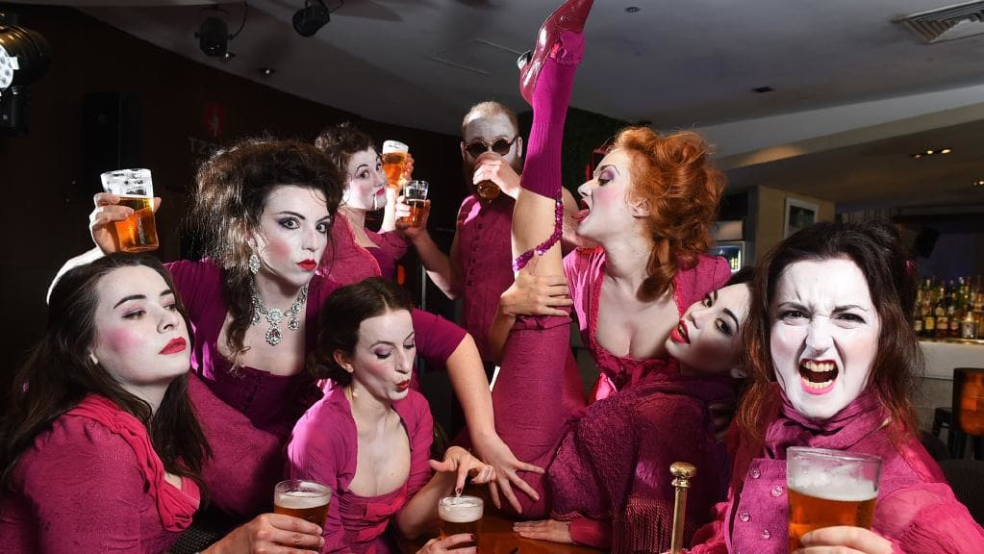
Debauchery

Slide 31
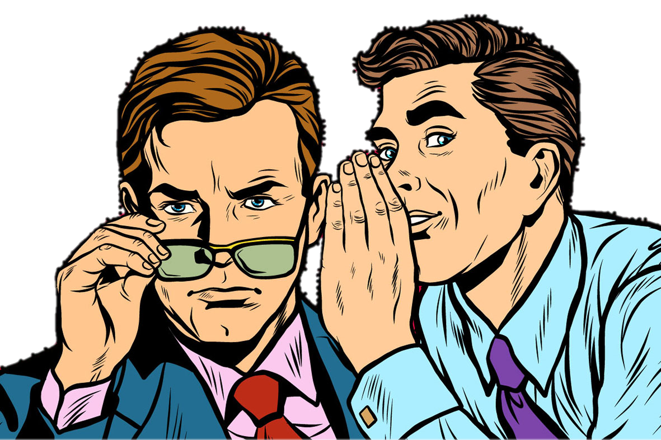
Gossip

Slide 32
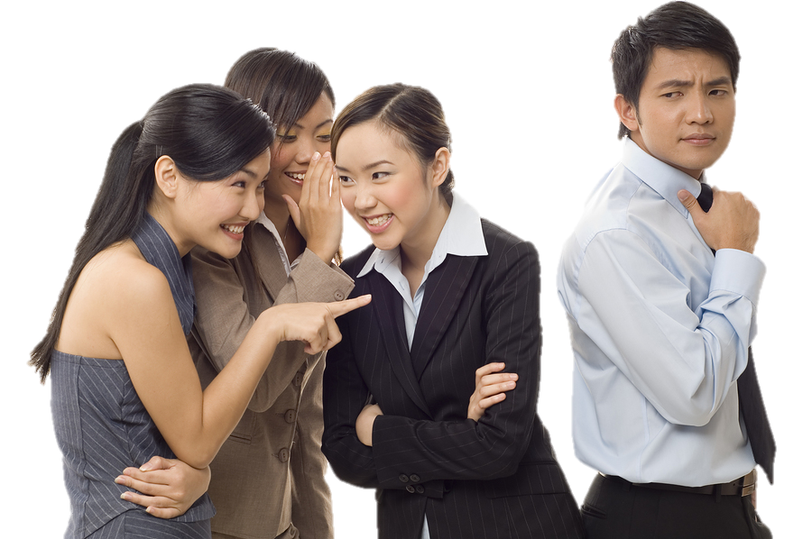
Rumor

Slide 33
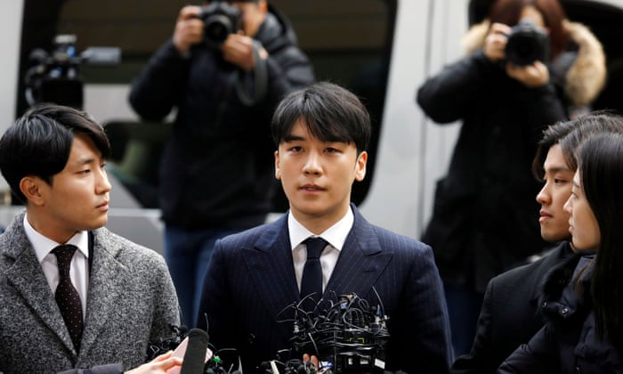
Scandal

Slide 34
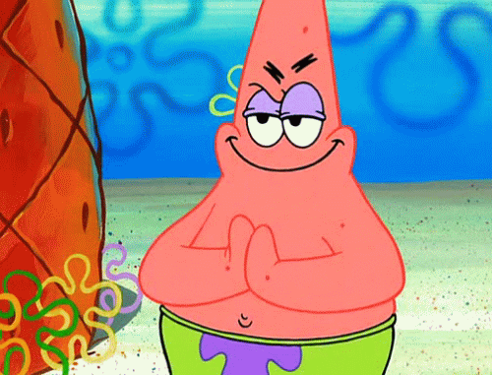
Scheming (Scheme)

Slide 35
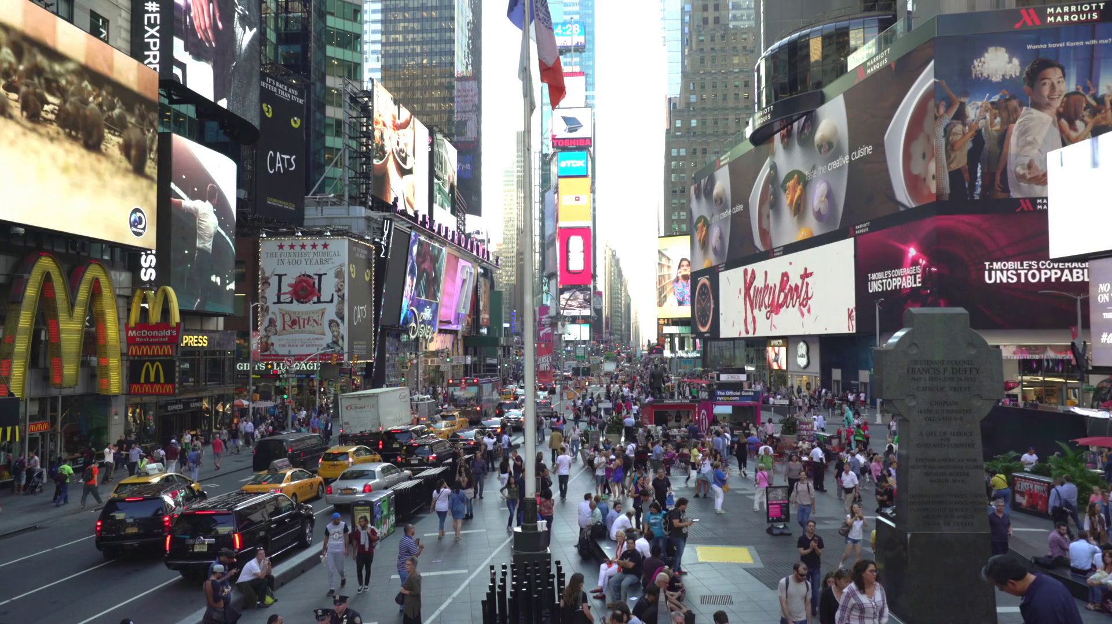
What kind of people live in Manhattan.

Slide 36
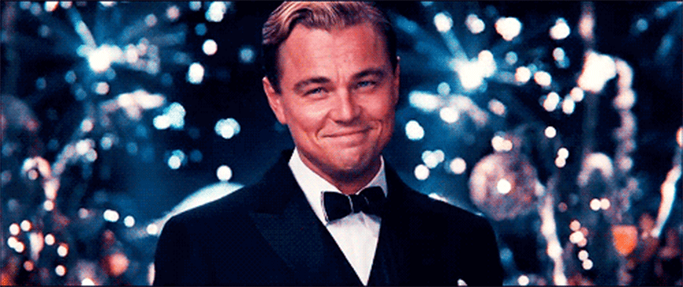

Slide 37
Welcome, everyone, and thank you for coming to Murder in Manhattan. As all of you know, this is a murder mystery party. During the party, each of you will be playing the role of a guest or employee of Francis Fisk at his party celebrating his company’s anniversary.
You will each receive a character sheet that details what your character knows and how you should act in response to specific situations (keep your secrets). Aside from these instructions, there is no particular script you need to follow; simply do your best to act as you believe your character would act.

Slide 38
During the murder mystery, I will be playing the part of Taylor Walker, one of the caterers. However, I will also be available to answer any questions about how the game works. Just let me know if you need to ask me something “out of character.”

Slide 39
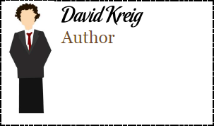
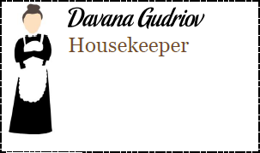
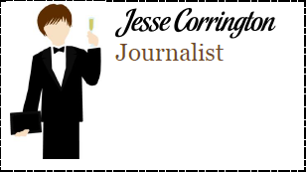
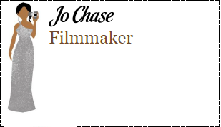
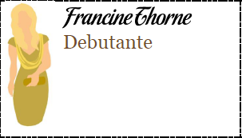
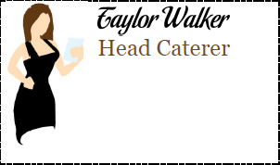
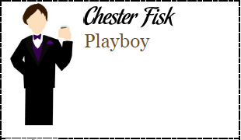
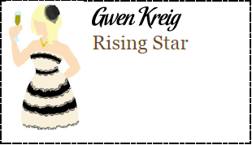
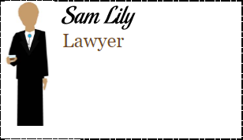
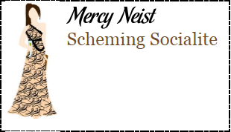
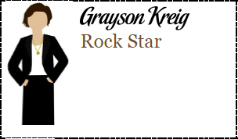
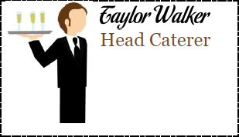
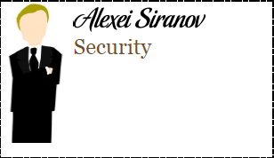
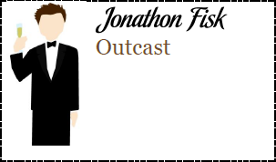
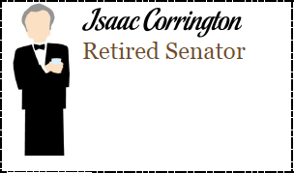
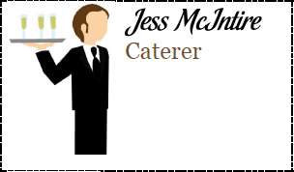
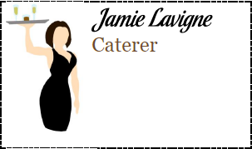
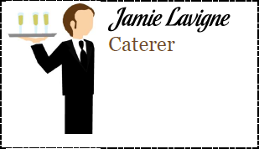
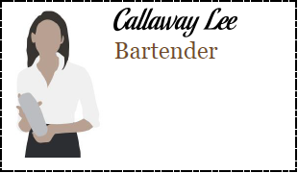
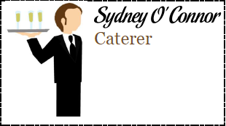
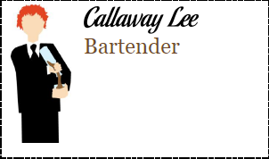
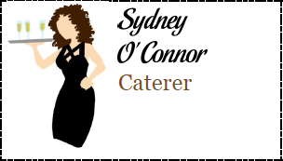
Choose a Character

Slide 40
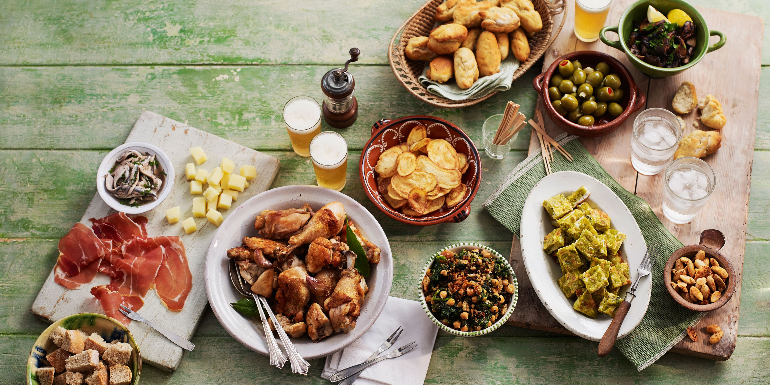
Potluck

Slide 41
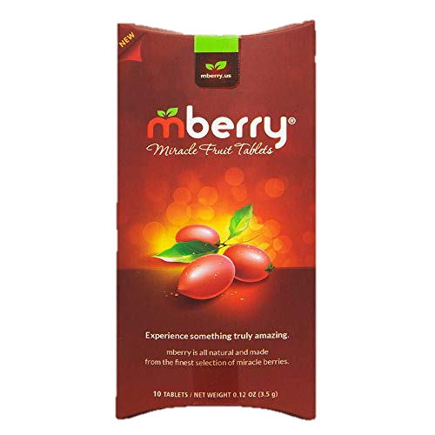
Miracle Berries
No sugars or additives
“Lemons become sweet lemonade, vinegar assumes the flavor of the apple juice, and strawberries transform into powdered sugar. Made from the finest selection of miracle berries, mberry elevates your taste experience to a level of unparalleled sweetness.”
Blocks sour and bitter flavors

Slide 42
Try miracle berries with:
rhubarb
mustard
ketchup
salt and vinegar chips
pickles
sour cream
Sumi chips
hot sauce
balsamic vinegar
BBQ sauce
Stout beer
Generic Tequila
Goat cheese
Blue Cheese
salsa
Lemon
Lime
Orange
Tomatoes
cranberries?
Grapefruit
kiwi
pineapple
apples
strawberries
pomegranate
raspberries
grapes
watermelon
blackberries

Slide 43
Your goal during the dinner is to get to know the other characters. Introduce yourselves, exchange backgrounds, and trade gossip. You should find there are some interesting secrets in the room - maybe even a secret or two for which one would kill. This means that you should pay special attention whenever you feel that a guest has something to hide. Even more importantly, make sure to protect your own secrets; you don’t want people drawing any unfavorable conclusions about you. Not in this prestigious crowd.

Slide 44
Each character sheet includes Gossip & Objectives pages that detail what you know about the other guests (secret). Check your sheet before you start a conversation so you know with whom you’re dealing.

Slide 45
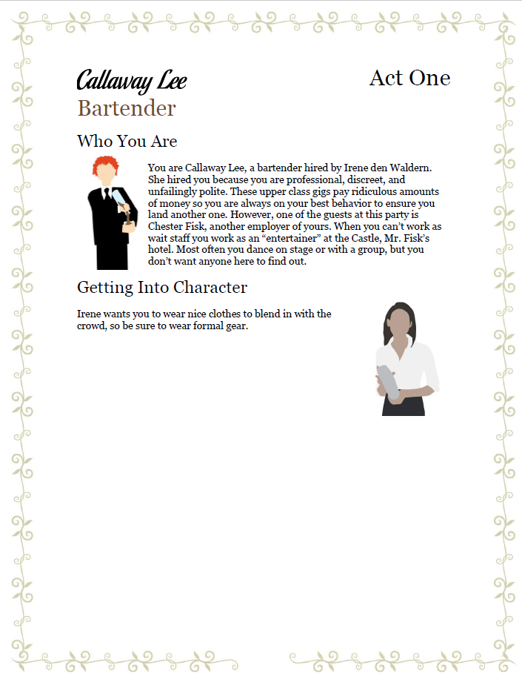
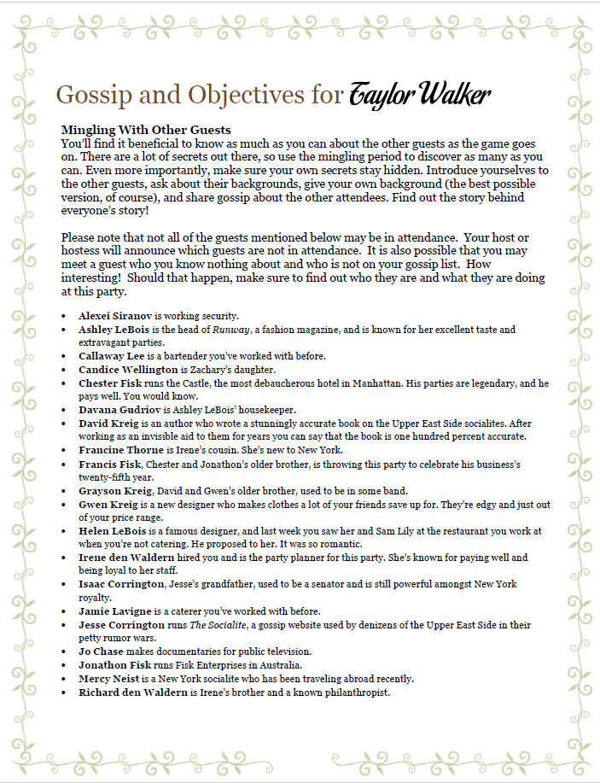

Slide 46
Please note: Some of the characters will not be coming to the party. I have crossed out those characters.
You may hear these names in your conversations, but you will not be interacting directly with those characters today.

Slide 47
Please, read over your character sheets and make sure you understand everything. Remember not to show your character sheets to anyone else and to be careful with what information you end up sharing with other players. Most of you have secret information listed on your sheet your character wouldn’t want to disclose to just anyone. Please take a minute to read over your character sheets now.

Slide 48
Awards
Best Dressed
Best Actor

Slide 51
What to bring:
Food
Character Sheet
Costume
Empty stomach

