Slide 1
Rhetoric
Modes of Persuasion

Slide 2
Talking with Emotion
Answer typical interview questions
but with a condition
Guess the condition

Slide 4
ETHOS
ETHICS
The appearance of credibility / authority

Slide 5
Ethos
“Character”

Slide 6
LOGOS
LOGIC
The appearance of logic / reason.

Slide 7
Logos
“Word”

Slide 8
PATHOLOGY
EMPATHY
SYMPATHY
PATHOS
An emotional persuasion.

Slide 9
Pathos
“Suffering”
“Experience”

Slide 11
Hearts over Heads
Emotional Speech
More convincing than Logos or Ethos.

Slide 12
Audience Emotions
Make the audience feel it.
Not always the speaker’s emotion.

Slide 13
Word Choice

Slide 15
Emotionally Charged Words
Mind Map
Sad
Happy
Angry
etc.

Slide 17
Emotionally Charged Words
Words that elicit a response.
Metaphors / Similes

Slide 18
Tone

Slide 19
Speaking without Words
Use:
ONLY tone of your voice / hand gestures
Guess what they are saying.

Slide 20
Stories

Slide 21
Stories
Caught up in the narrative.
The social condition

Slide 23
Body Language
Adds expression

Slide 24
Story telling
Read a story.
Add emotions / gestures

Slide 25
Vivid Language
Rhetorical Devices
Quotations

Slide 27
Humor
Calms people down
Personality
Common Ground

Slide 29
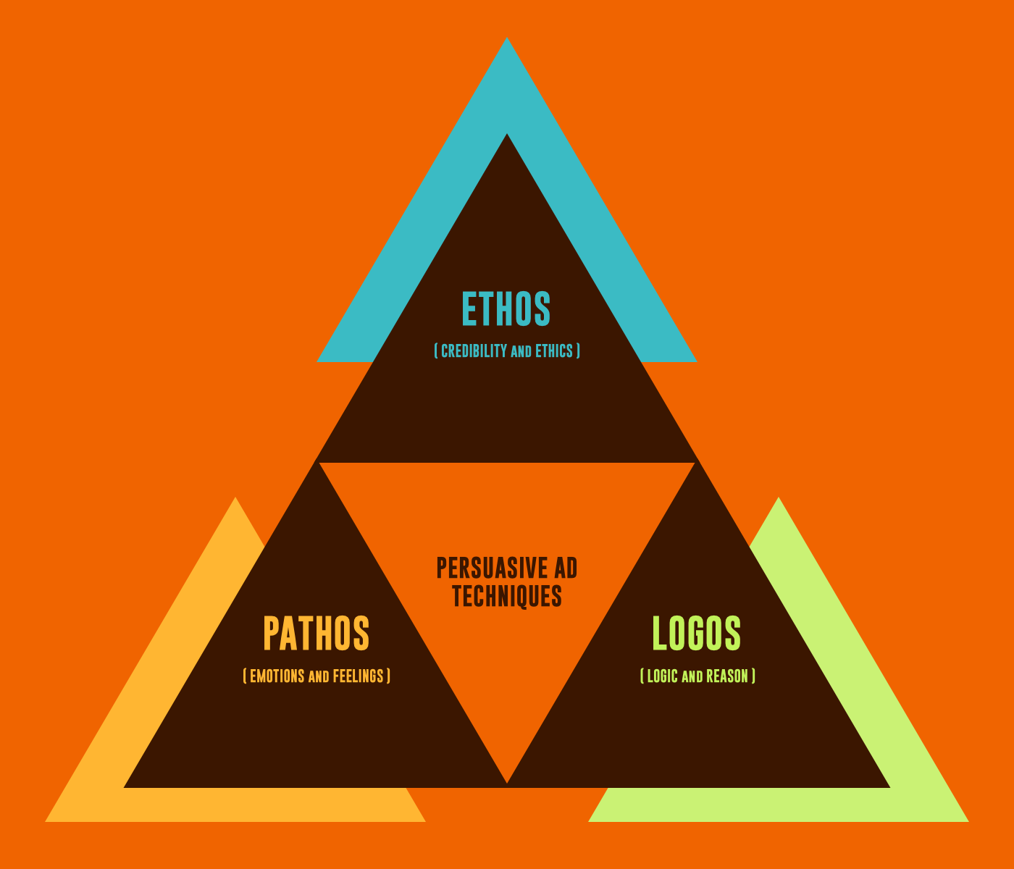

Slide 30
Language of Cancer
https://www.medpagetoday.com/special-reports/apatientsjourney/79229

Slide 31
ESL toybox
www.esltoybox.com

Slide 32
Awestruck: Surprising facts about why we fall for charismatic leaders | Jochen Menges | TEDxUHasselt
https://www.youtube.com/watch?v=qpCnR7BOS0I
I Have Cancer. Please Don't Call Me a 'Survivor'
https://www.medpagetoday.com/special-reports/apatientsjourney/79229
English Speech | Mohammed Qahtani: The Power of Words (English Subtitles)
https://www.youtube.com/watch?v=xwbI8VOsDTo
Ethos, Pathos & Logos: How to Use Persuasive Ad Techniques
https://www.youtube.com/watch?v=lmR58_dqLxY

