Slide 1
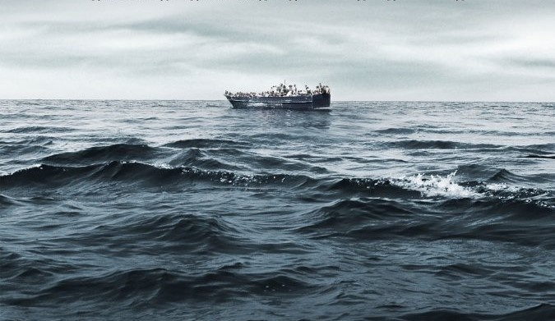
LOST
at
SEA

Slide 2
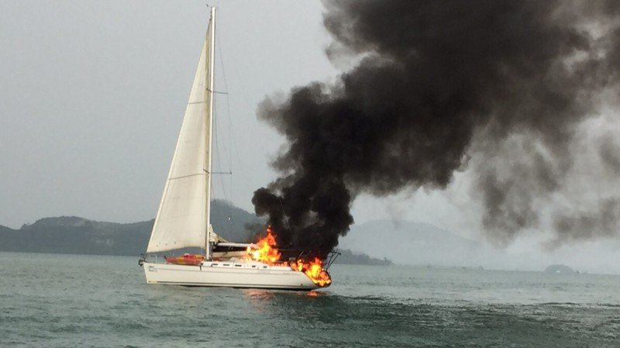
You have chartered a yacht with three friends, for the holiday trip of a lifetime across the Atlantic Ocean. Because none of you have any previous sailing experience, you have hired an experienced skipper and two-person crew.

Slide 3
Unfortunately in the mid-Atlantic a fierce fire breaks out in the ships galley and the skipper and crew have been lost whilst trying to fight the blaze. Much of the yacht is destroyed and is slowly sinking.

Slide 4
Your location is unclear because vital navigational and radio equipment have been damaged in the fire. Your best estimate is that you are hundreds of miles from the nearest landfall.

Slide 5
You and your friends have managed to save 15 items, undamaged and intact after the fire. In addition, you have salvaged a four-man rubber life craft and a box of matches.

Slide 6
Your task is to rank the 15 items in terms of their importance for you, as you wait to be rescued. Place the number 1 by the most important item, the number 2 by the second most important and so forth until you have ranked all 15 items.

Slide 7
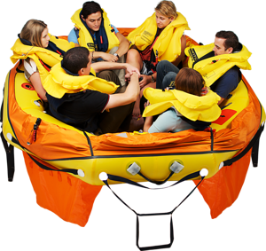
LOST AT SEA
Rank the items by most important
Individually
As a group
Check Answers

Slide 8
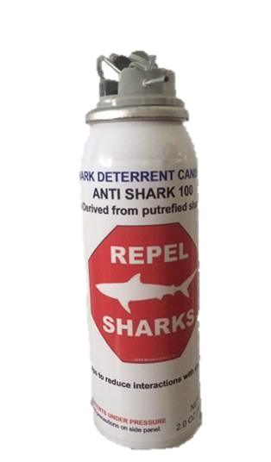
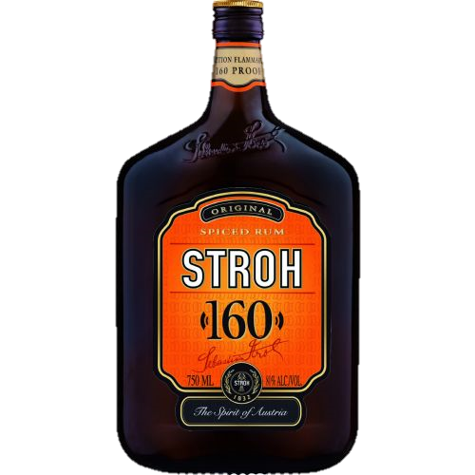
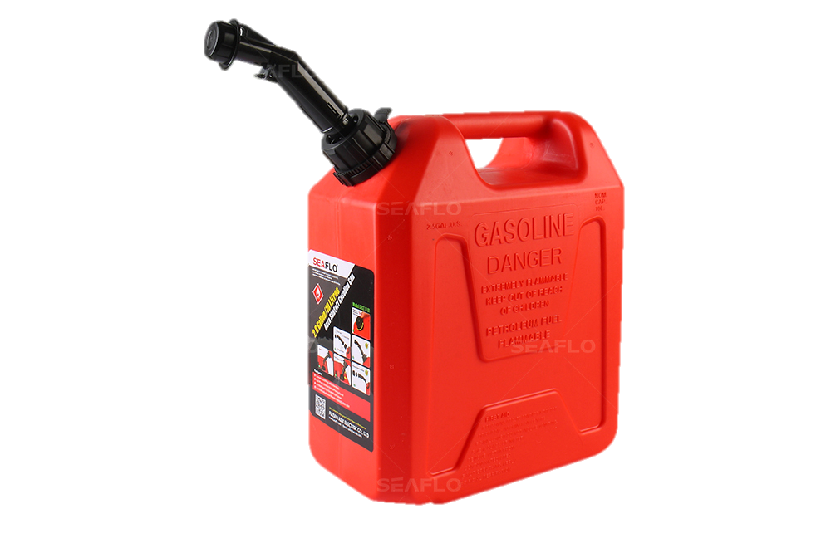
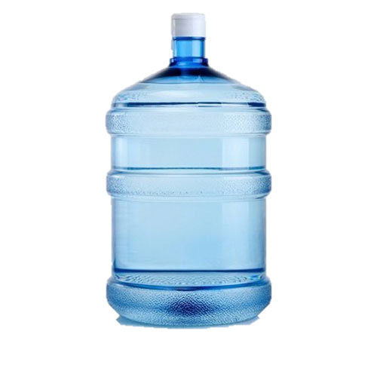
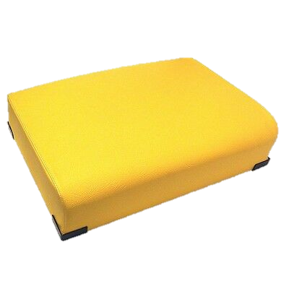
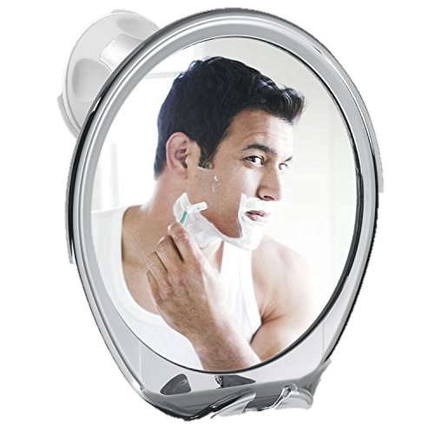
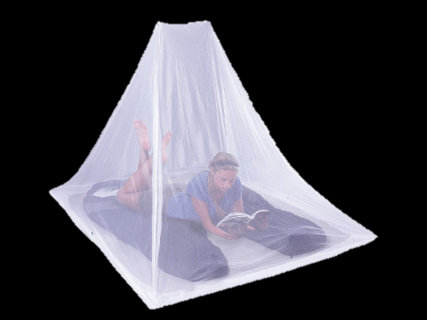
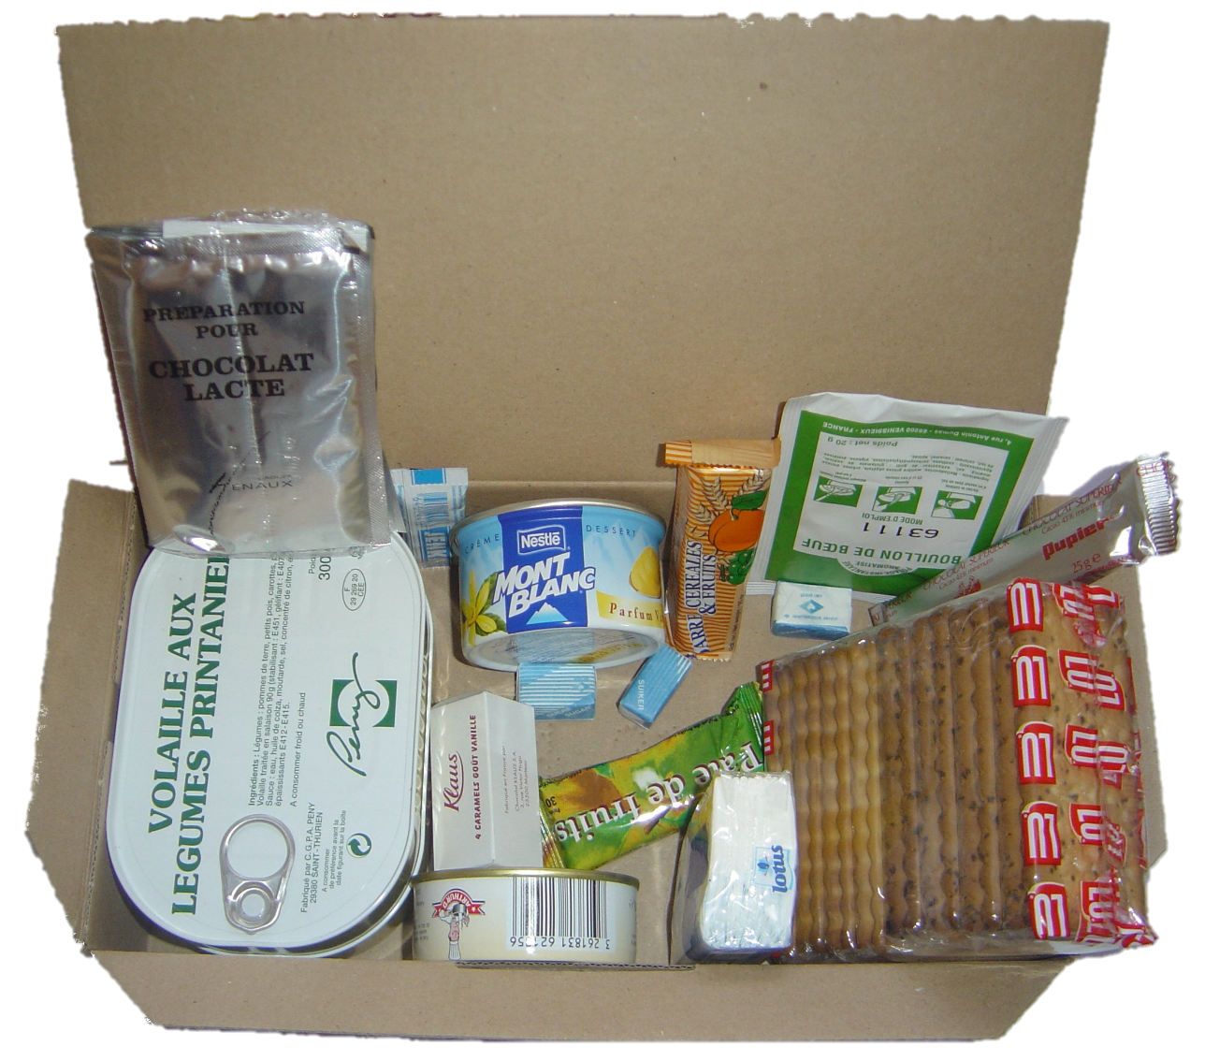
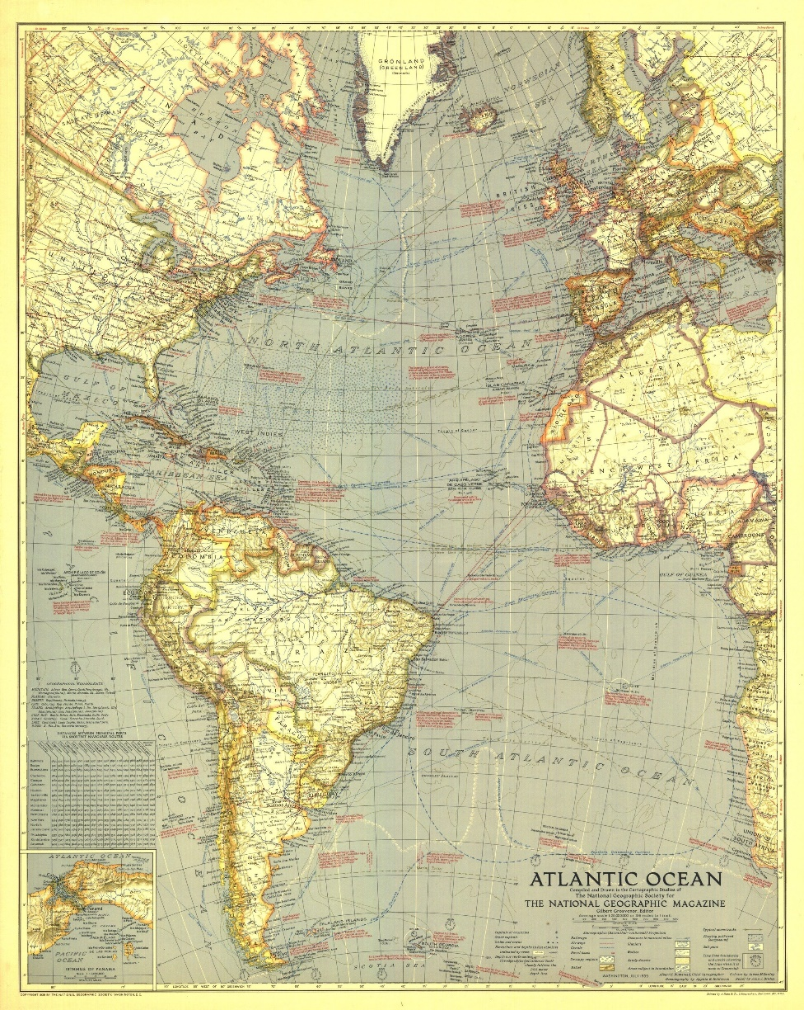
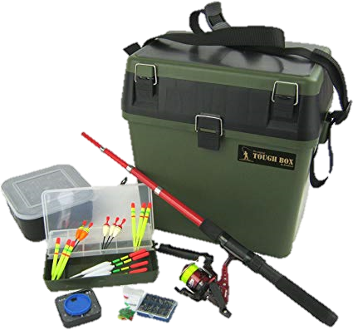
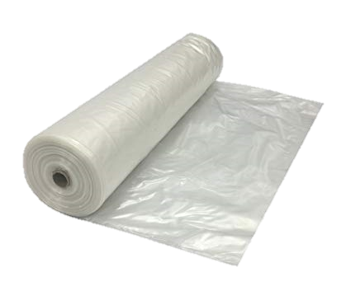
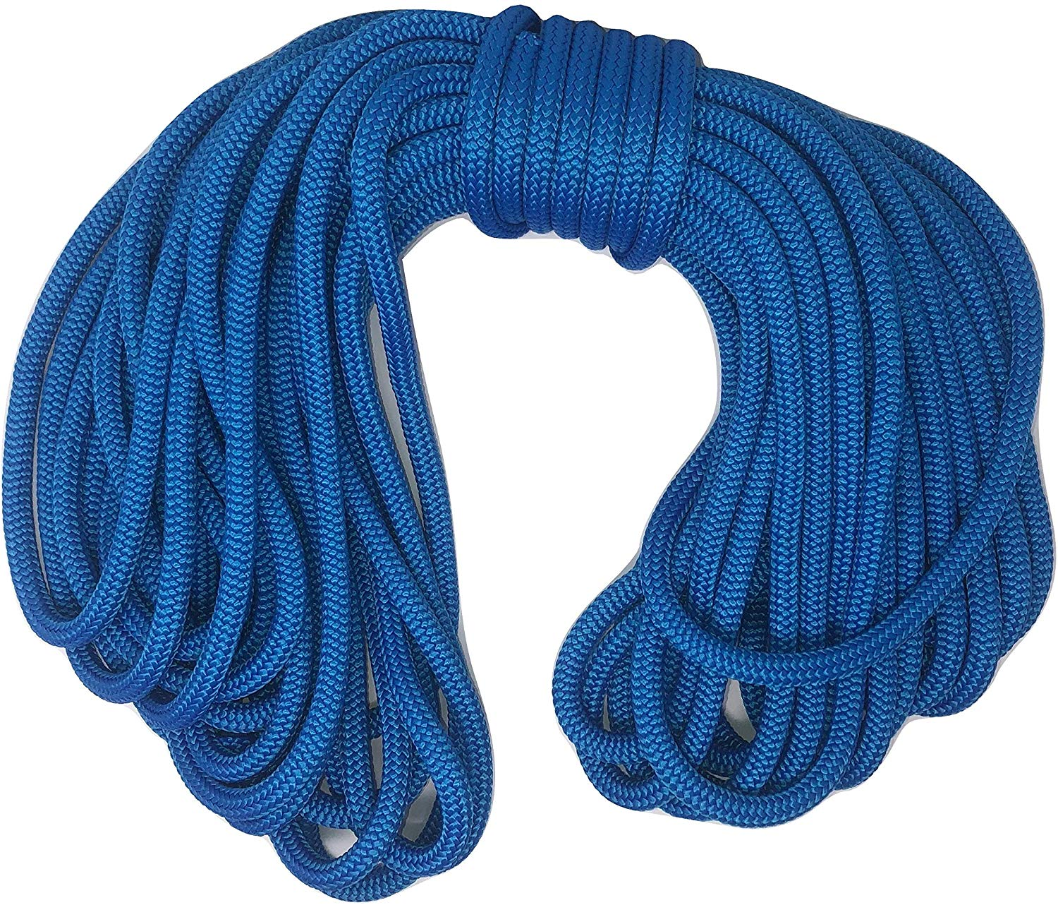
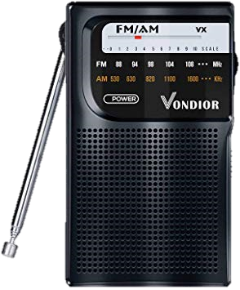
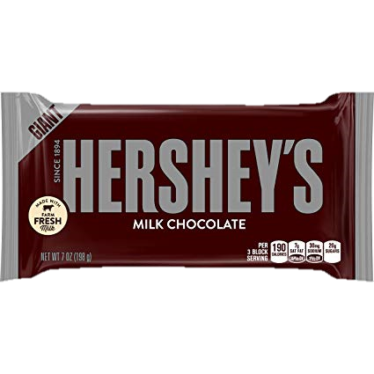
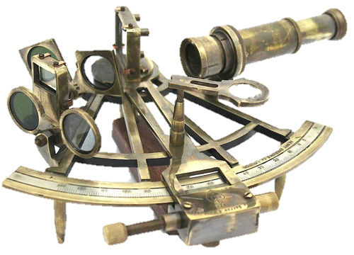
LOST AT SEA
Rank the items by most important:
Individually
As a group

Slide 9
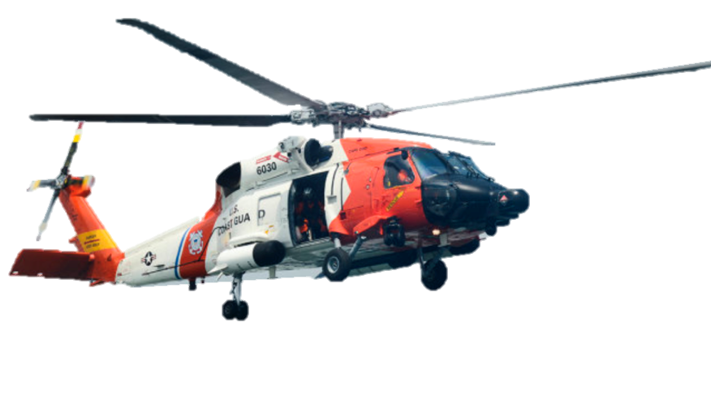
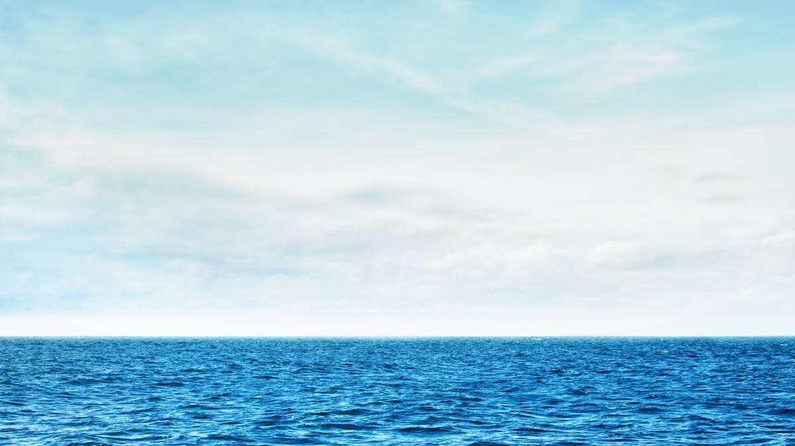
Coast Guard Analysis

Slide 10
1
SHAVING MIRROR
Use the sun to create a signal.

Slide 11
2
Can of Oil/Gas
It can float on water and be ignited (signal).

Slide 12
3
25L of Water
It is enough for several days.

Slide 13
4
Army Rations
This is your basic food intake.

Slide 14
5
Plastic Sheeting
Can be used to collect rain water and make a shelter.

Slide 15
6
2 chocolate bars
Reserve food supply.

Slide 16
7
Fishing Kit
No guarantee that you can catch fish.

Slide 17
8
Nylon Rope
Connect people, or equipment to prevent losing them

Slide 18
9
Floating cushion
Useful as a life preserver if someone falls overboard.

Slide 19
10
Shark repellent
Repel sharks

Slide 20
11
160% Rum
Antiseptic to treat wounds. Dangerous if drunk because of dehydration.

Slide 21
12
Transistor radio
It would be out of range of any radio station.

Slide 22
13
Map of Atlantic
Worthless without navigation equipment.

Slide 23
14
Mosquito netting
There are no mosquitos in the middle of the ocean.

Slide 24
15
Sextant
Useless without relevant charts and a chronometer.

Slide 25
total

Slide 26
0
to
25
Excellent
You demonstrated great survival skills.
Rescued!

Slide 27
26
to
32
Good
Above average results. Good survival Skills.
Rescued!

Slide 28
33
to
45
AVERAGE
Seasick, hungry and tired.
Rescued.

Slide 29
46
to
55
Fair
Dehydrated and barely alive.
It was tough, but rescued.

Slide 30
56
to
70
Poor
Rescued, but just in time!

Slide 31
Very poor
I have some bad news…
You empty raft was washed up on the beach.
No one was found.
71+

Slide 33
ESL toybox
www.esltoybox.com

