Slide 1
Movie Genres

Slide 2
Today
Learn movie genres
Play a game

Slide 3
The Dark Knight
Jurassic World
My favorite movies are ___________________ and ____________________.

Slide 4
What is your favorite movie?
My favorite movies
are ___________________ and ____________________.
I don’t have a favorite movie.

Slide 5
Genre
type of movie

Slide 6
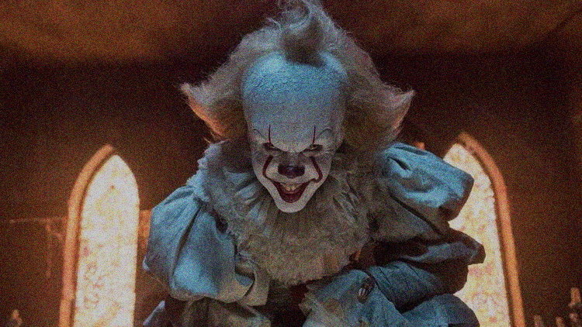
Scary
Horror

Slide 7
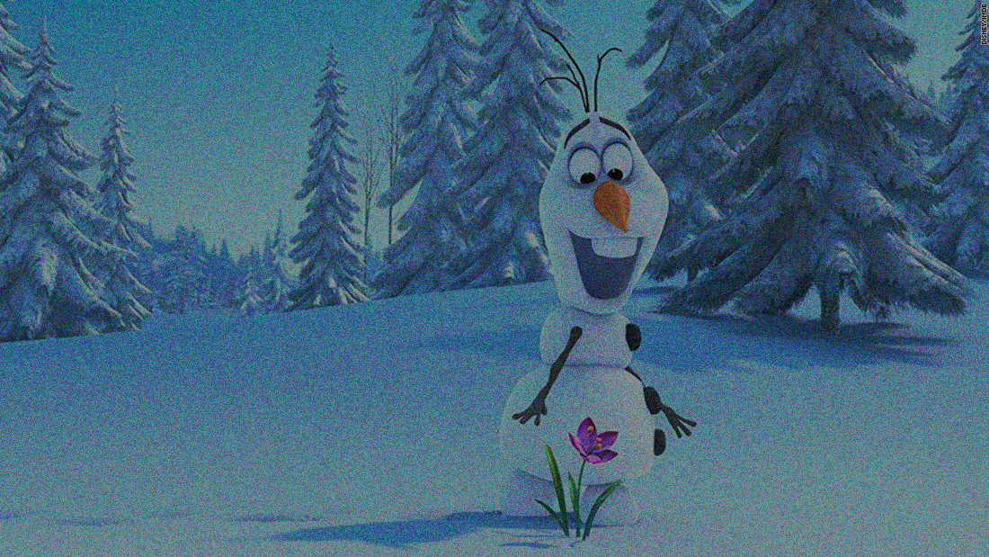
Drawing
Animation

Slide 8
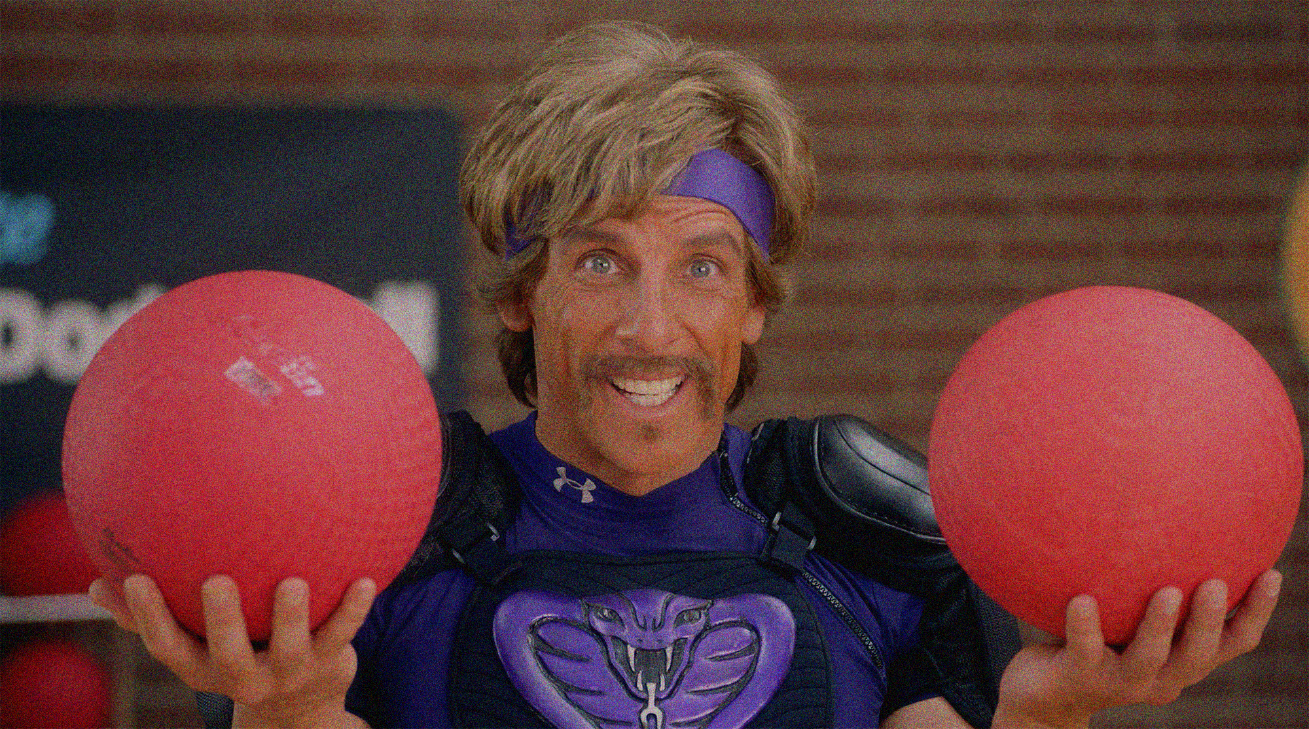
Funny
Comedy

Slide 9
Funny
or
Fun

Slide 10
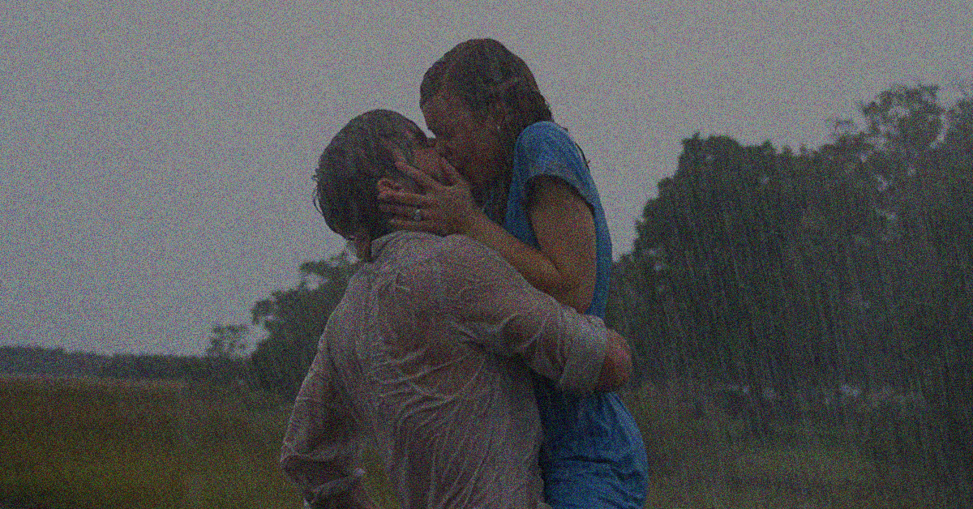
Love
Romance

Slide 11
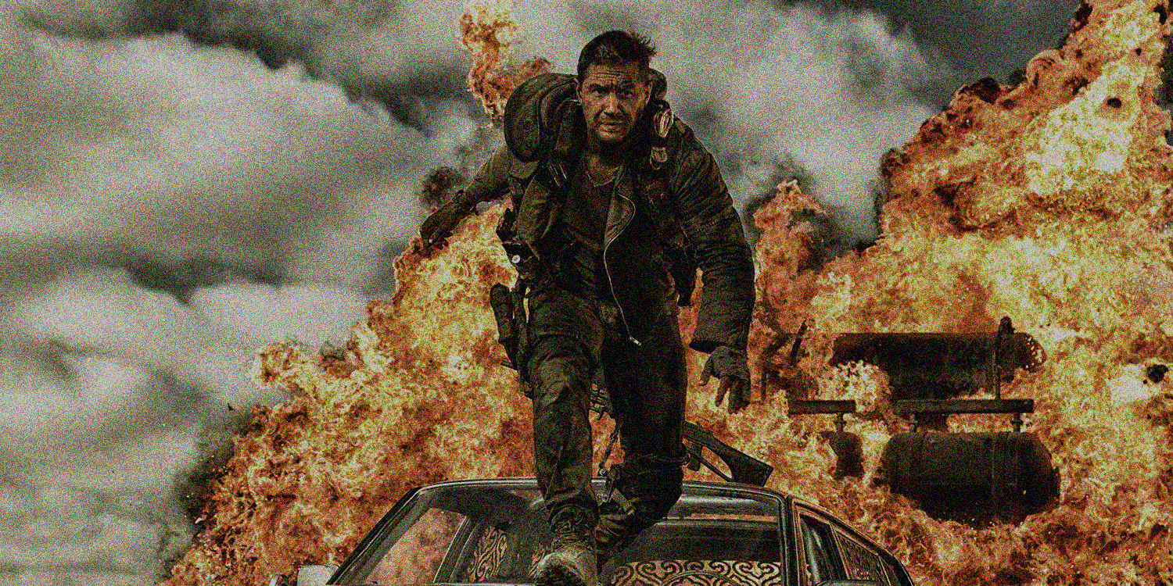
exciting
Fast
Action

Slide 12
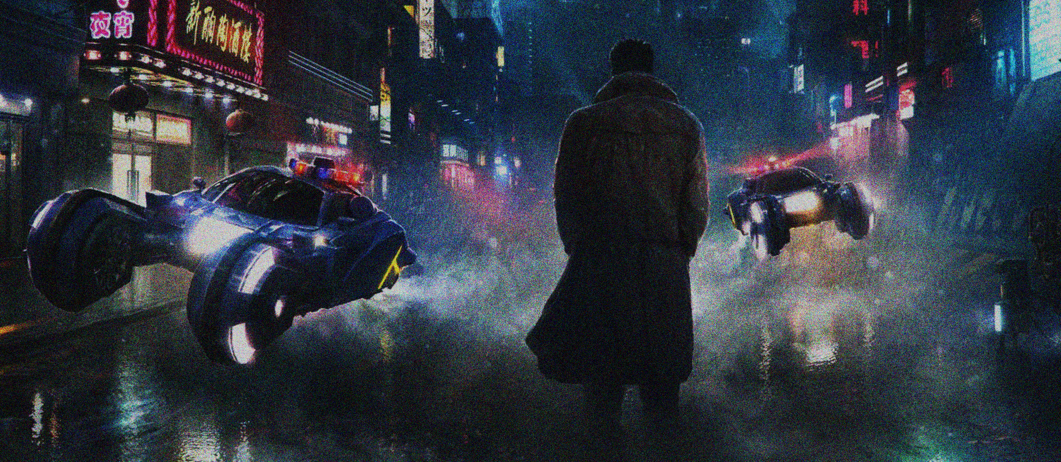
Future
space
Science Fiction

Slide 13
Sci Fi

Slide 14
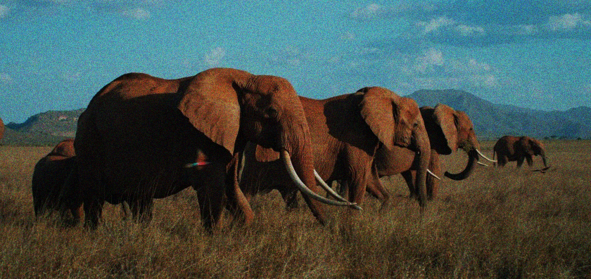
Real
Documentary

Slide 15
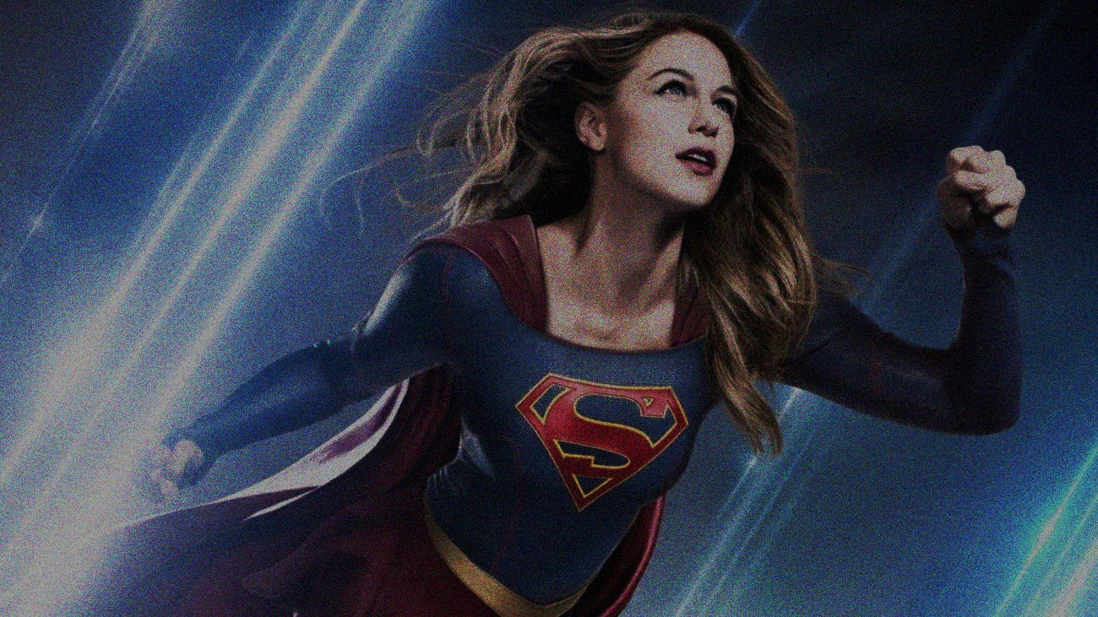
Superhero

Slide 16
Guess
the genre

Slide 17
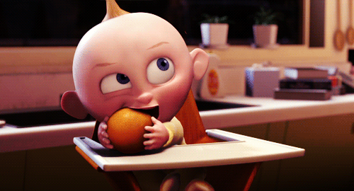
Animation
This is an ______________________ movie

Slide 18
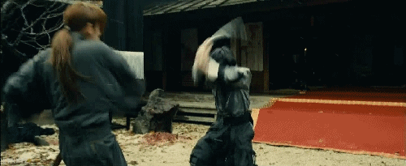
Action
This is an ______________________ movie

Slide 19
comedy
This is a ______________________ movie

Slide 20
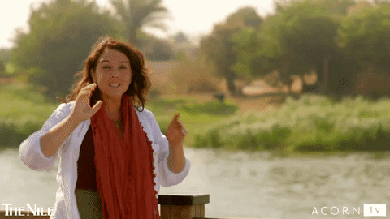
documentary
This is a __________________________ movie

Slide 21
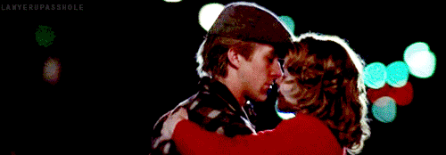
Romance
This is a ______________________ movie

Slide 22
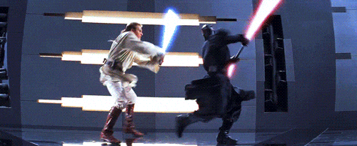
Science Fiction
This is a __________________________ movie

Slide 23
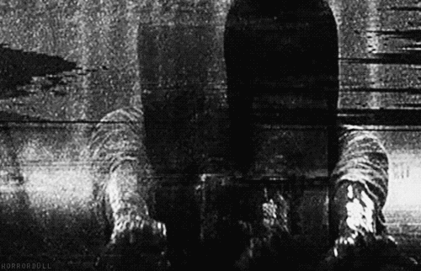
Horror
This is a ______________________ movie

Slide 24
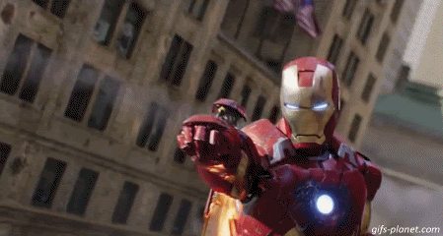
Superhero
This is a ______________________ movie

Slide 25
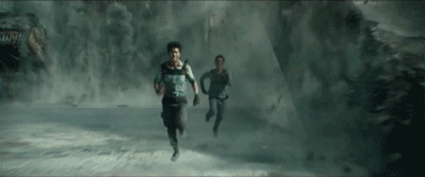
Action
This is an ______________________ movie

Slide 26
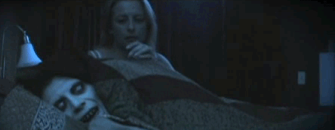
Horror
This is a ______________________ movie

Slide 27
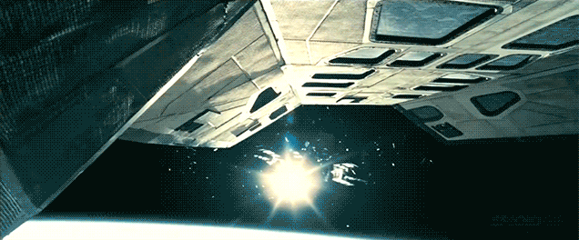
Sci Fi
This is a ______________________ movie

Slide 28
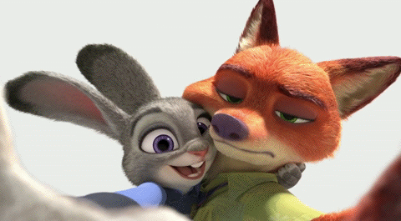
Animation
This is a ______________________ movie

Slide 29
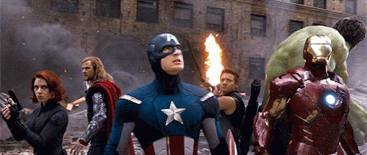
Superhero
This is a ______________________ movie

Slide 30
Guess
the movie

Slide 31
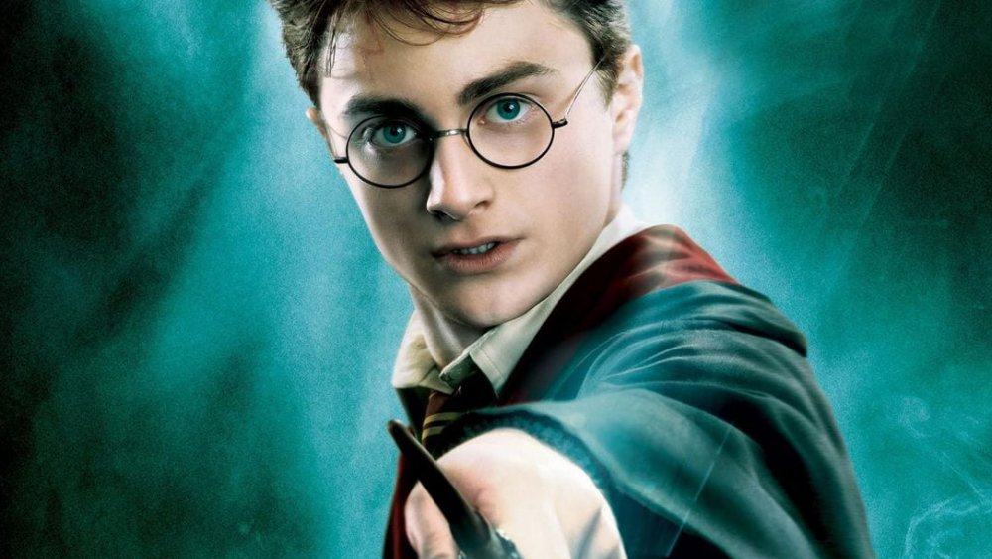

Slide 32
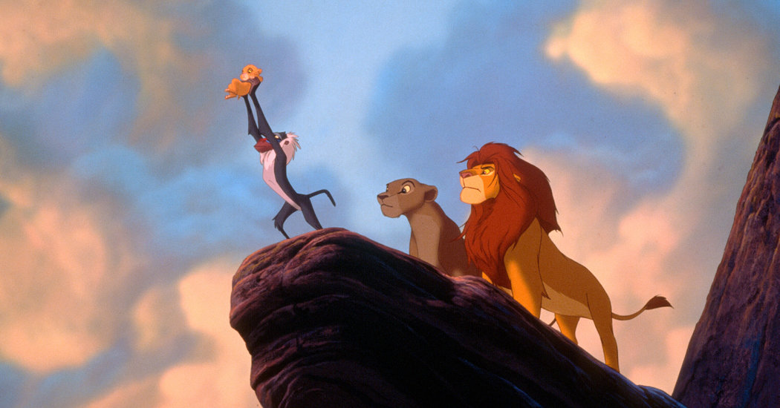

Slide 33
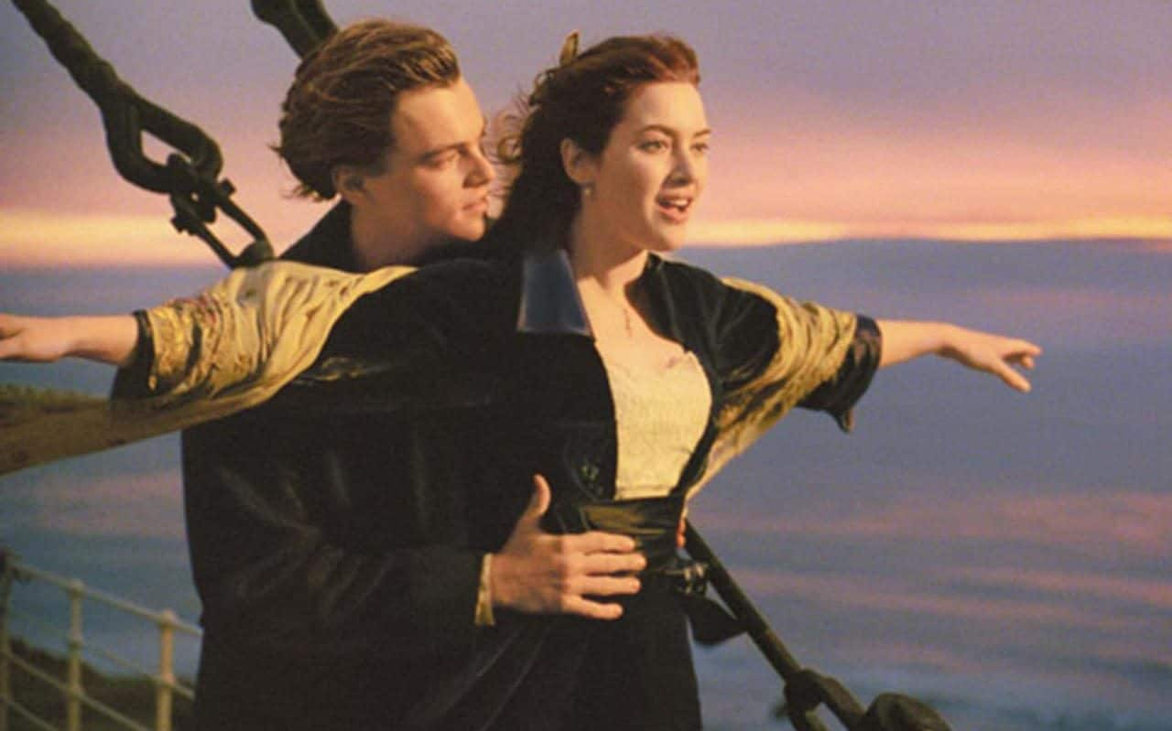

Slide 34
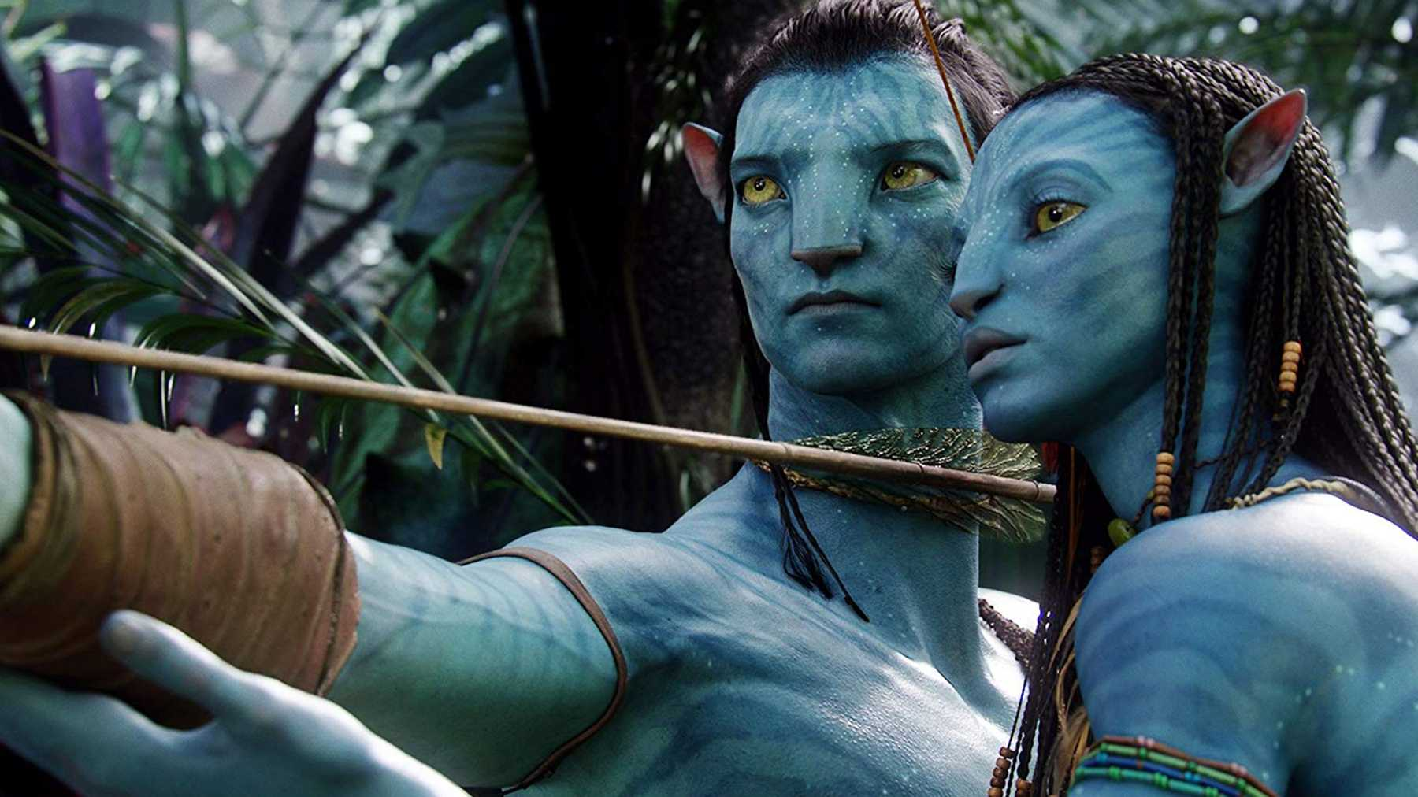

Slide 35
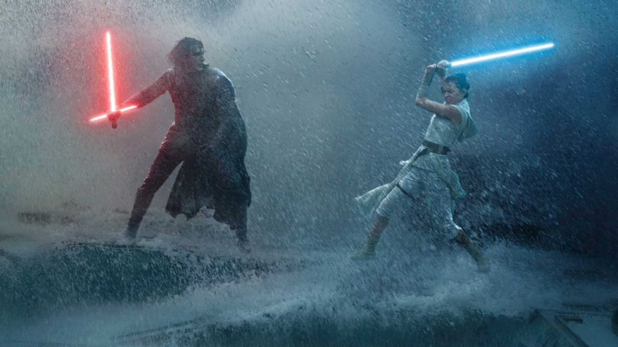

Slide 36
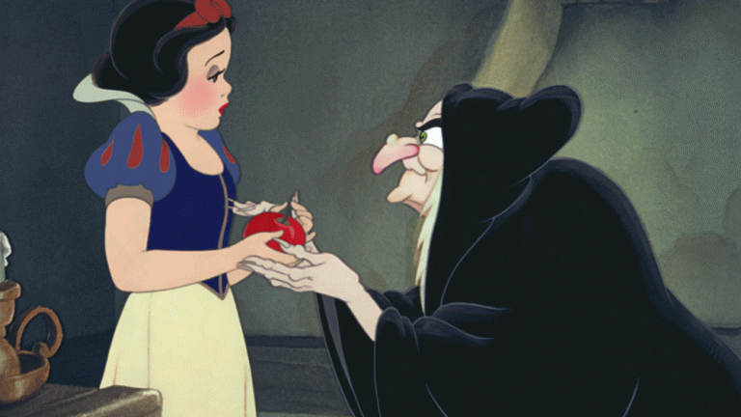

Slide 37
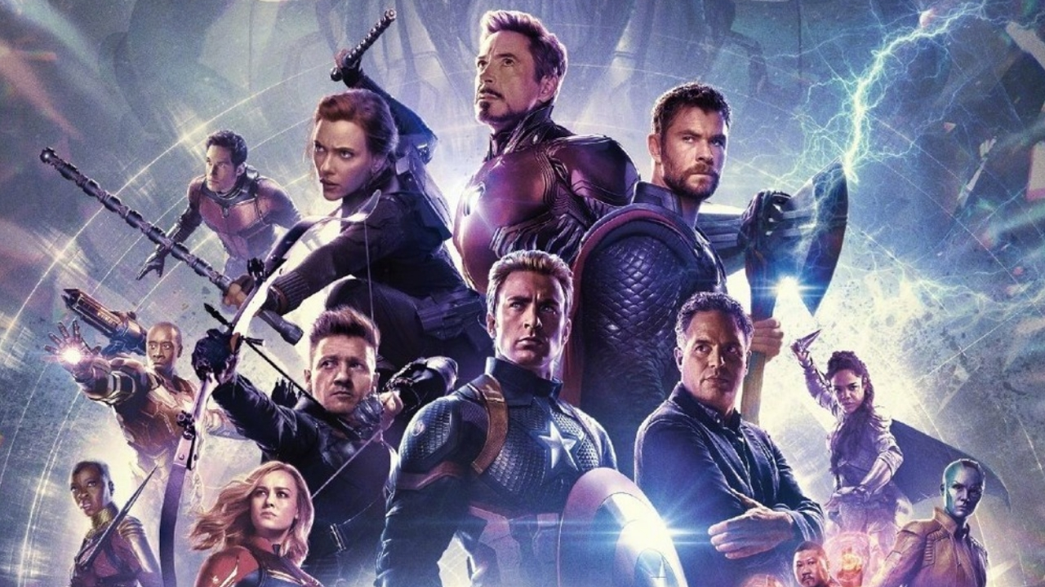

Slide 38
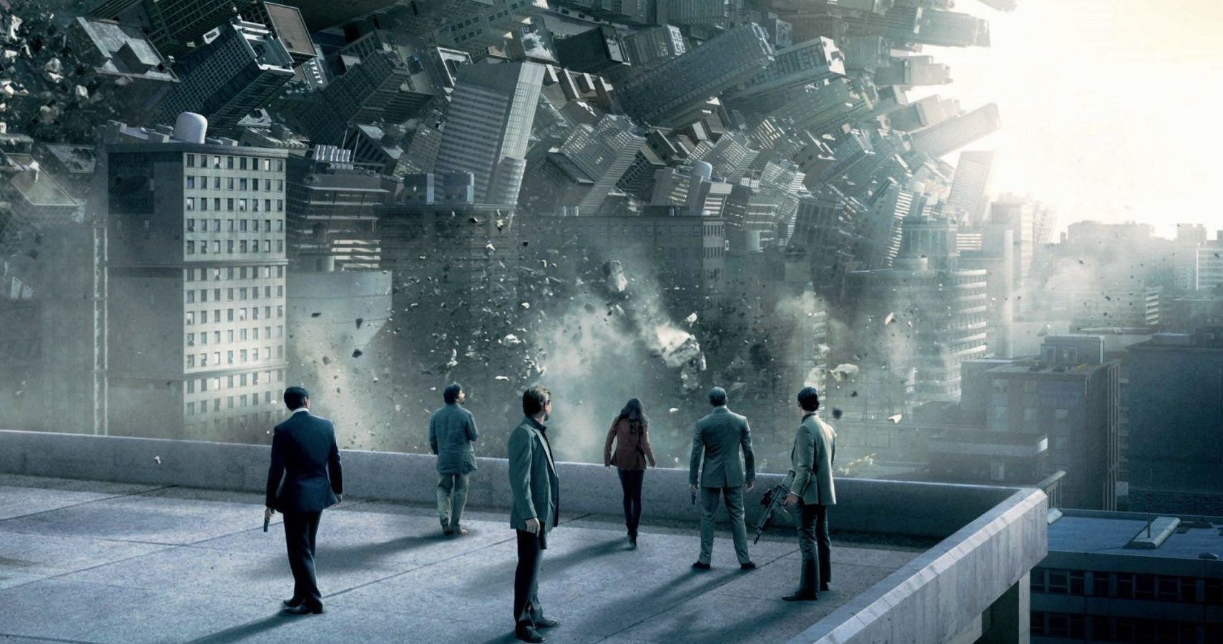

Slide 39
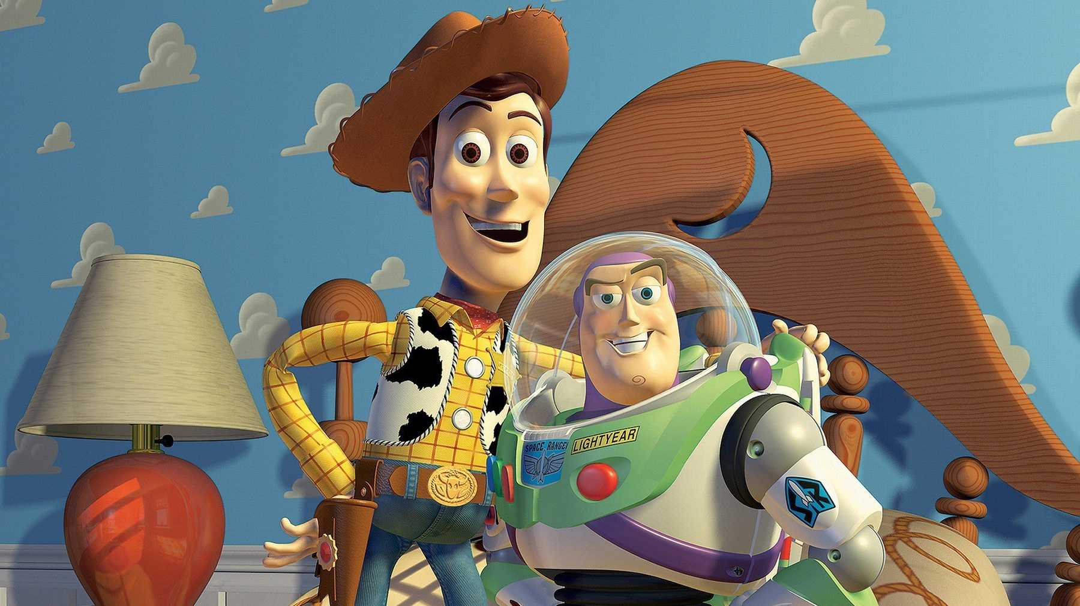

Slide 40
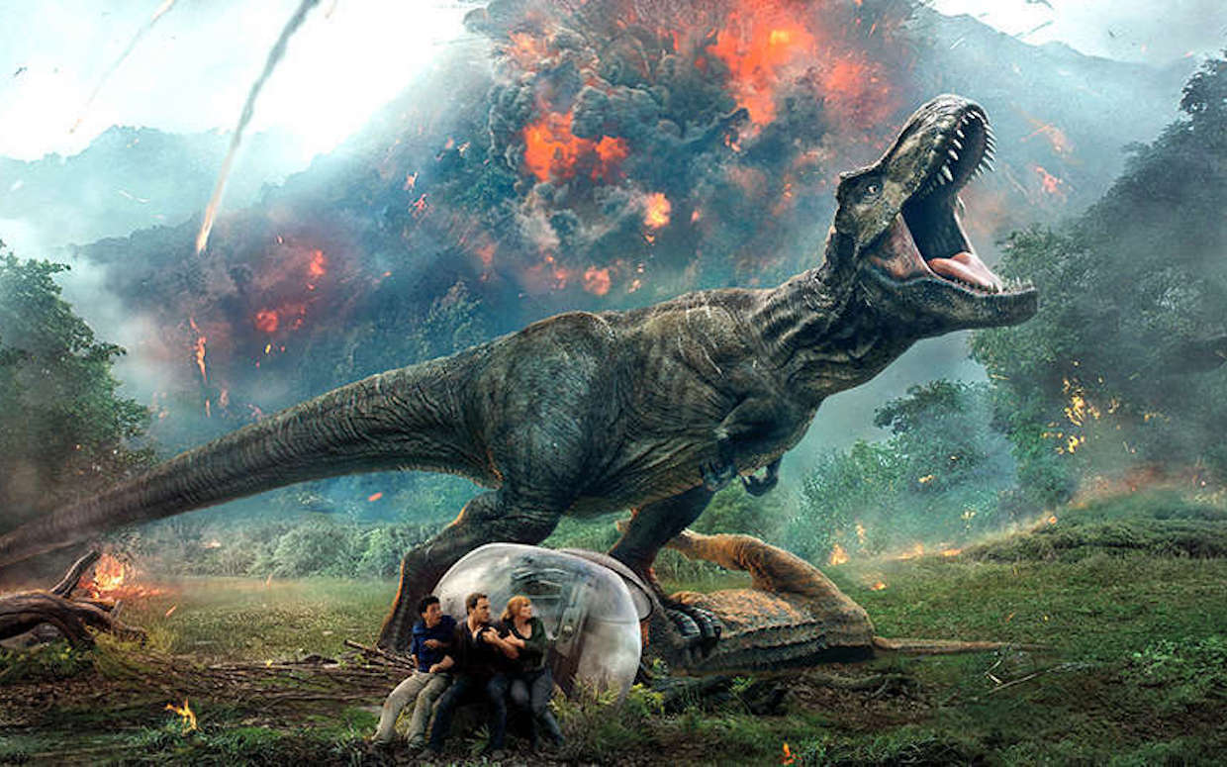

Slide 41
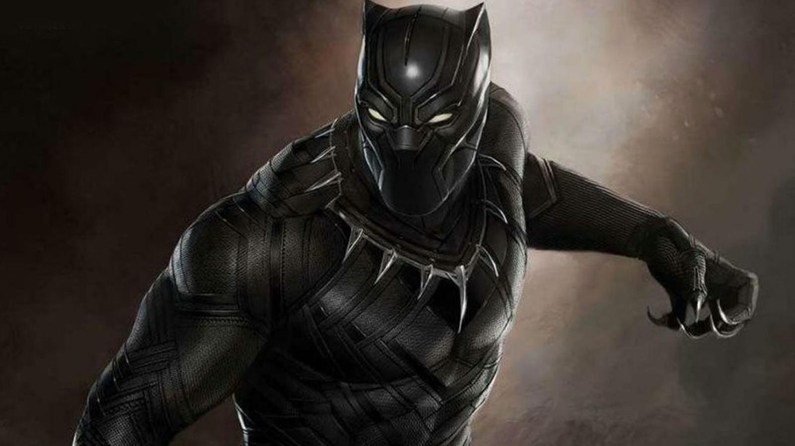

Slide 42
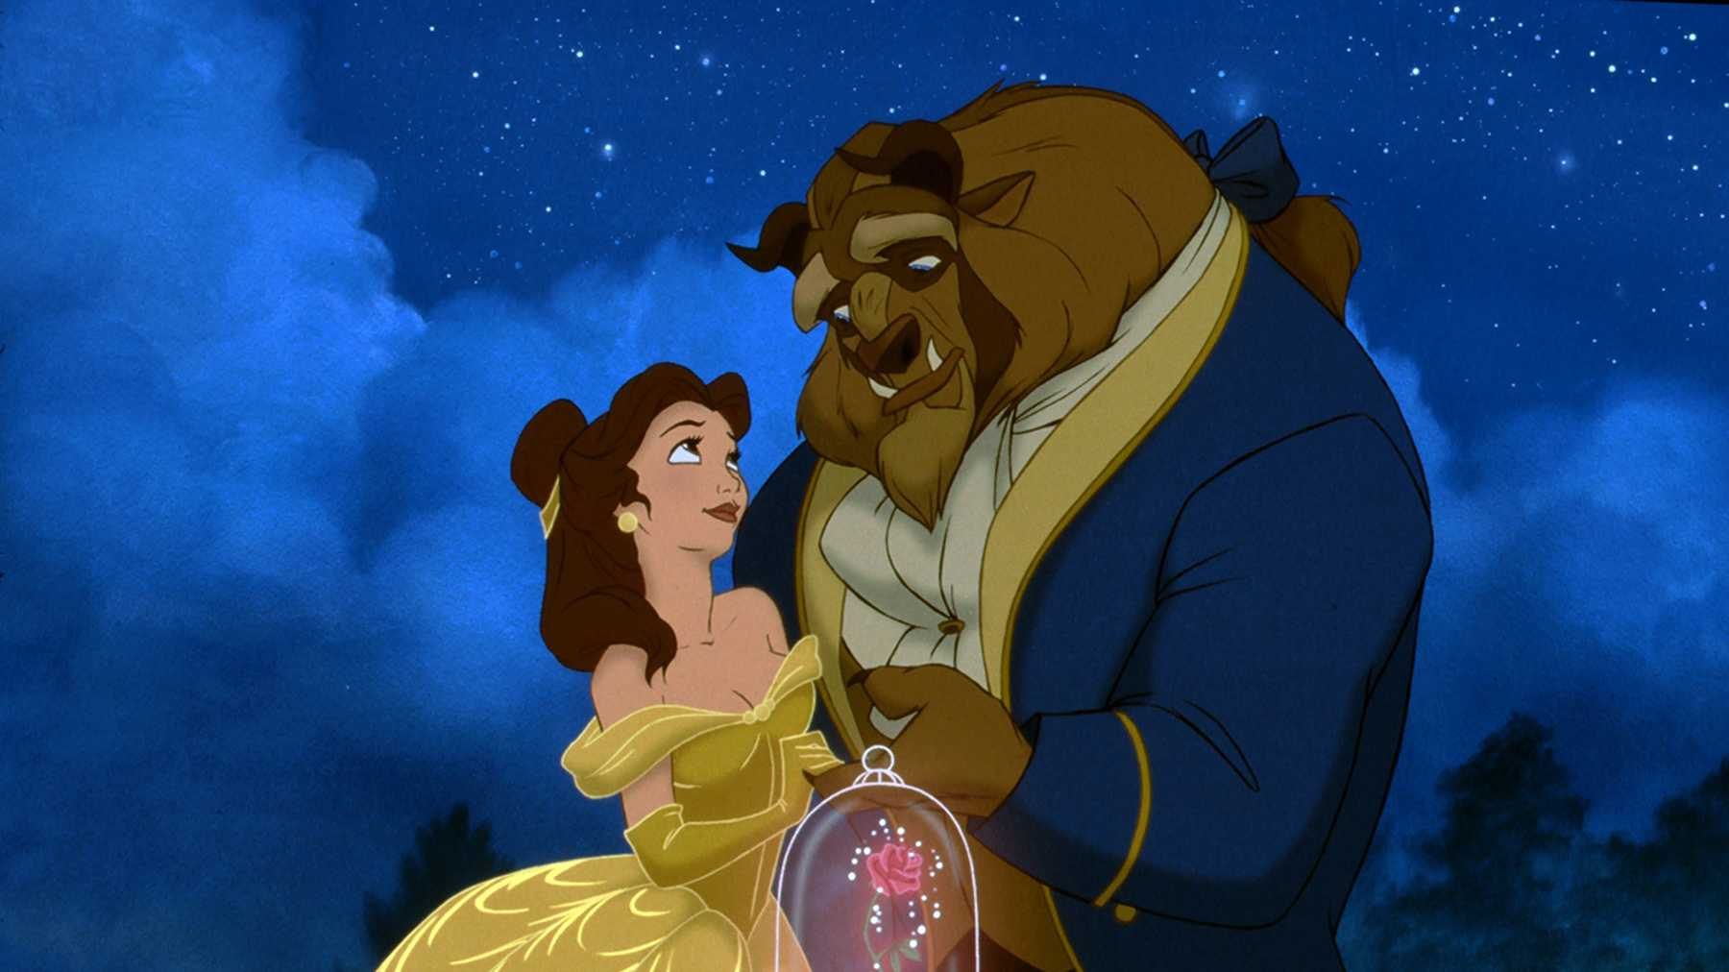

Slide 43
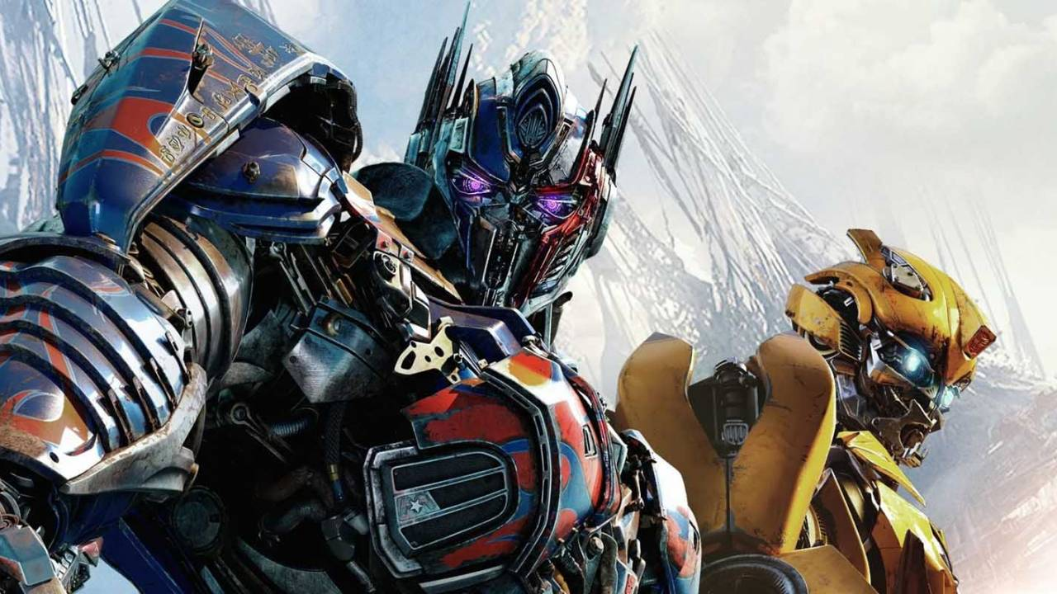

Slide 44
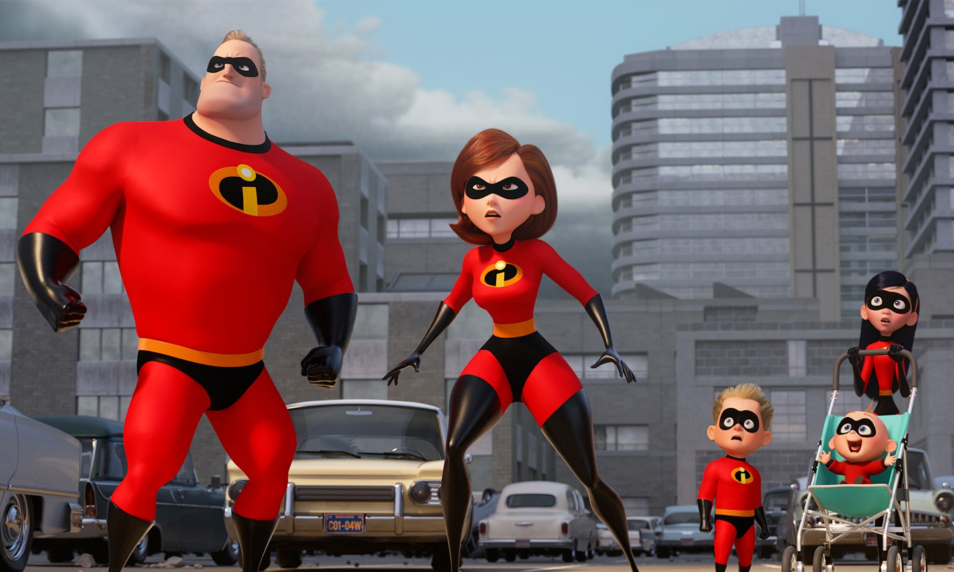

Slide 45
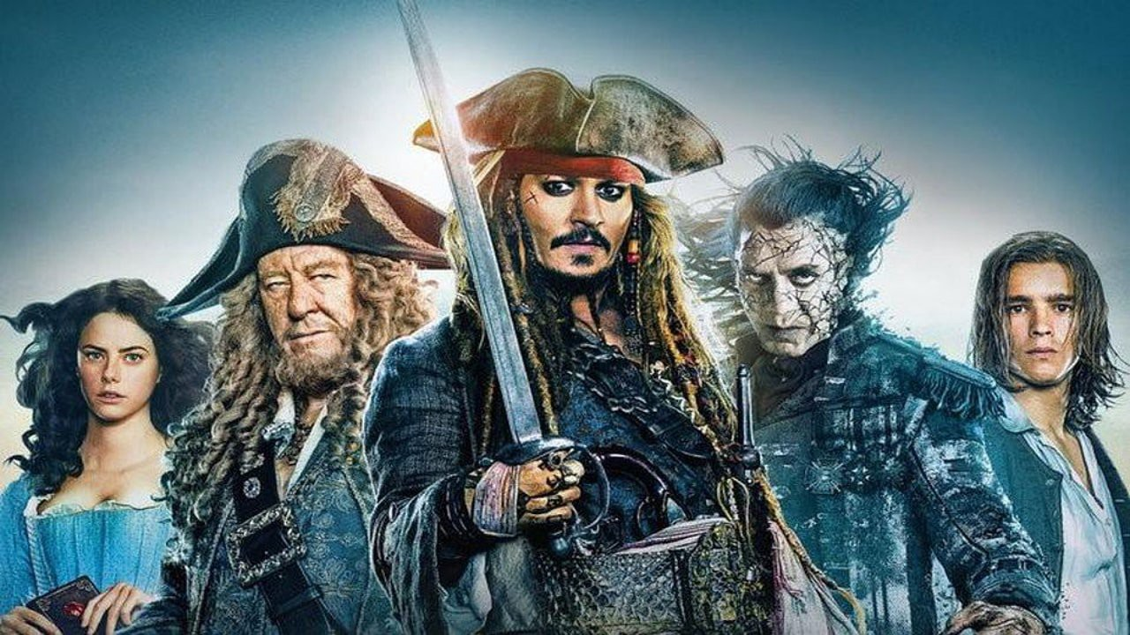

Slide 46
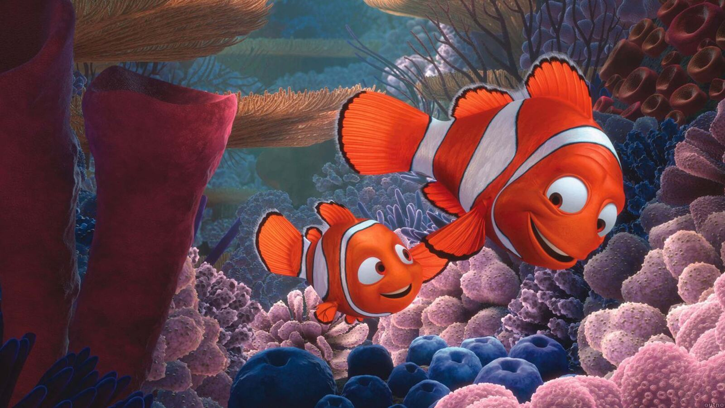

Slide 47
