Slide 1
My
Favorites
Movie Quiz

Slide 2
Animal
Number
Food
Friend
1
2
1
2
1
2
1
2
3
3
3
3
4
5
4
5
4
5
4
5

Slide 3
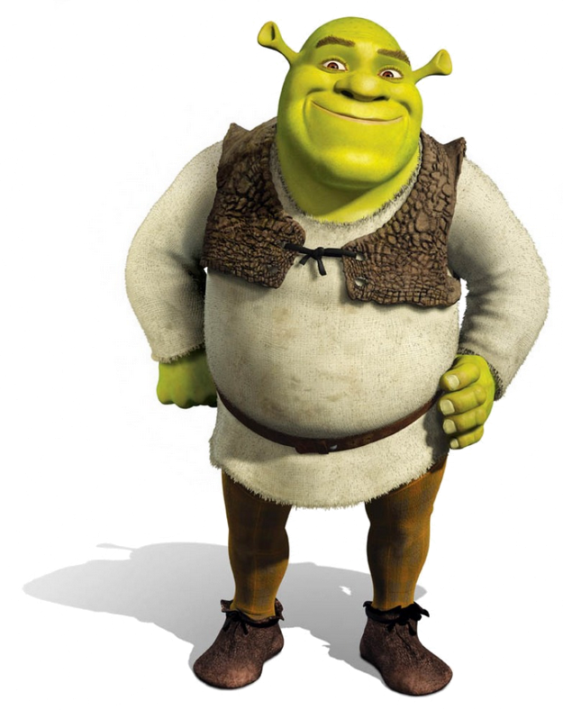
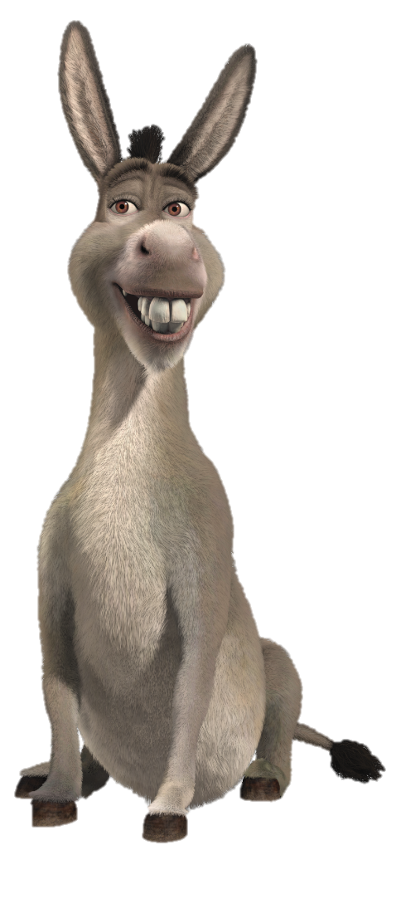
My favorite animal is _________.
My favorite animal is donkey.

Slide 4
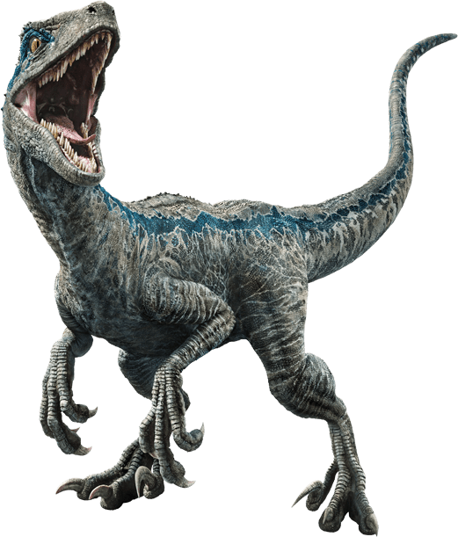
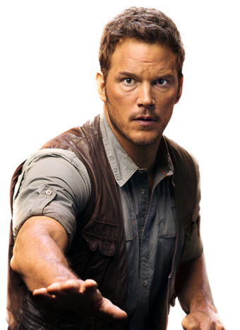
My favorite animal is a ______________.
My favorite animal is a dinosaur.

Slide 5
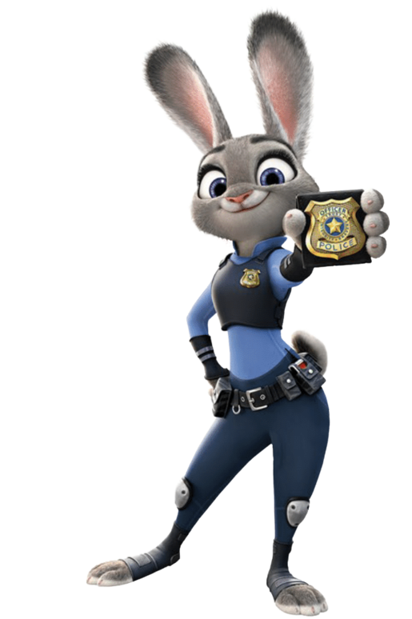
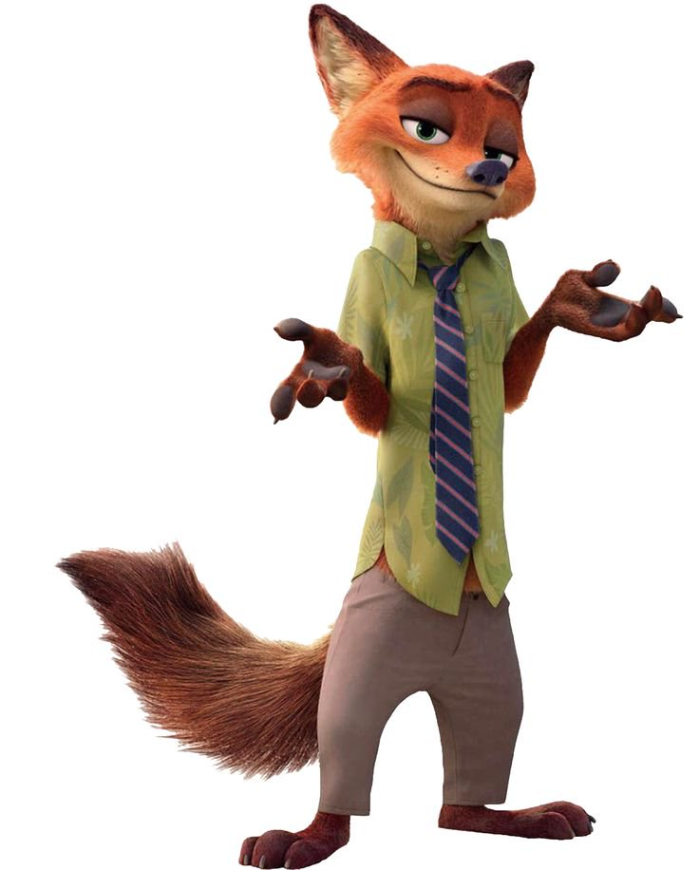
My favorite animal is a ________.
My favorite animal is a fox.

Slide 6
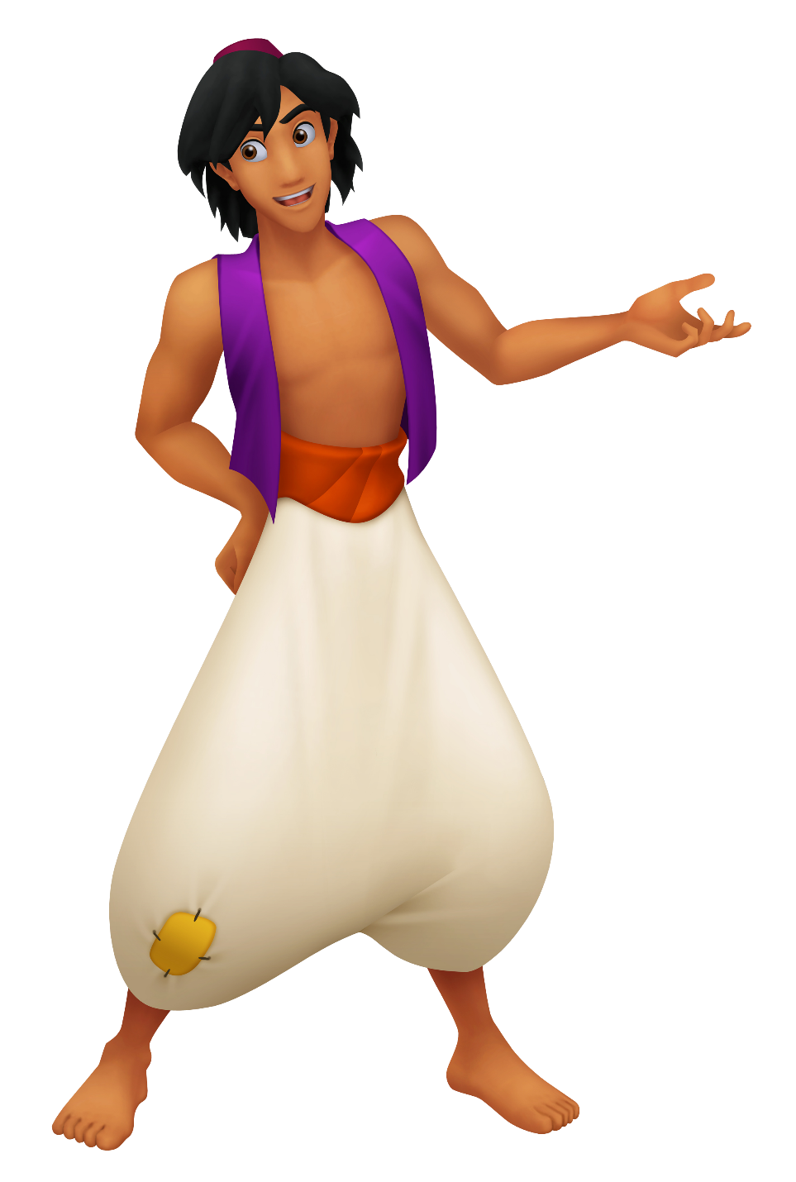
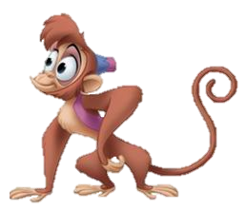
My favorite animal is a ____________.
My favorite animal is a monkey.

Slide 7
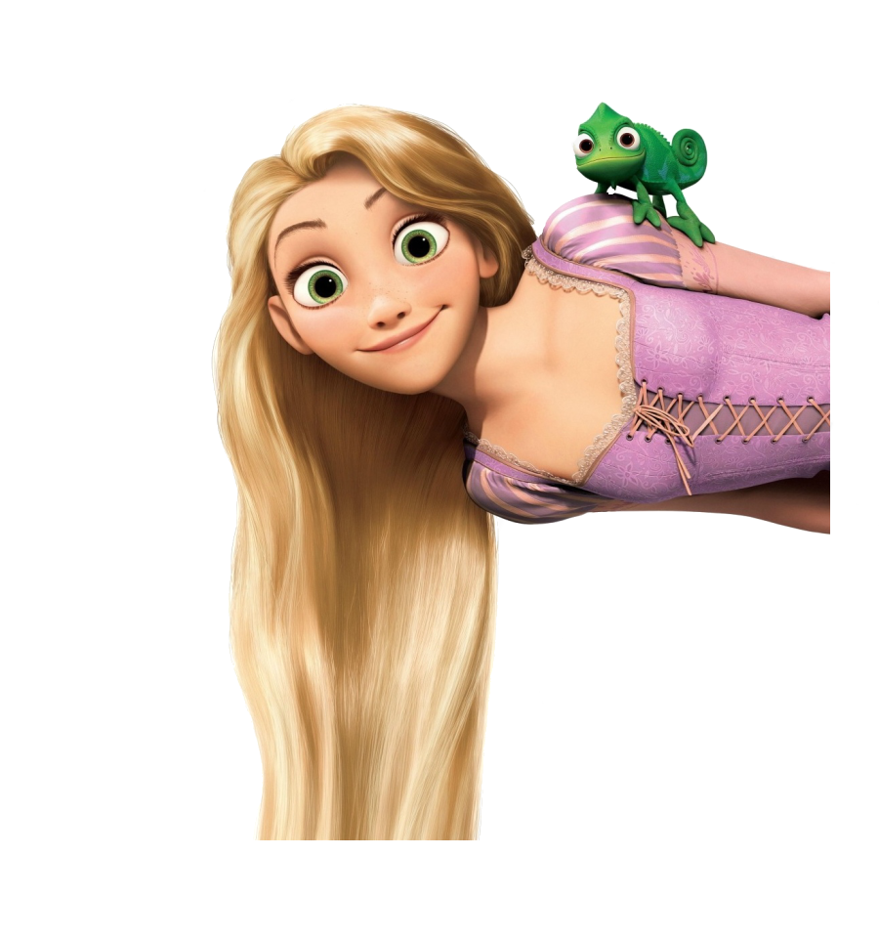
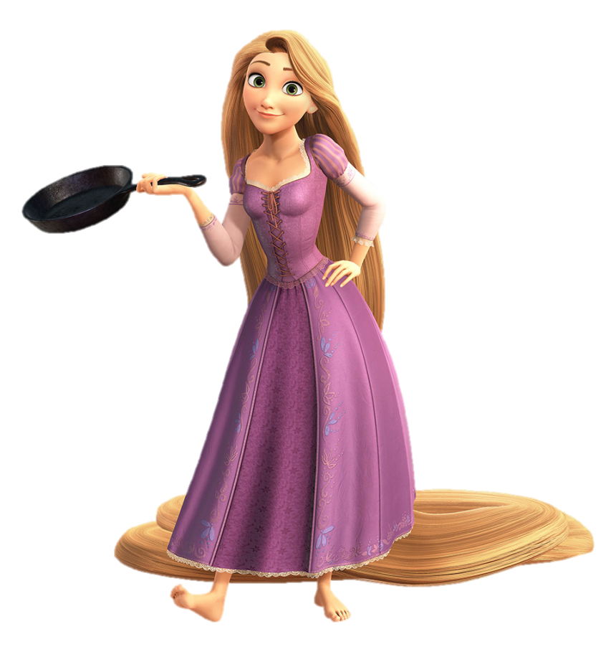
My favorite animal is a _____________.
My favorite animal is a chameleon.

Slide 8
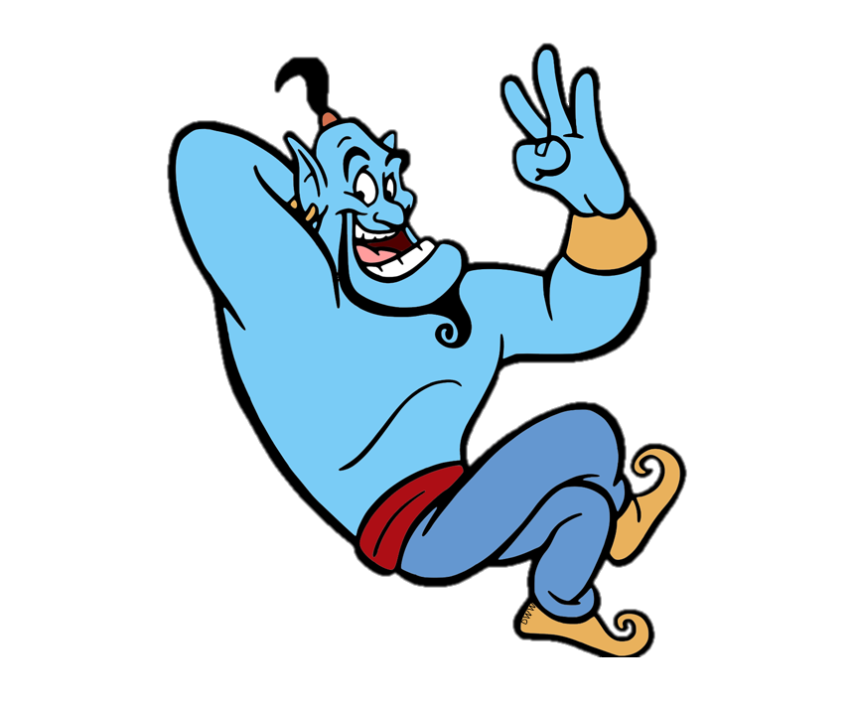
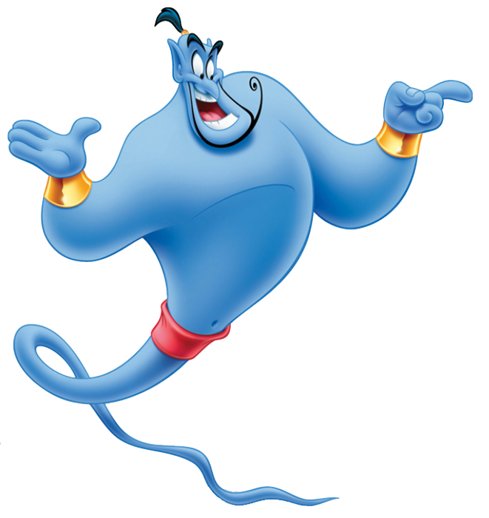
My favorite number is _______.
My favorite number is 3.

Slide 9
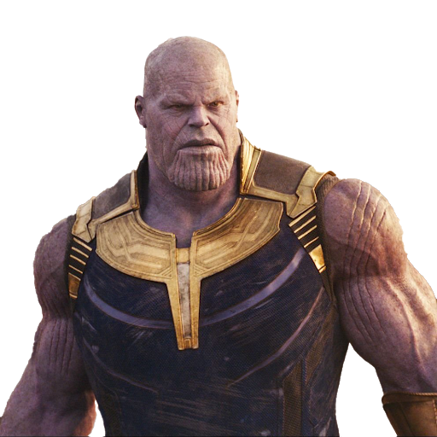
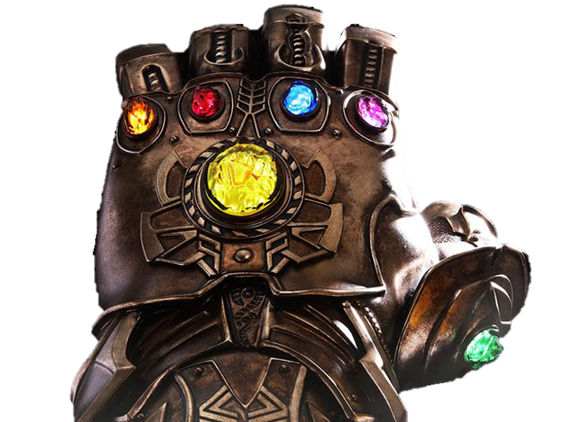
My favorite number is _____.
My favorite number is 6.

Slide 10
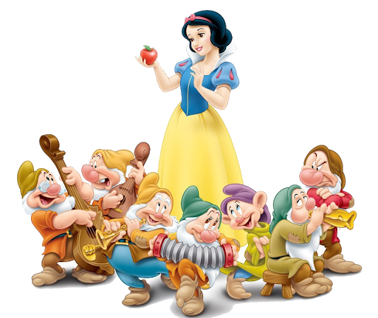
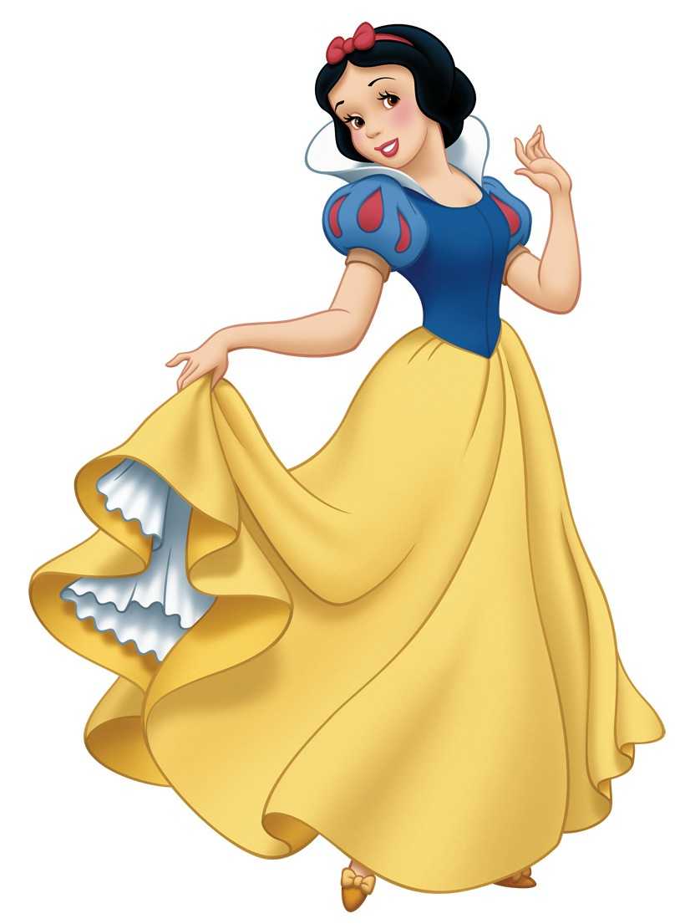
My favorite number is 7.
My favorite number is _______.

Slide 11
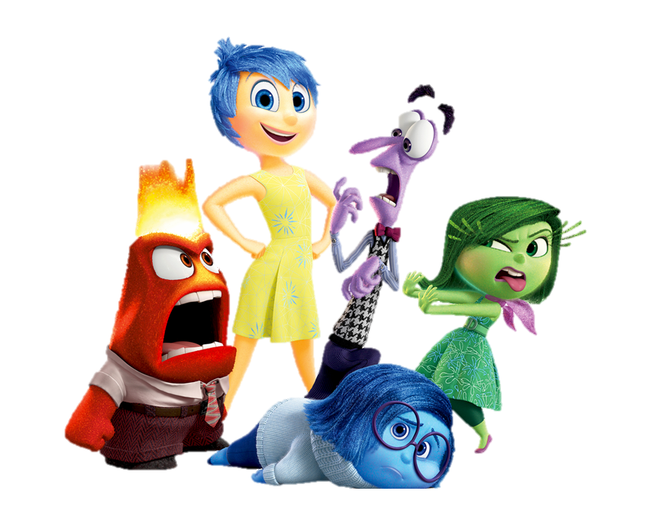
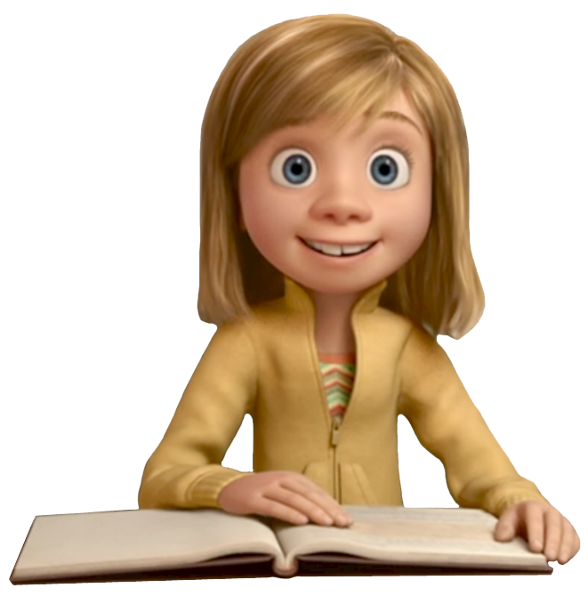
My favorite number is 5.
My favorite number is _____.

Slide 12
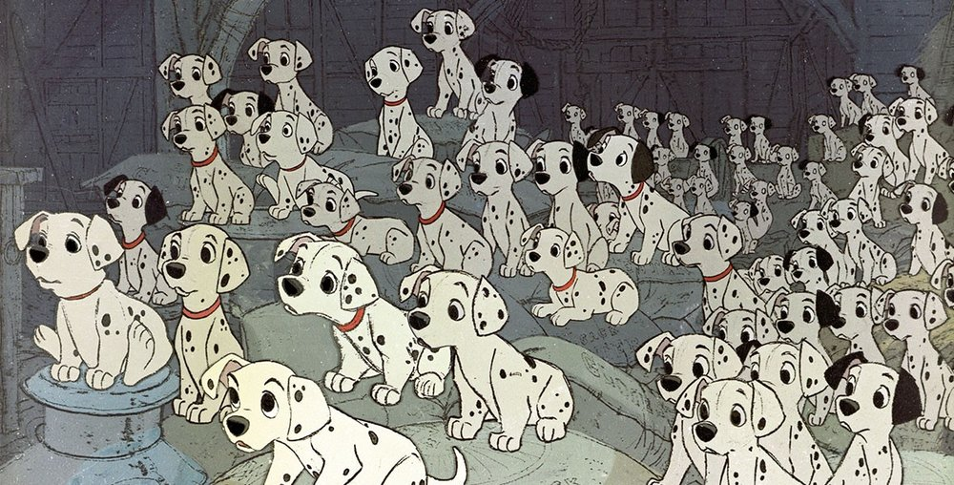
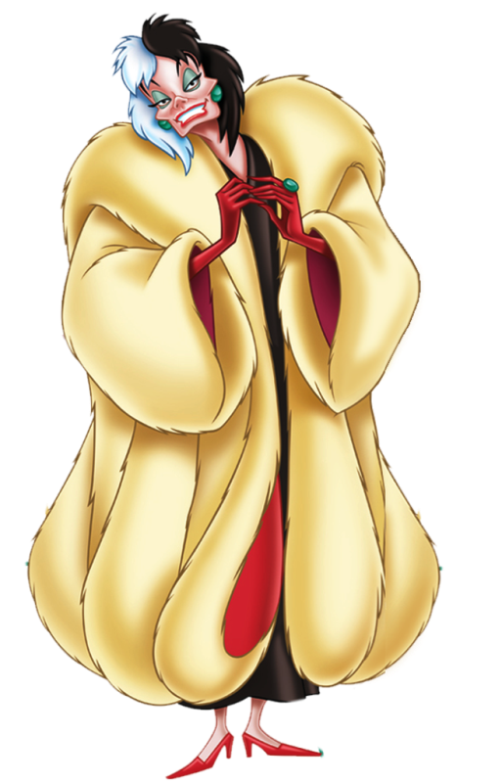
My favorite number is 101.
My favorite number is _____.

Slide 13
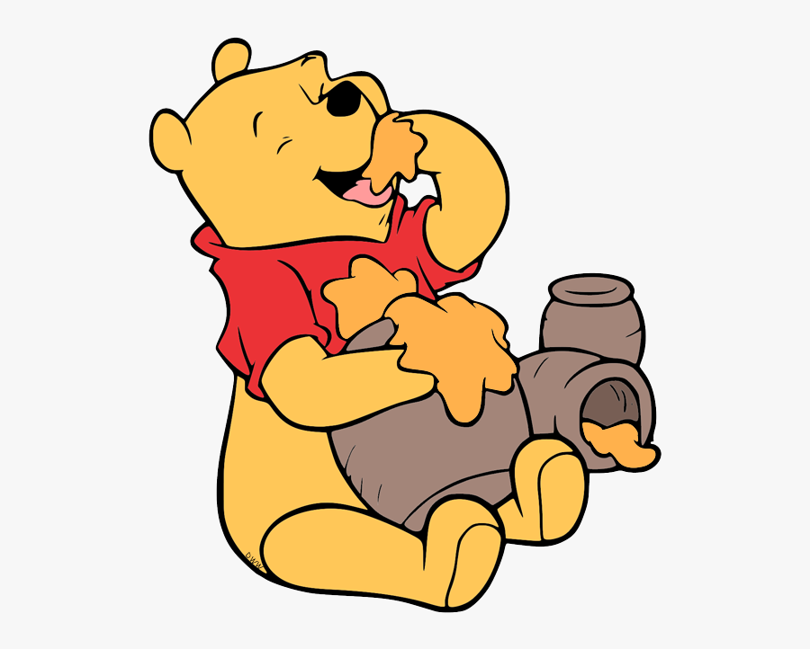
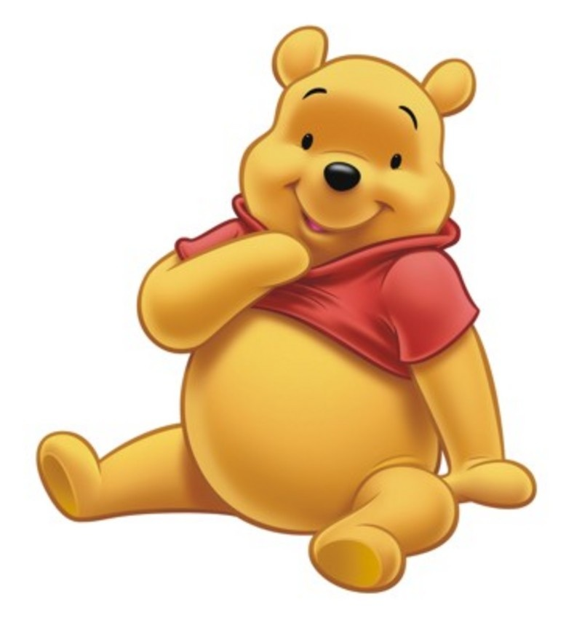
My favorite food is ___________.
My favorite food is honey.

Slide 14
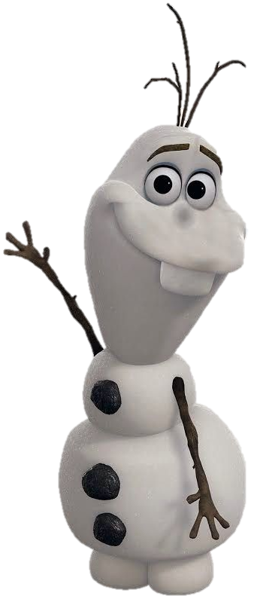
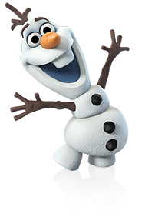
My favorite food is ___________.
My favorite food is carrots.

Slide 15
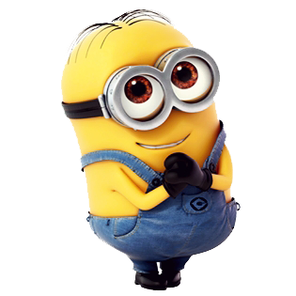
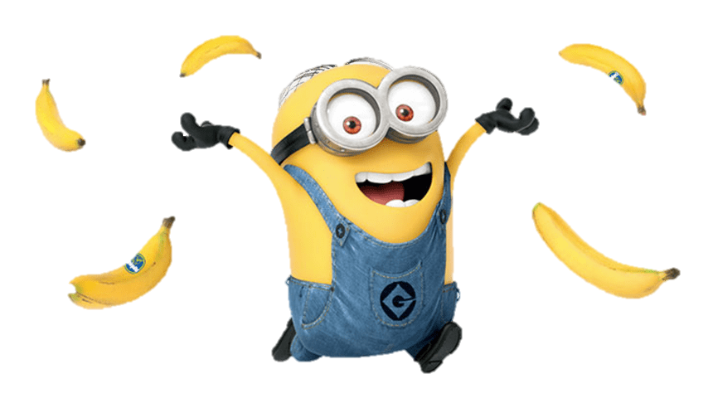
My favorite food is ___________!
My favorite food is bananas!

Slide 16
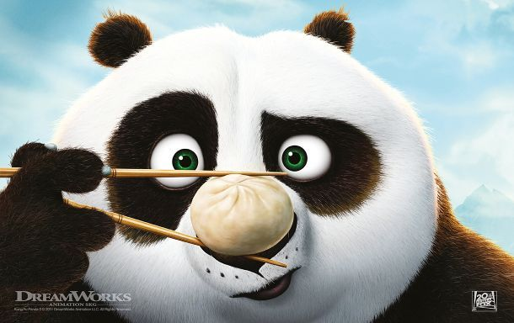
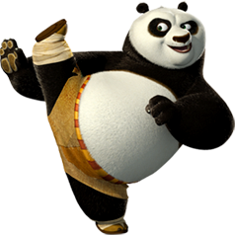
My favorite food is _______________.
My favorite food is dumplings.

Slide 17
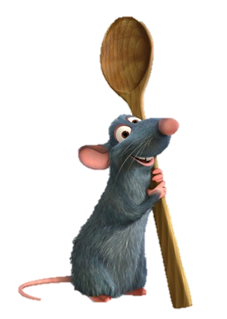
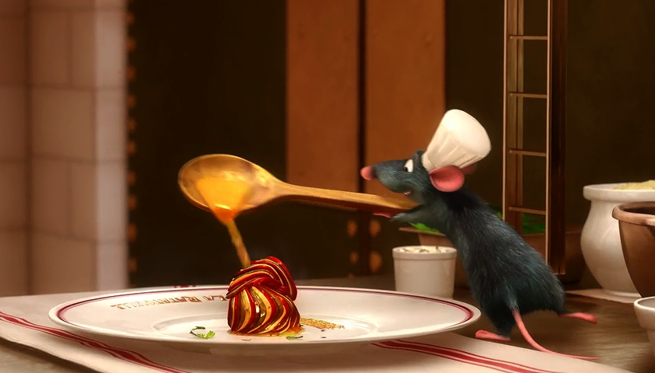
My favorite food is _____________.
My favorite food is ratatouille.

Slide 18
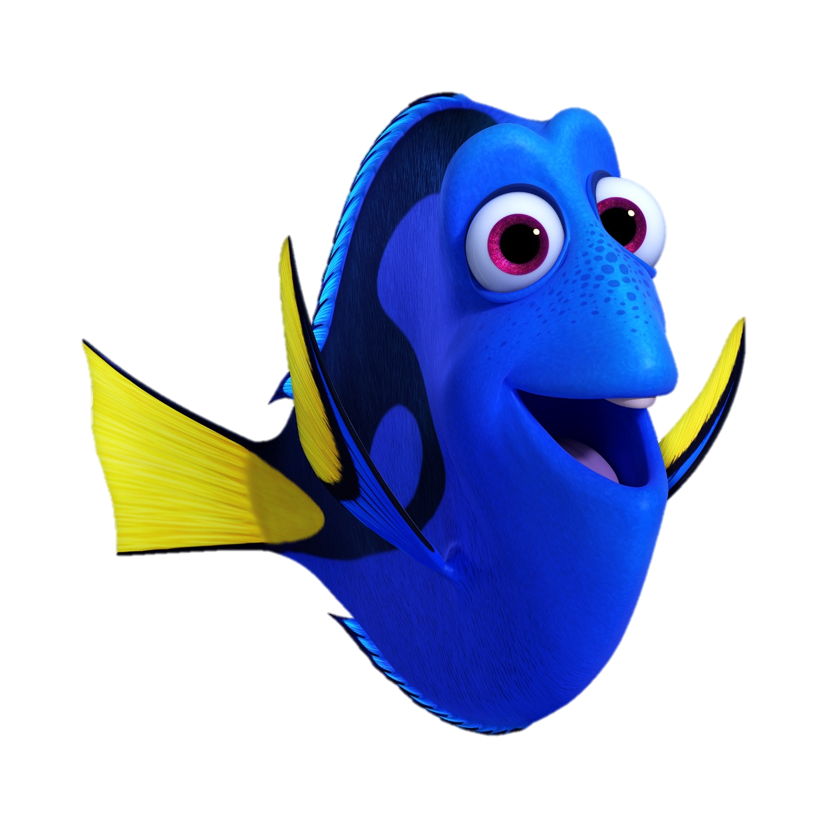
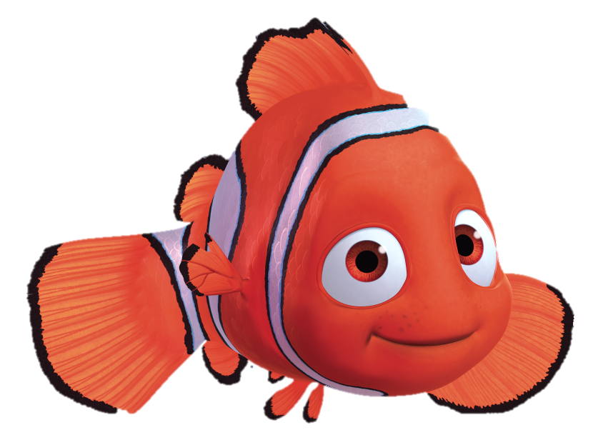
My favorite friend is __________.
My favorite friend is Nemo.

Slide 19
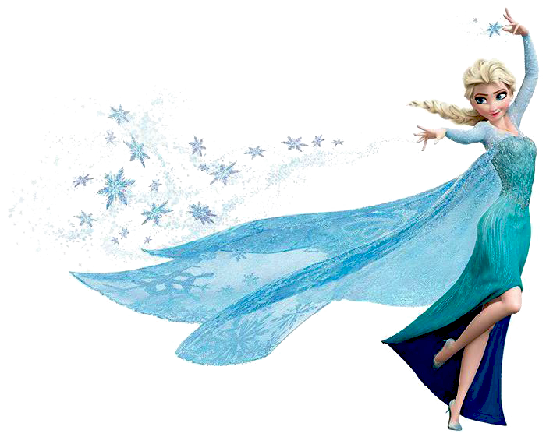
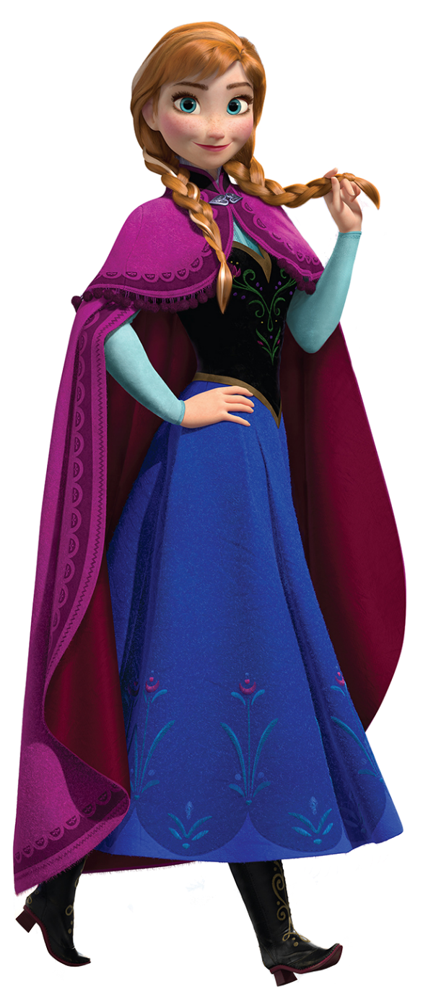
My favorite friend is Ana.
My favorite friend is ________.

Slide 20
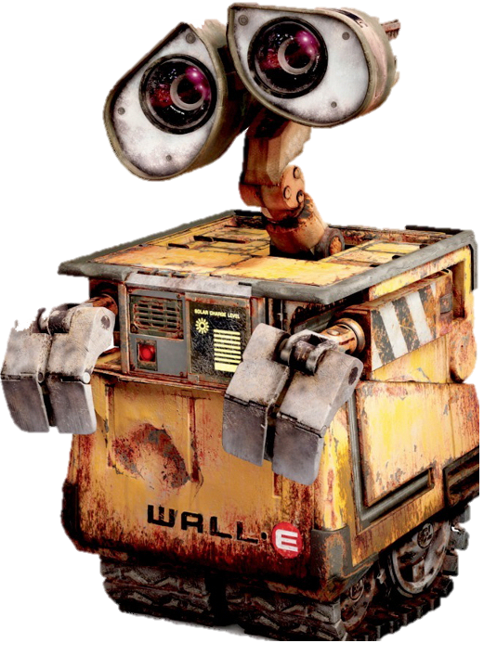
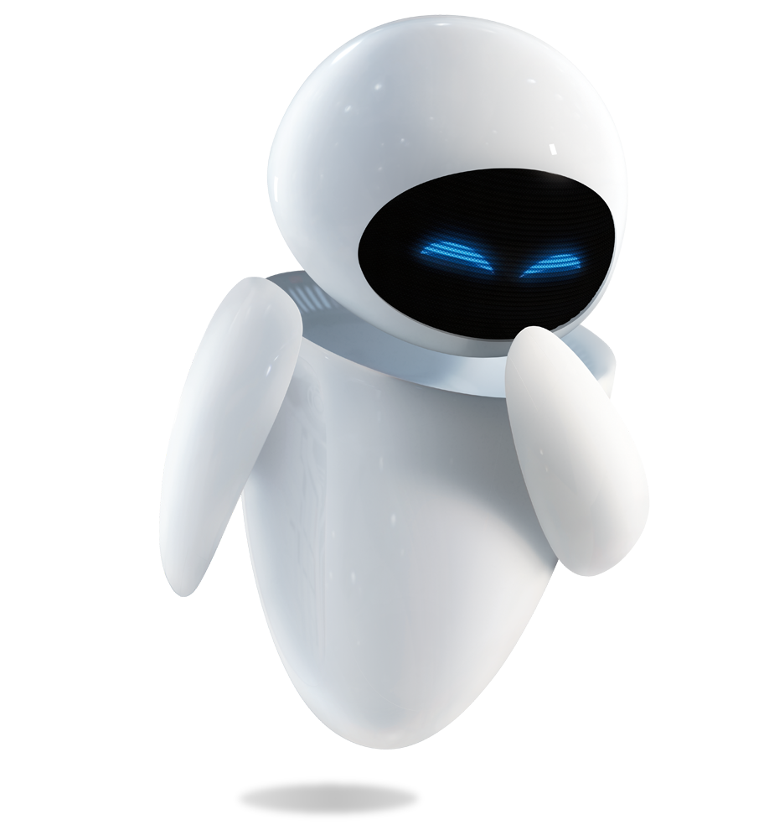
My favorite friend is _________.
My favorite friend is Eve.

Slide 21
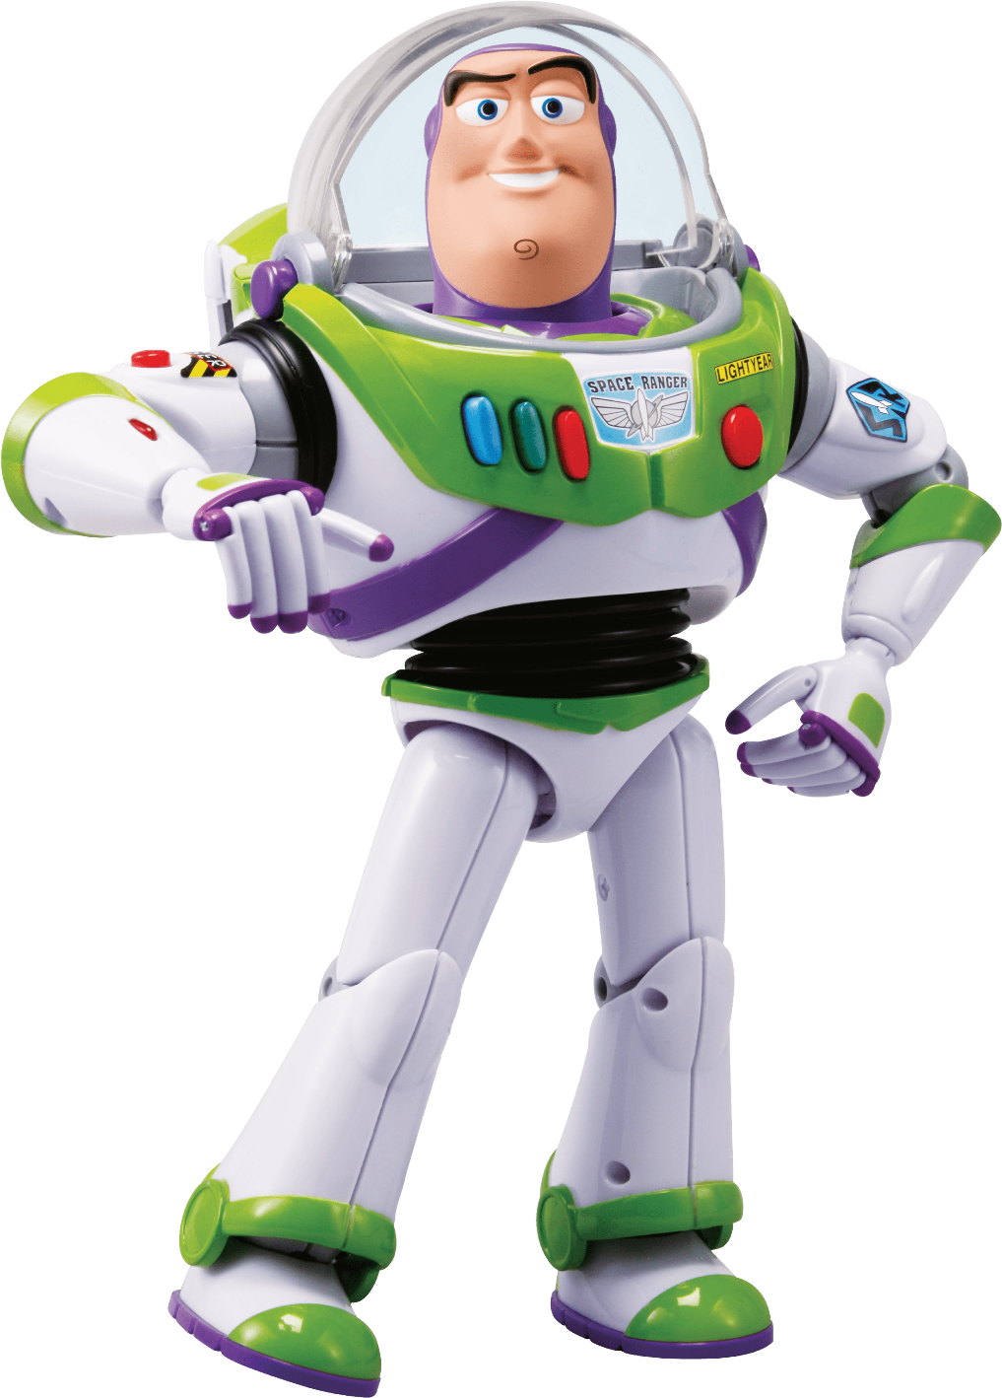
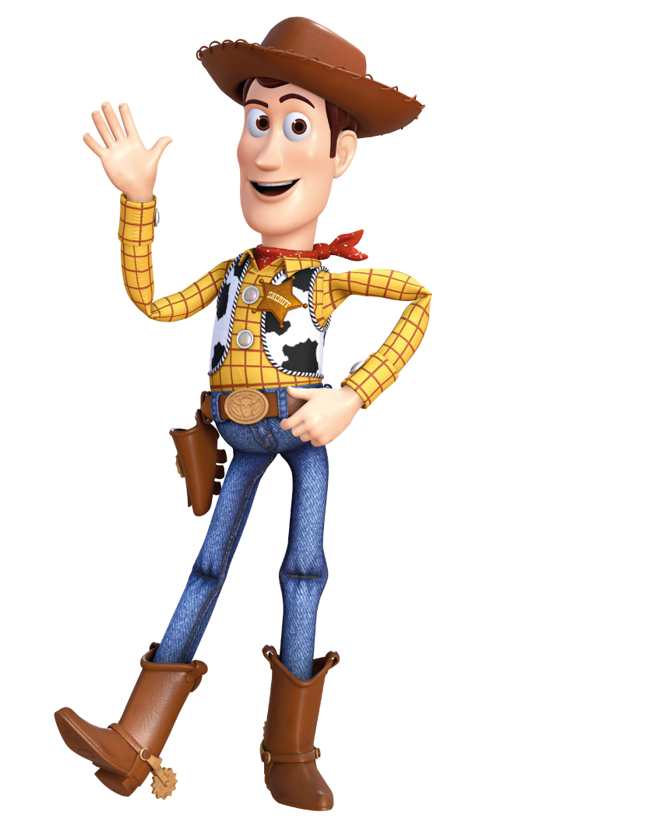
My favorite friend is _____________.
My favorite friend is Woody.

Slide 22
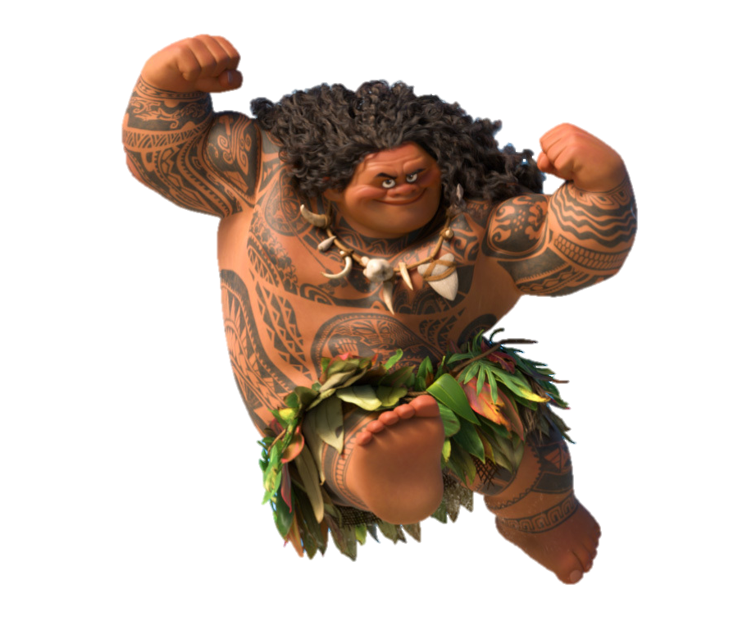
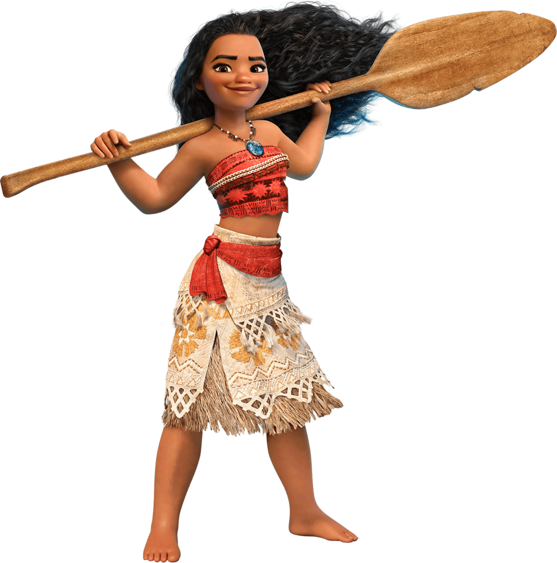
My favorite friend is ___________.
My favorite friend is Maui.

