Slide 1
Hobbies

Slide 2
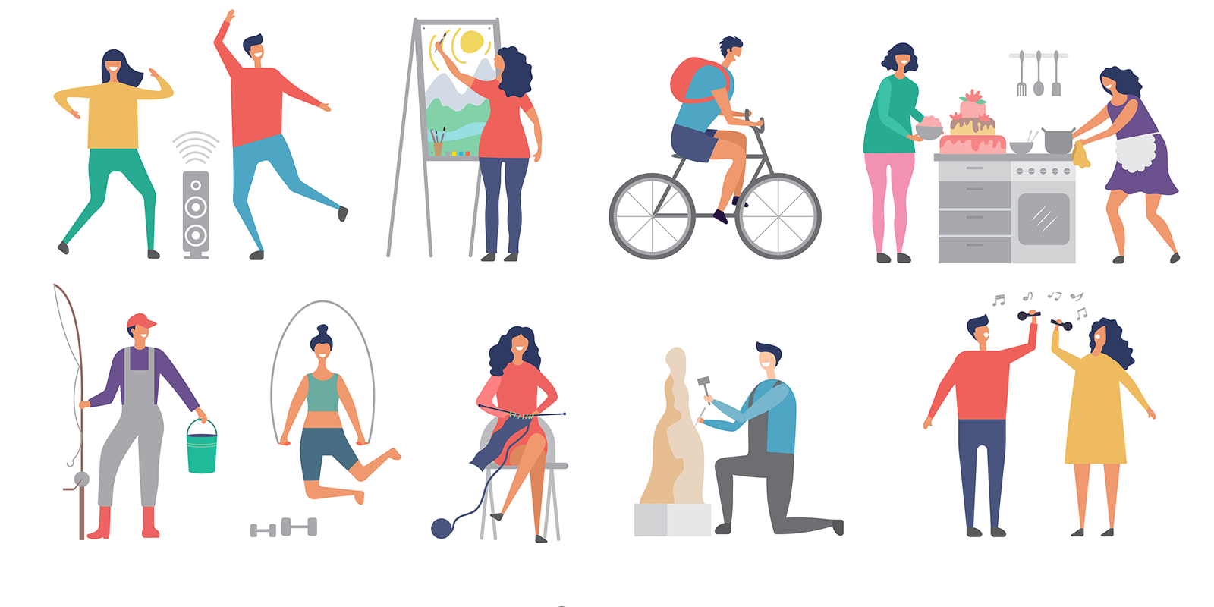

Slide 3
Hobbies
She is cycling.
Her hobby is cycling.

Slide 4
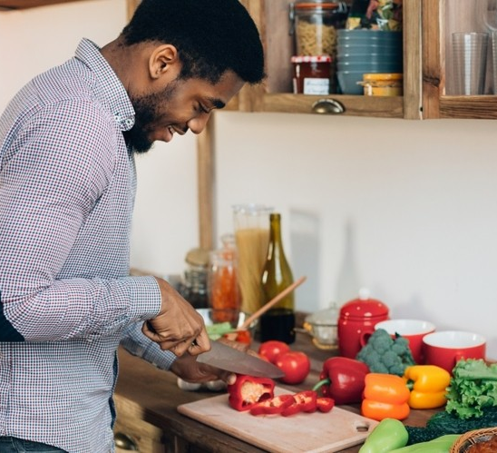
Hobbies
He is cooking.
His hobby is cooking.

Slide 5
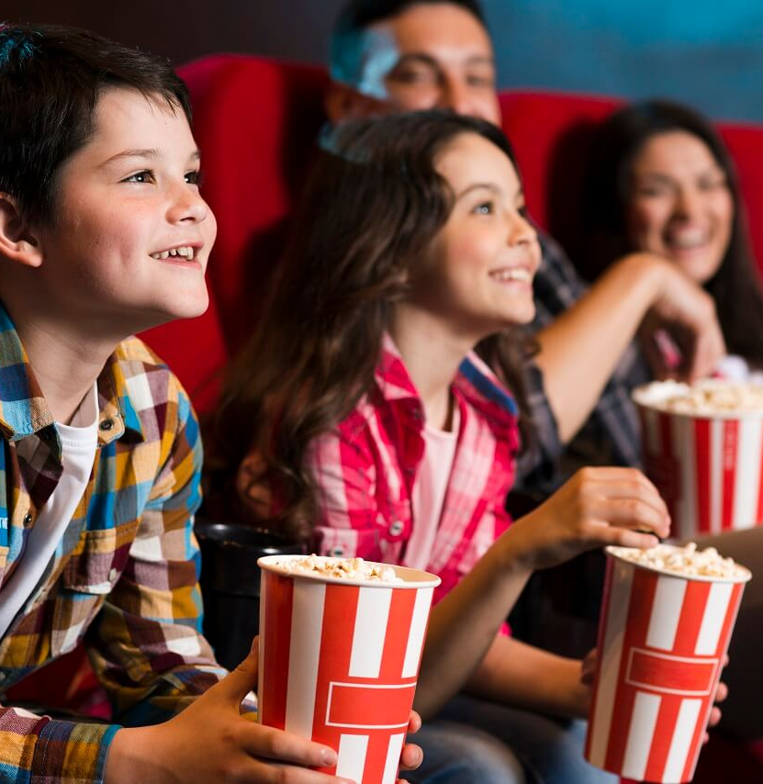
Hobbies
They are watching a movie.
Their hobby is watching a movie.

Slide 6
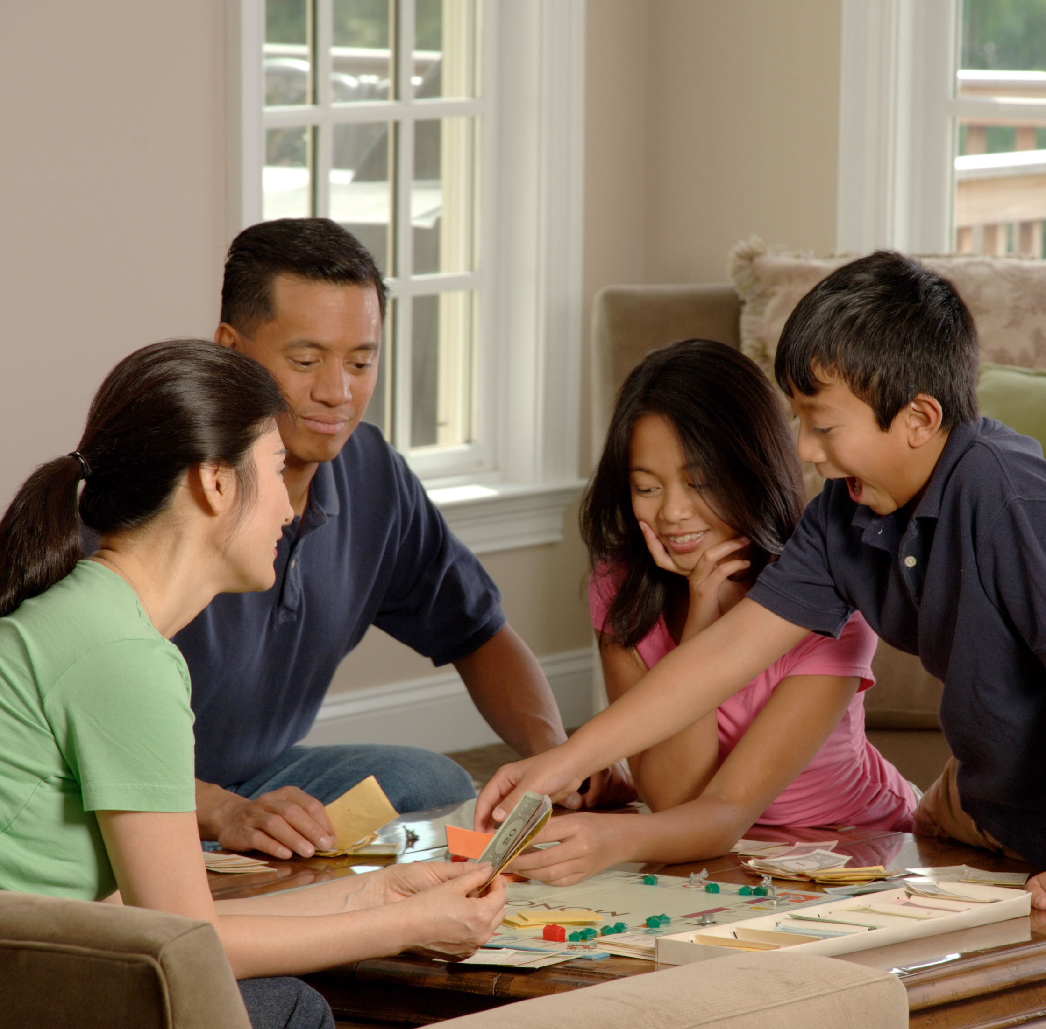
Hobbies
They are playing board games.
Their hobby is playing board games.

Slide 7
Hobbies
She is reading.
Her hobby is reading.

Slide 8
NOT Hobbies
Sleeping
Studying
Eating

Slide 9
Practice
What is your hobby?
My hobby is _________.

Slide 10
What is your hobby?
My hobby is ____________.
caring for my pets
hiking
gaming
reading
watching movies
making art
writing
playing sports
cooking
listening to music
gardening
shopping

Slide 11
Monday
Tuesday
Wednesday
Thursday
Friday
Saturday
Sunday
Notes:
What is today? What day is yesterday?
What day is tomorrow?

Slide 12
Saturday
Sunday
The Weekend
“What did you do last weekend?”
“I like to ______.”
“Last weekend I _________.”
Fill in the blank with your hobby!

Slide 13
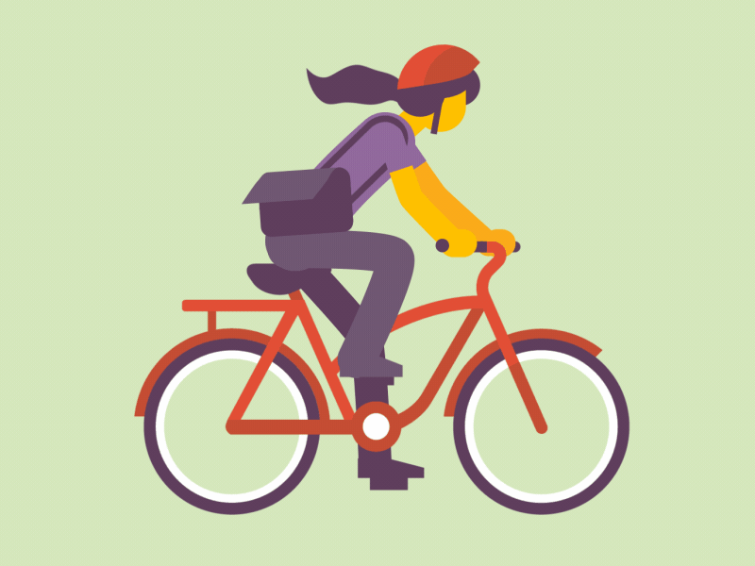
See you tomorrow!

