Slide 1
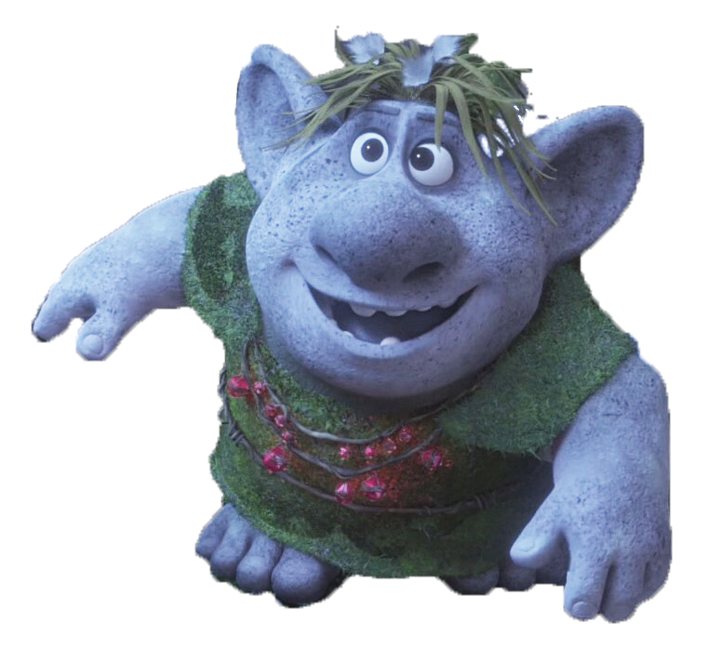
GRASS
TROLLS

Slide 2
MATERIALS

Slide 3
Flowers
Twist Tie
Sock
Rubber
Band
Moss
Suit
Eyes
Jewels
Seeds
Cup
Dress
Notes:
Click on the image to reveal the English word.

Slide 4
How to
Make it

Slide 5
Step 2
Soak moss in
water for 30 minutes

Slide 6
Step 3
Put the seeds in the sock

Slide 7
Step 4
Put the moss
in the sock

Slide 8
Step 5
Tie the sock

Slide 9
Step 6
Twist to
make a nose

Slide 10
Step 7
Add eyes

Slide 11
Step 7
Add a mouth

Slide 12
Step 7
Add cheeks

Slide 13
Step 8
Add clothes

Slide 14
Step 1
Color the clothes

Slide 15
Step 8
Add details

Slide 17
Plant
Care

Slide 18
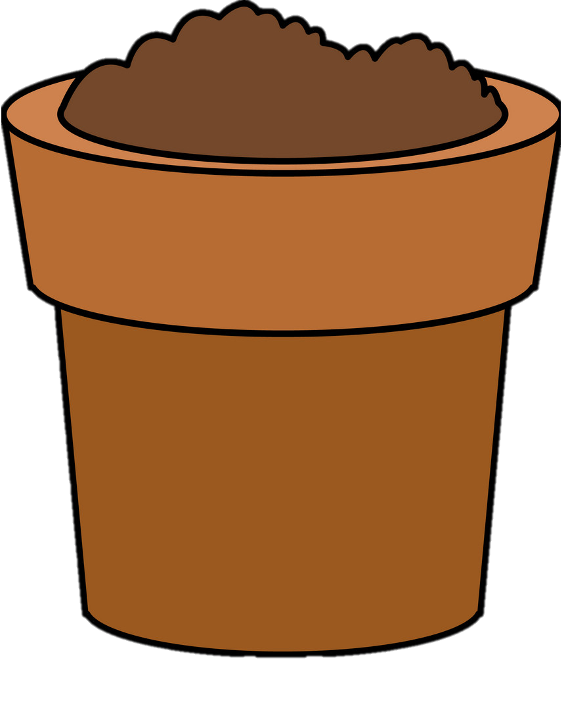
What does grass need to grow?
SOIL
WATER
SUN

Slide 19
SOIL
Moss

Slide 20
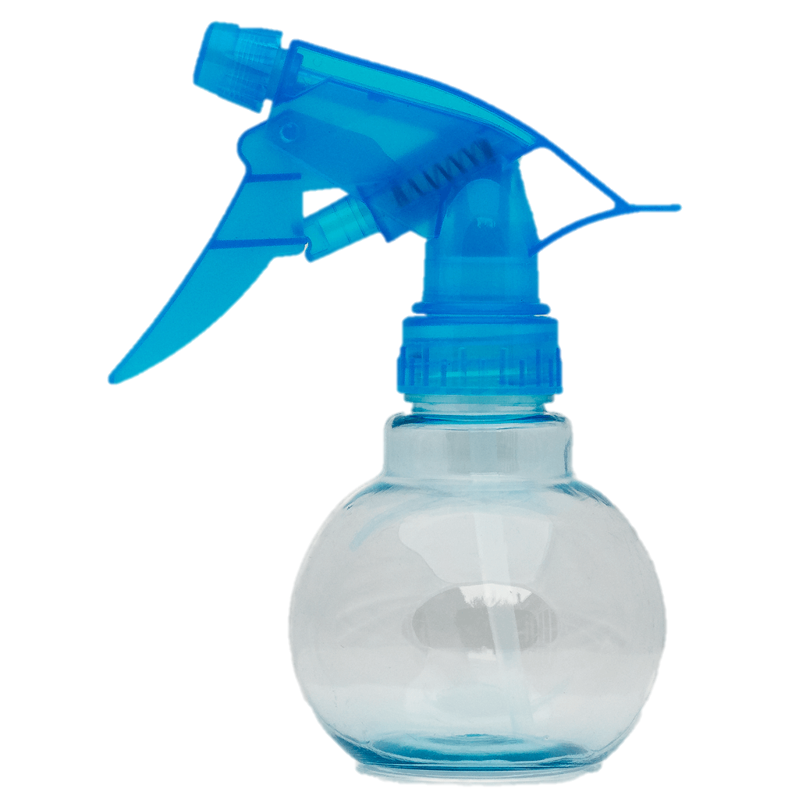
WATER
Every 5 days

Slide 21
SUN
Near a window

Slide 22
Who is it?

Slide 23
Step 9
What is its name?

Slide 24
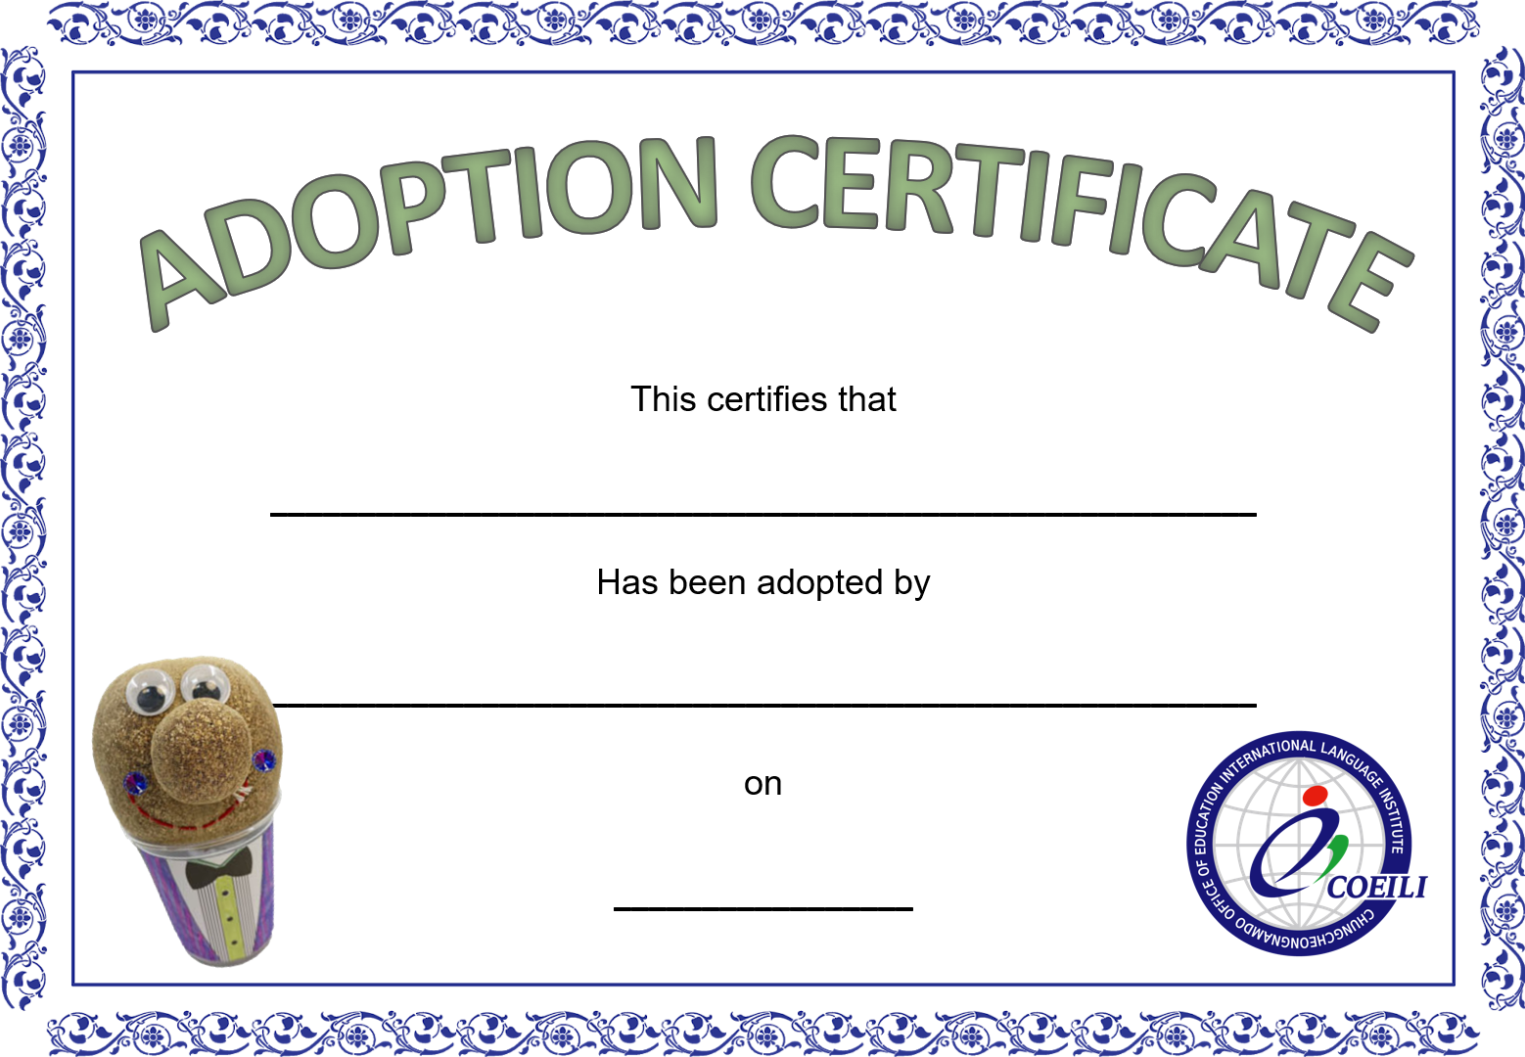

Slide 25
Step 9
Where is it from?

Slide 26
Step 9
Is it a boy or girl?

Slide 27
Step 9
What are
its hobbies?

Slide 28
Step 9
How old is it?

Slide 29
Step 9
Tell me about
its family.

Slide 30
Step 9
What does it like?

Slide 31
Step 9
What does it hate?

Slide 32
Step 9
How is it the
same / different
from you?

Slide 33
Step 9
Will our characters
be friends?

Slide 34
HAIRCUT
CONTEST

Slide 35
Upload a photo of your
finished grass troll
to the website

