Slide 1
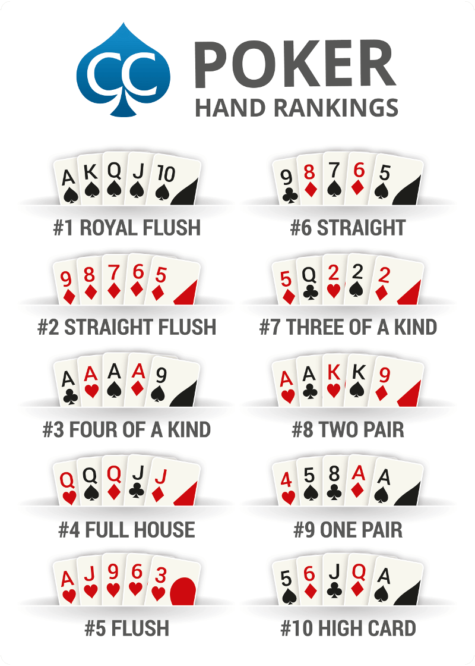
11 – Poker Hands

Slide 2
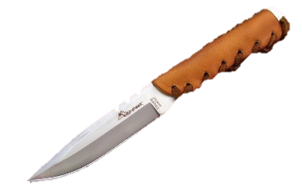
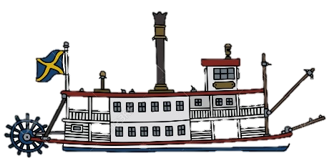
Poker face
I’ll call
I’m all in
All the chips are down
I see you and I raise you
I’ll call your bluff
Pass the buck
The buck stops here
Square deal
Fair deal
New deal
Raw deal
Big deal
No big deal
Ante up
Up the ante
Put up or shut up
You bet!
She’s throwing in her hand
The cards are stacked against me
An ace up your sleeve
Card sharp (later, Card Shark)
Wild card
No emotion
I will match your bet
I bet all of my chips
I’m all in
I am going to bet more than you
I think you're lying, so I will match your bet.
A new player is the dealer
It’s my turn to be the dealer
The deal was fair for everyone
The deal was fair for everyone
A new hand
The dealing was not fair to me
Ironic expression meaning “very important”
Ironic expression meaning “unimportant”
Pay the money (bet)
Raise the minimum bet
Pay the money or leave
You are correct
She is folding
The deck has been arranged to make me lose (through cheating)
Cheating
A professional poker player
A card that can have multiple values
A buckskin knife was used to show who was the dealer

