Slide 1
L | E | P | R | E | C | H | A | N
 |  |  |  |  |  | U | N | I | C | O | R | N
 |  |  |  |  |  |  | E | L | V | E | S
 |  |  |  | A | U | N | T
C | O | U | S | I | N
 |  |  |  |  | M | E | L | M | A | N
G | L | O | R | I | A
 |  | P | E | N | G | U | I | N | S
 |  |  |  |  | A | L | E | X
 |  | F
 |  | R
 |  | O | L | A | F
 |  | Z
 |  | E
A | N | N | A
P | A | R | R | O | T
 |  | S | E | A | G | U | L | L
 |  | G | R | A | P | E
K | I | W | I
 |  | P | O | L | I | C | E
N | U | R | S | E
B | A | S | K | E | T | B | A | L | L
 |  | S | O | C | C | E | R

Slide 2
Lesson 5 – Outline and Summarize

Slide 4
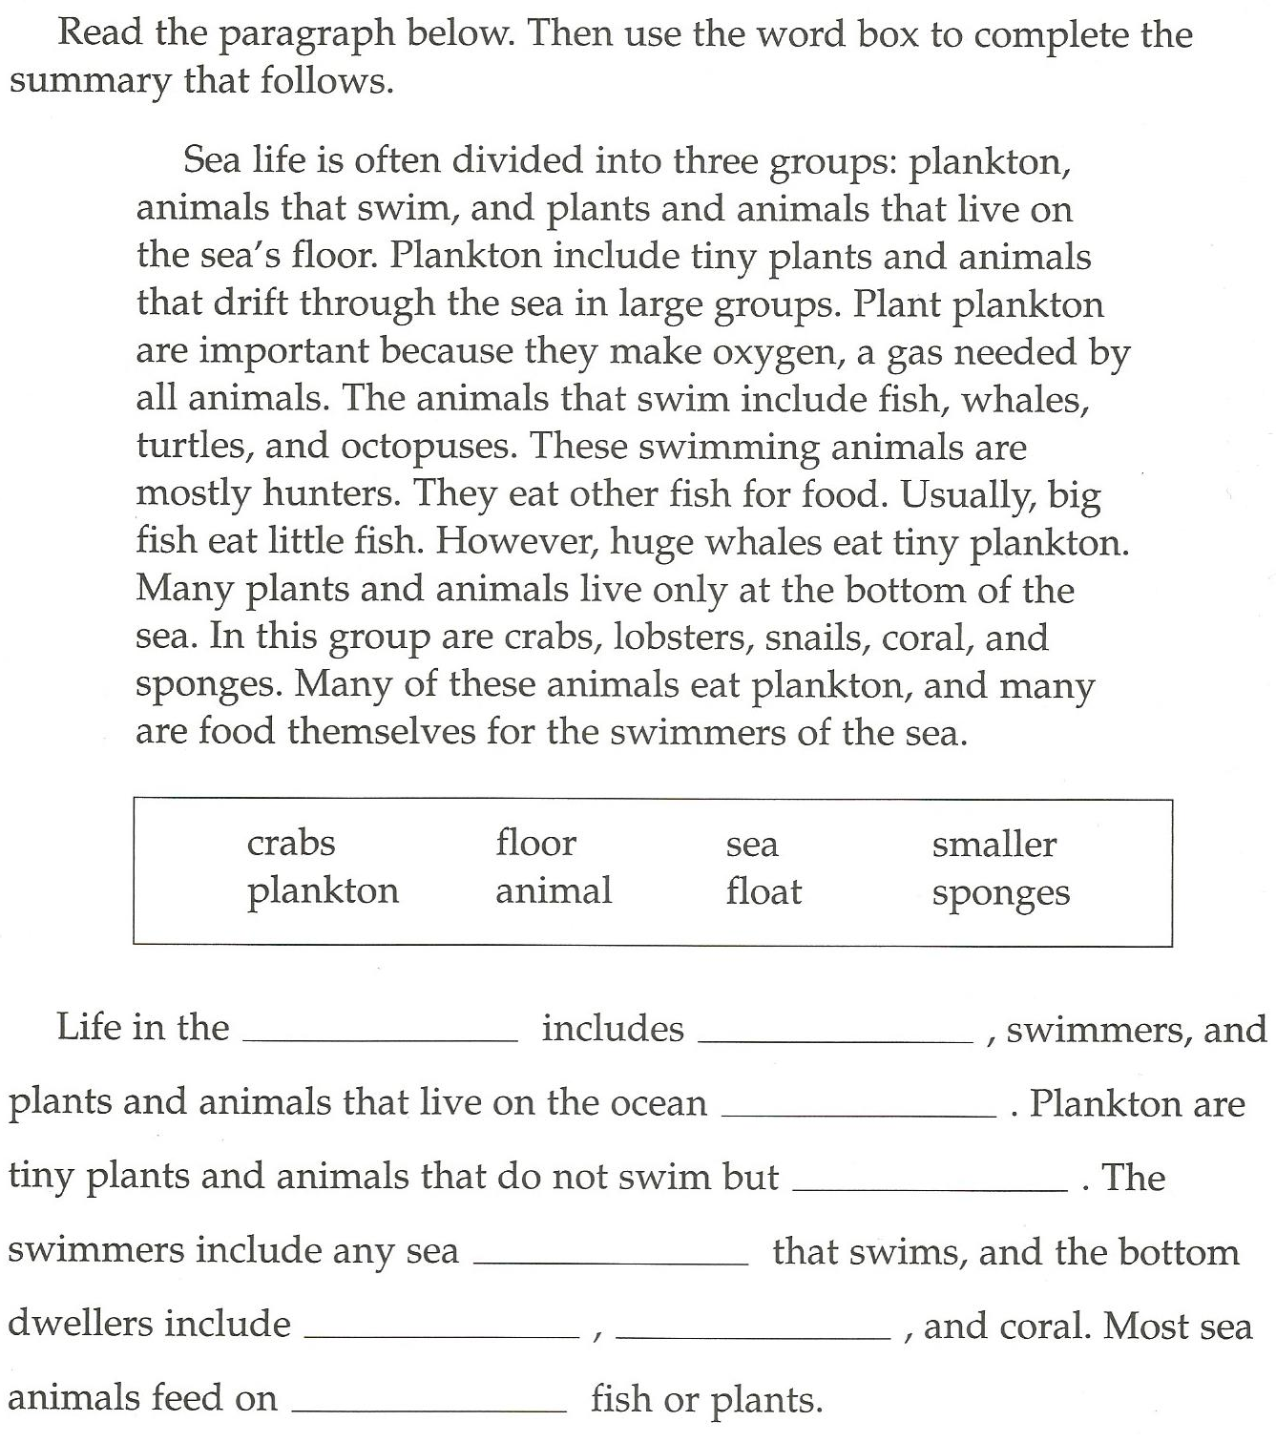

Slide 5
Summarize the Story:
The Man and the Hamburger

Slide 6
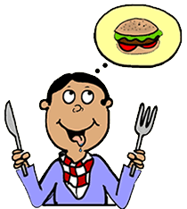
The Man and the Hamburger
Once upon a time, there was a very hungry man. He really wanted to eat a hamburger. But not any hamburger. A special hamburger from New York. He remembered eating when he was young.

Slide 7
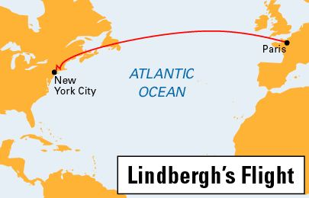
The Man and the Hamburger
Now he lived in France, so he needed to take an airplane. The plane ticket was very expensive.

Slide 8
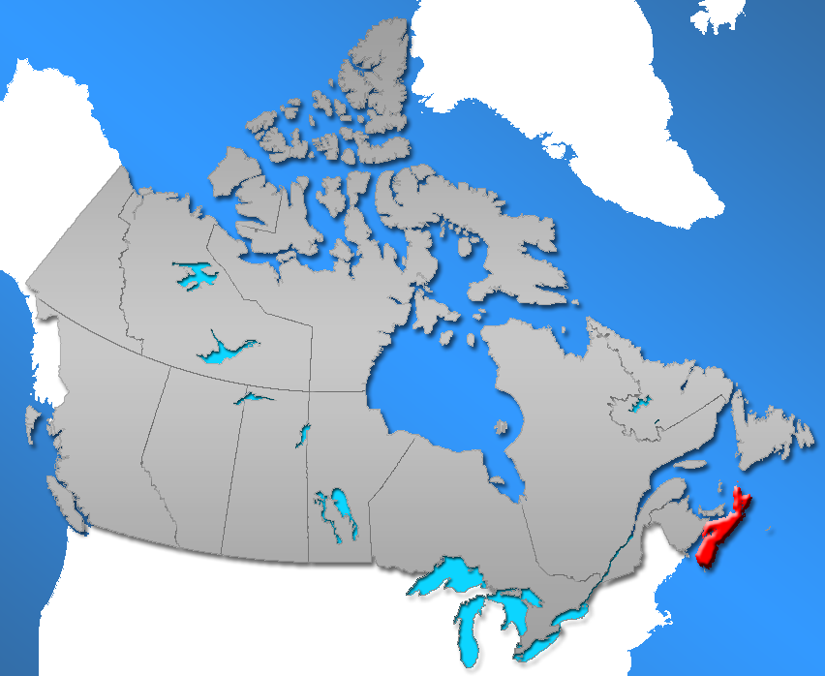
The Man and the Hamburger
The airplane crashed in Nova Scotia. The man was not hurt but really hungry.

Slide 9
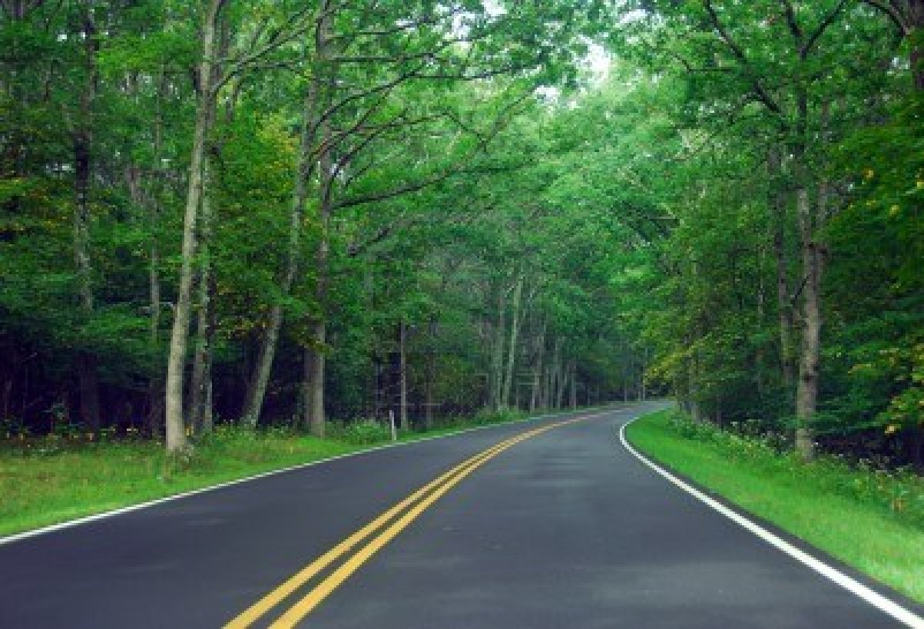
The Man and the Hamburger
He started running through the forest until he found a road.

Slide 10
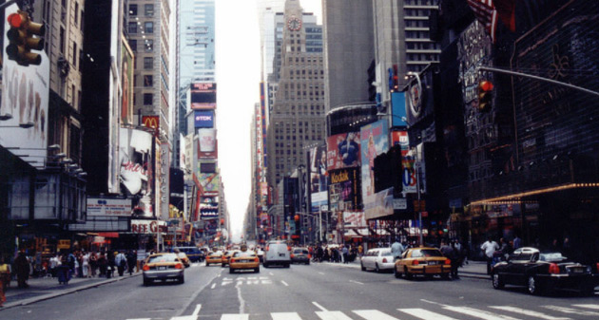
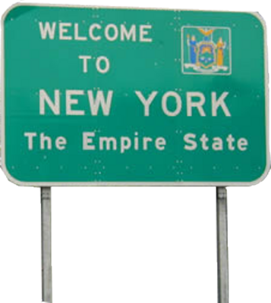
The Man and the Hamburger
A nice man in a car drove him to New York.

Slide 11
The Man and the Hamburger
When he got to New York, the man realized that he had no money. He cleaned dishes to make some money.

Slide 12
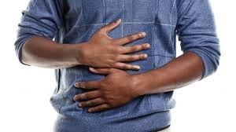
The Man and the Hamburger
Now he was really hungry.

Slide 13
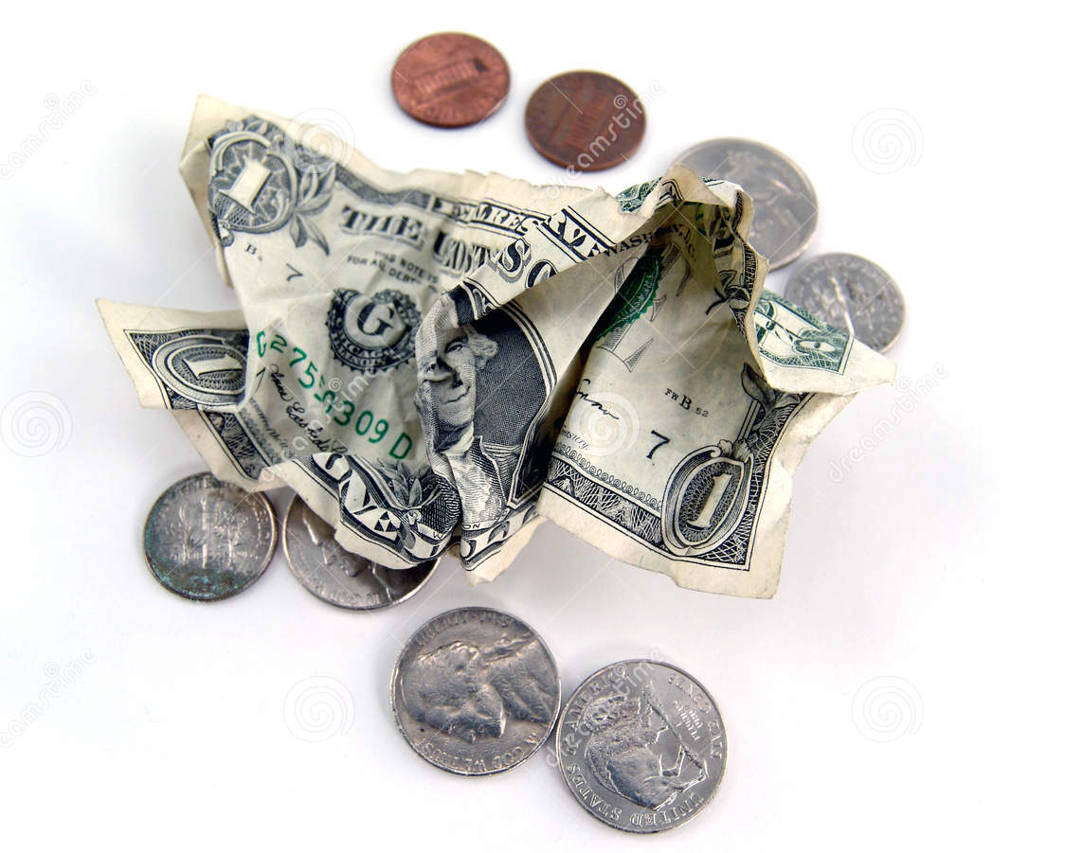
The Man and the Hamburger
The man finally got enough money to buy the hamburger.

Slide 14
The Man and the Hamburger
The man was so hungry and excited that he ran all the way to the restaurant.

Slide 15
The Man and the Hamburger
The man was sweating and breathing heavy and ordered a special hamburger.
“Sorry, but we don’t sell the special hamburger anymore,” said the waiter.

Slide 16
The Man and the Hamburger
“Oh,” said the man…

Slide 17
The Man and the Hamburger
“Then, I will have a pizza.”

Slide 18
Can you summarize in 1 sentence?

Slide 19
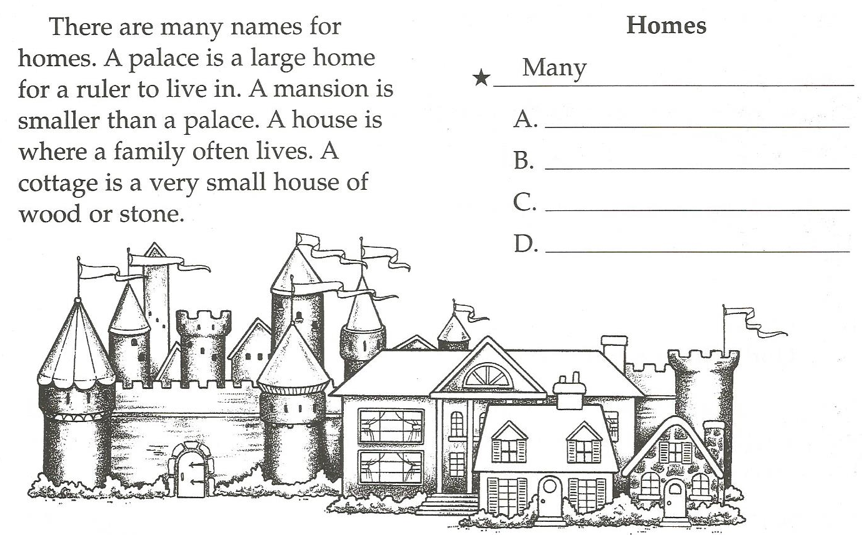
Many names for homes
Palace
Mansion
House
Cottage

Slide 20
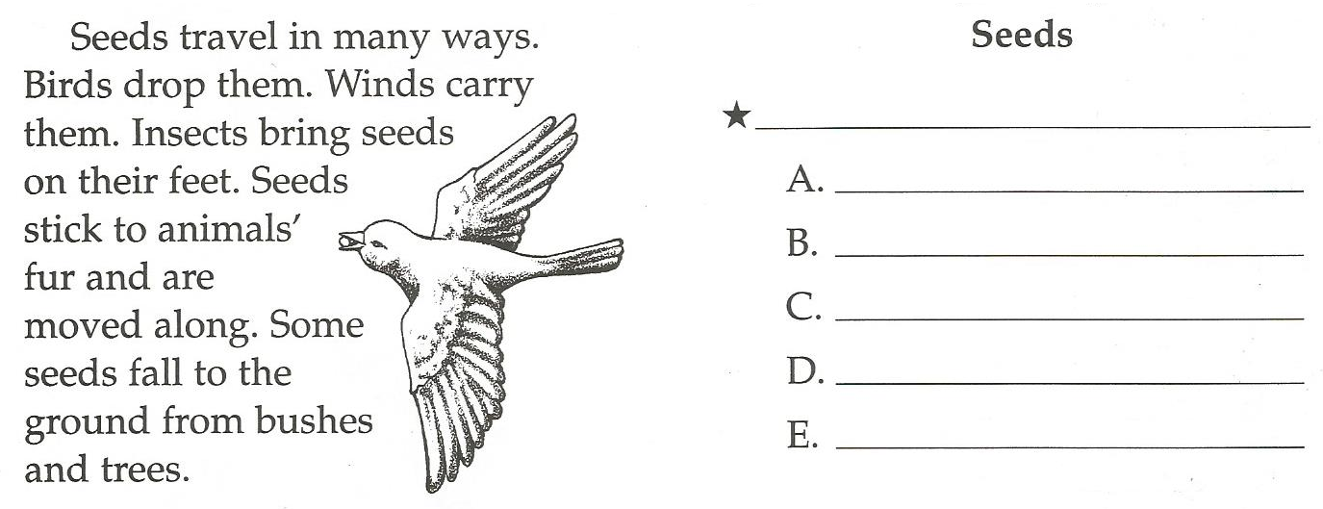
Travel in many ways
Birds
Winds
Insects
Animal fur
Fall from trees / bushes

Slide 21
Planting Seeds:

Slide 22
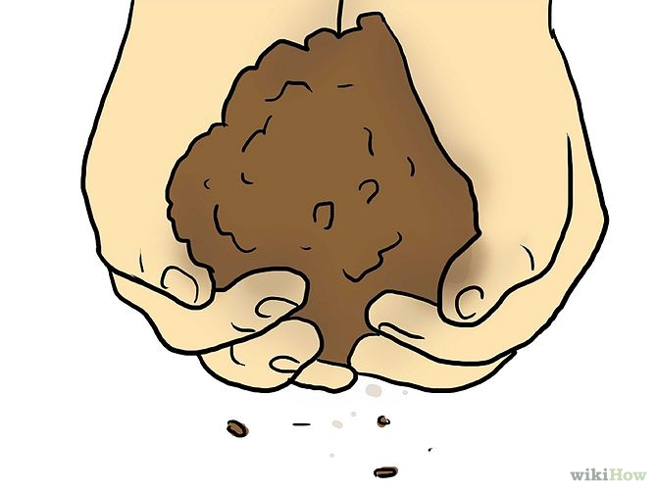

Slide 23
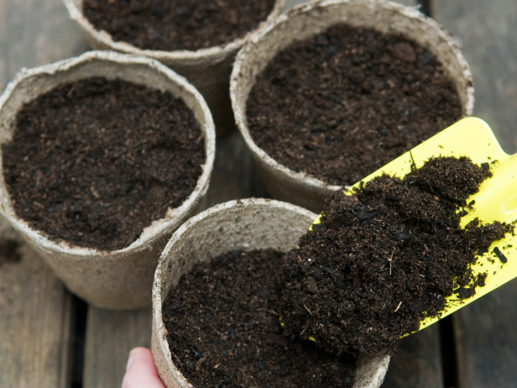

Slide 24
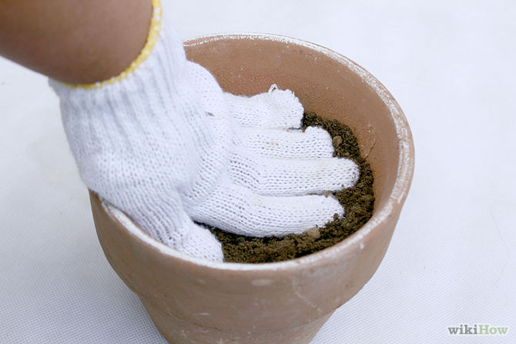

Slide 25
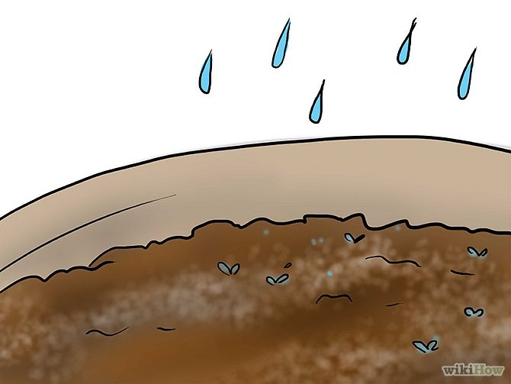

Slide 26
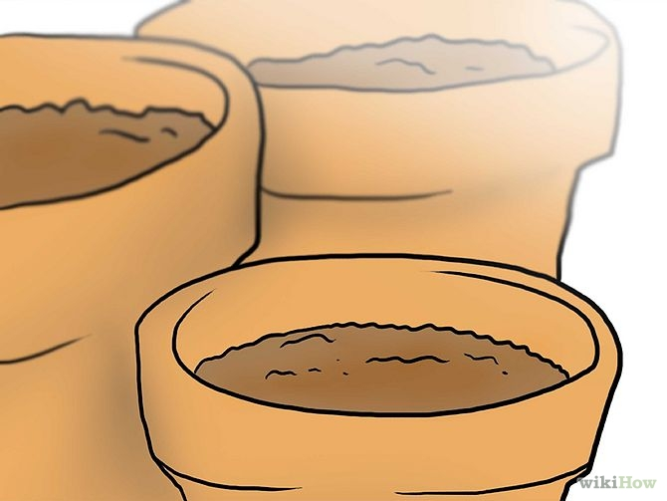

Slide 27
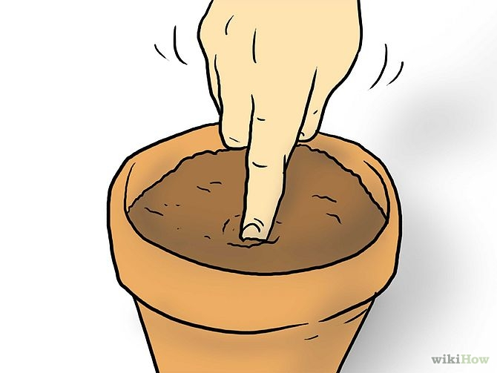

Slide 28
