Slide 1
What is she doing?
Charades

Slide 2
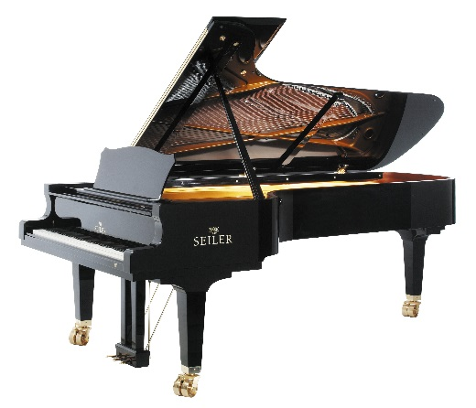
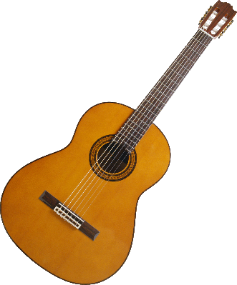
Writing
Reading a book
Making a Robot
Playing Piano
Running
Riding a Bike
Listening to Music
Playing Guitar

Slide 3
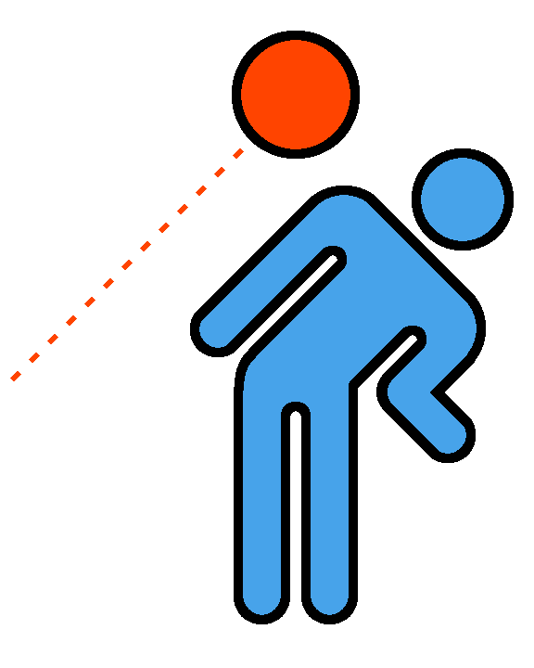
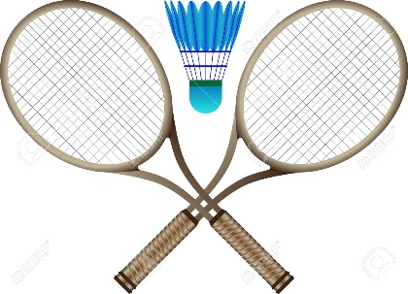
Playing Baseball
Playing Basketball
Playing Soccer
Singing
Playing Badminton
Playing Dodgeball
Playing Tennis
Walking

Slide 4
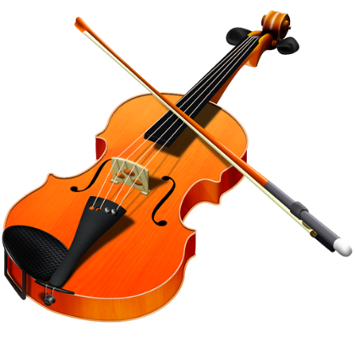
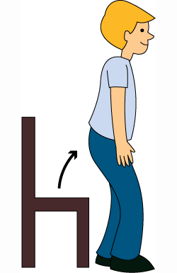
Playing Violin
Swimming
Jumping
Smiling
Sitting
Flying
Standing Up
Doing Homework

Slide 5
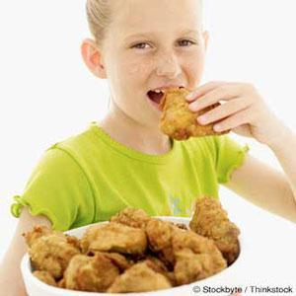
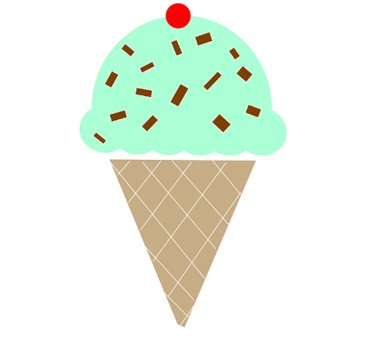
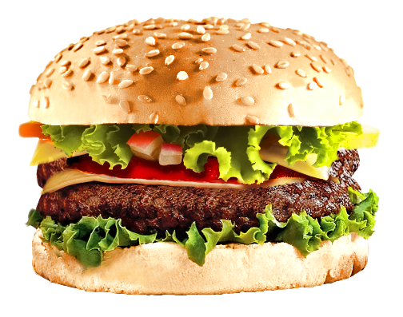
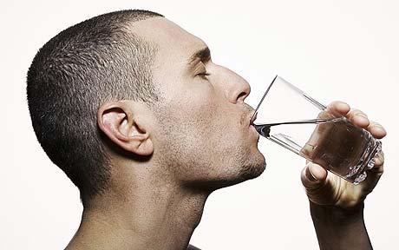
Eating Pizza
Eating Ice Cream
Eating Chicken
Dancing
Eating Hamburger
Eating Soup
Drinking
Talking

Slide 6
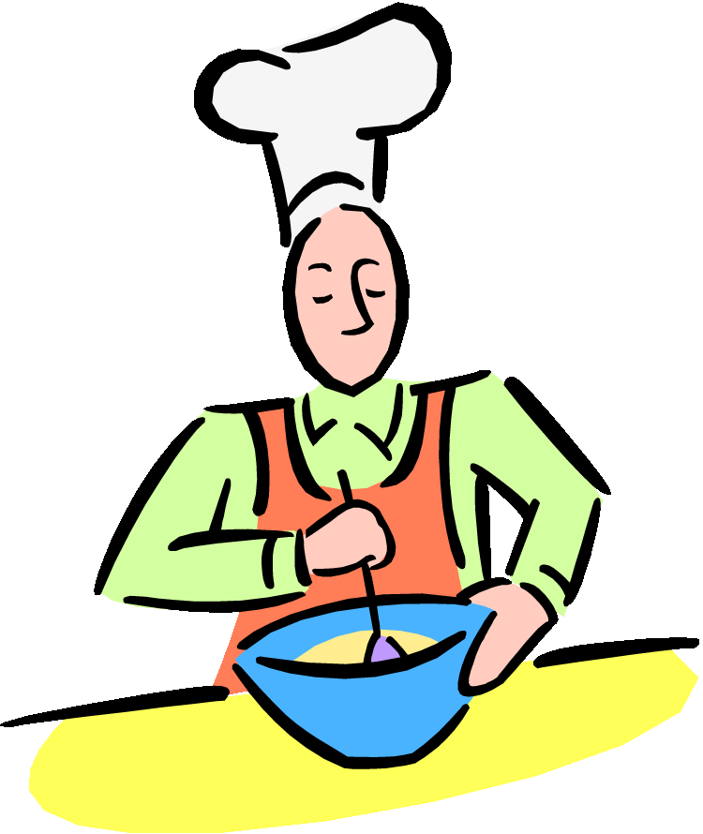
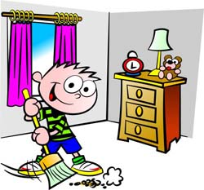
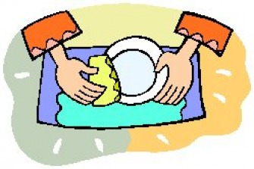
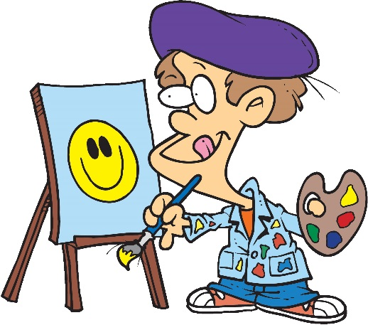
Cooking
Crying
Cleaning
Sleeping
Washing Dishes
Cleaning Bedroom
Washing the Windows
Painting

Slide 7
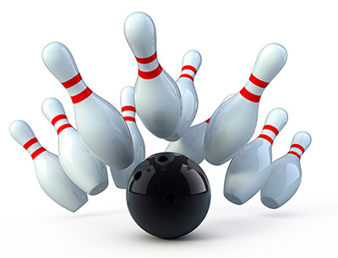
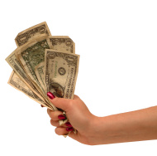
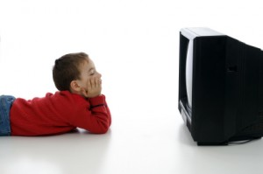
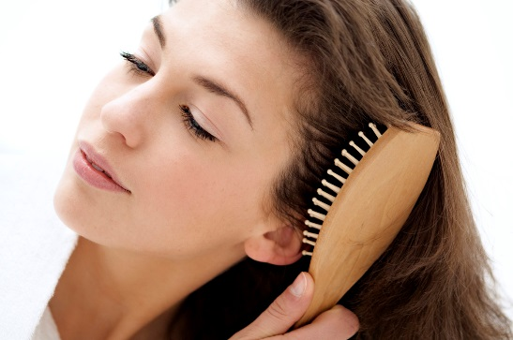
Driving a Car
Watching a Movie
Bowling
Brushing Teeth
Watching TV
Washing Hands
Brushing Hair
Buying

Slide 8
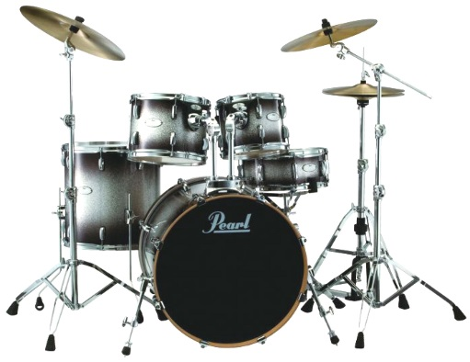
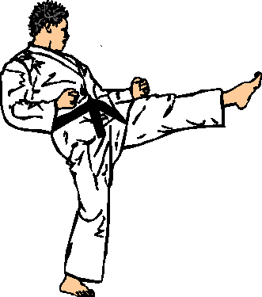
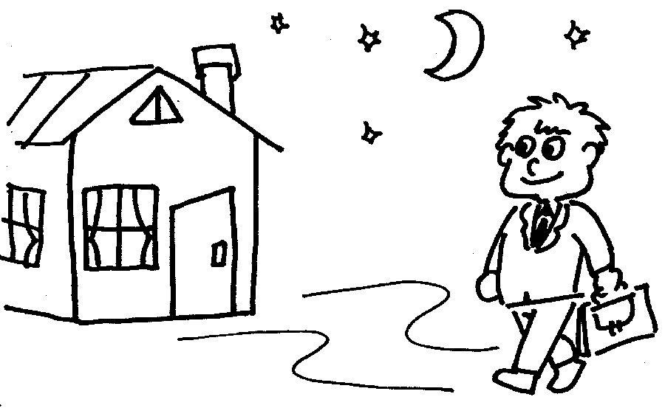
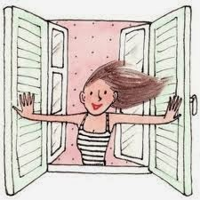
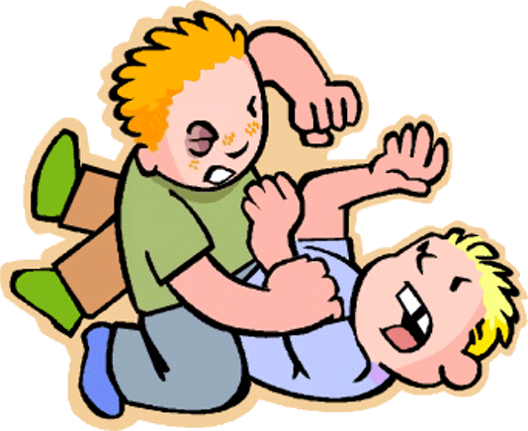
Hugging
Playing the Drums
Kicking
Going Home
Laughing
Fighting
Taking Pictures
Opening the Window

