Slide 1
Review Darts

Slide 2
Rules
Choose a dart board.
Answer questions provided by the teacher.
If you are correct, choose a dart.
Keep score.

Slide 3
Choose Dart Board
1
2
3
4
5
6
7
8

Slide 4
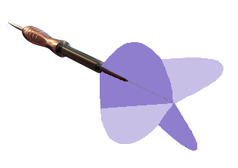
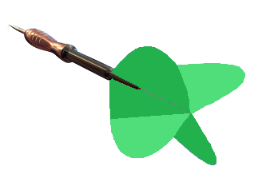
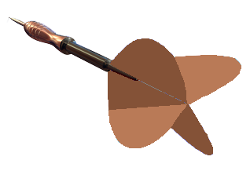
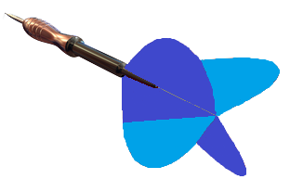
7
5
3
1
New Dart Board

Slide 5
7
5
3
1
New Dart Board

Slide 6
7
5
3
1
New Dart Board

Slide 7
7
5
3
1
New Dart Board

Slide 8
7
5
3
1
New Dart Board

Slide 9
7
5
3
1
New Dart Board

Slide 10
7
5
3
1
New Dart Board

Slide 11
7
5
3
1
New Dart Board

